Slide 1
Eight to Graduate
SENIOR YEAR
EXPERIENCE
2020
Fall Senior Information Meeting
Notes:
Maria Kohnke

Slide 2
Your magic number is eight:
Eight (8!) months until May 16, 2020
Eight Key Tasks
Eight Important Dates to Remember
Notes:
Maria Kohnke

Slide 3
You’re a senior . . .
What possibly can go wrong?
Image courtesy of Stuart Miles at FreeDigitalPhotos.net
Notes:
???

Slide 4
Seniors don’t fail courses, right?
Image courtesy of Boaz Yiftach at FreeDigitalPhotos.net
Notes:
???

Slide 5
Gee, I think I’ll drop my upper division Philosophy class–
Cartoon History 101 sounds easier.
Image courtesy of Bplanet FreeDigitalPhotos.net
Notes:
???

Slide 6
123 credits, 124 credits:
Who’s counting?
Image courtesy of Stuart Miles at FreeDigitalPhotos.net
Notes:
???

Slide 7
If you pretend math
doesn’t exist, the
requirement will go
away.
Image courtesy of farconville at FreeDigitalPhotos.net
Notes:
???

Slide 8
What do you mean
I had to apply to graduate—
I’ve been here four
years.
Everyone knows I’m
graduating.
Image courtesy of debspoons at FreeDigitalPhotos.net
Notes:
???

Slide 9
Endings and Beginnings
Notes:
Melissa Maxwell-Doherty

Slide 10
Purpose asks why and how questions
Purpose involves a job or career, and yet is much bigger than that.
Purpose is also about
making meaning in relationships,
gifts and abilities,
and serving others.

Slide 11
Vocation/Purpose
Cal Lutheran equips graduates like you who are:
Called an empowered
to serve the neighbor
so that all may flourish
Notes:
Melissa Maxwell-Doherty

Slide 12
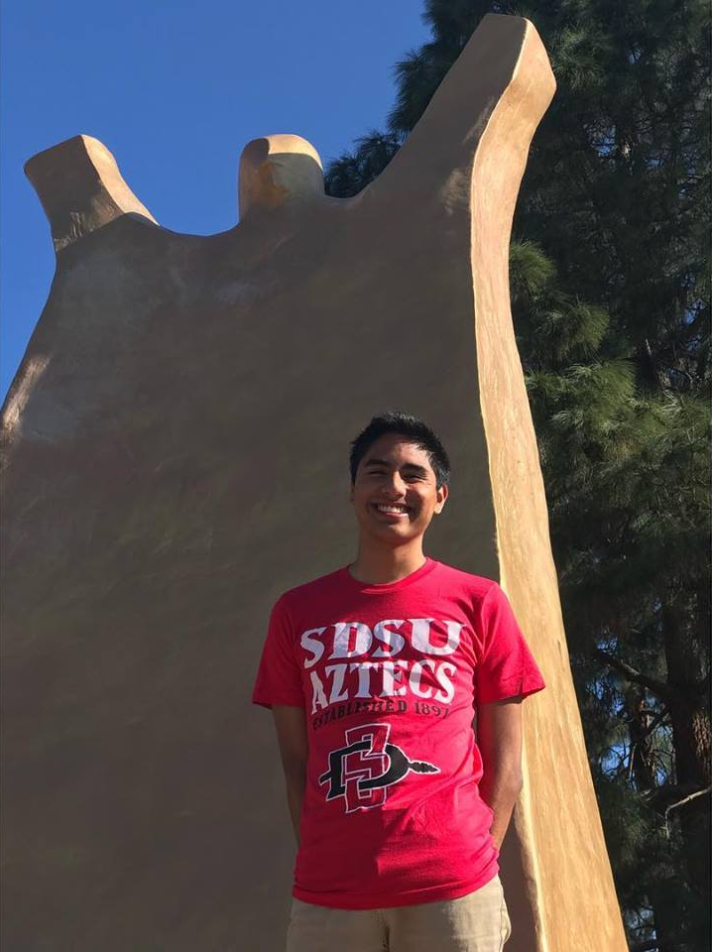
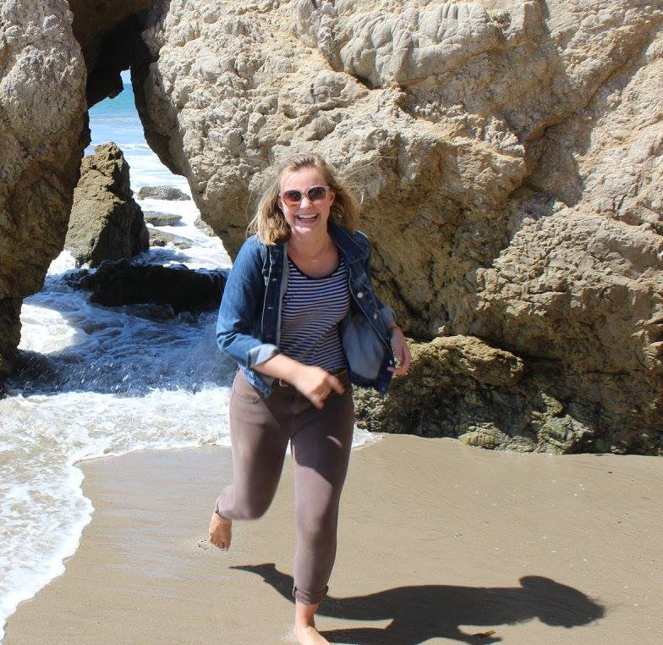
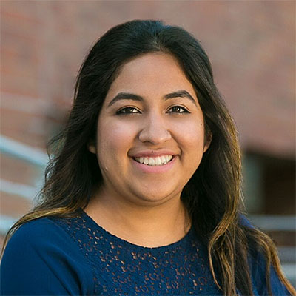
Andres Elvira ‘18
Anna Berg ‘17
Daniel Lacey ‘17
Dalia Flores ’16, MPPA ’17

Slide 13
END STRONG!
Make the connections:
Team Projects are challenging—but part of life! Get ready to tell interviewers how you managed team projects.
Writing and speaking opportunities are priceless preparation for that “good job” down the road.
Use electives to improve the “toolkit” of knowledge and skills that will serve you well later.
Decent grades are good. Explaining what you learned and what you can do with it is better.
Notes:
Melissa Maxwell-Doherty

Slide 14
Welcome academic challenges: Get in the habit of over-delivering now, BEFORE you get into the job market.
Continue to get to know your professors—they may write references later.
Enjoy the year—but remember that your academic performance is as important in May as in September.
Notes:
Melissa Maxwell-Doherty

Slide 15
Begin smart. Purpose takes Planning.
Think about your post-graduation options
Working for a for-profit company
Working for a non-profit organization
Starting your own business
Volunteering for a non-profit – in the U.S., or outside
Or some combination!
Notes:
Paul Witman

Slide 16
Begin smart.
Prepare for interviews:
Own your education. Interviewers will want to know what you learned, what you can do, what you learned from success and failure, what you did out of class as well as in.
Visit career services: Prepare a resume; find out about resources available to you. Reflect on your interests and skills.
Notes:
Paul Witman

Slide 17
Plan for graduate or professional schools.
Research the schools to which you want to apply.
Register for the GREs, MCATs, LSATs, etc.
Line up your letters of recommendation early. A last-minute letter will sound like a last-minute letter.
Good grades are important—but your statement of purpose is what will distinguish you.
Notes:
Paul Witman

Slide 18
Anticipate Plan B, or C, or D: as often as not, it turns out the be the A-Plan after all.
Don’t look (too much) past the present: what happens in Spring semester is as important as what has happened until then.
Enjoy your year—but don’t lose momentum!
Notes:
Paul Witman

Slide 19
Senior Registration
Students who apply by Oct 1st deadline will be able to register for the Spring 2020 (and Summer 2020 if necessary) Semester during Senior Audit meeting with Student Success Counselor
Graduation fee is $100 through Oct 1st. Fee is $125 after that date
Degree Completion Agreement generated
Make appointment with Student Success Counselor
Will document all remaining requirements and any outstanding paperwork/action needed
Have your advising meeting with your Faculty Advisor, review agreement and Spring (and Summer if needed) classes
Make adjustments and complete any needed paperwork
Return by November 29th at 5:00pm to remain registered.
Notes:
Maria Kohnke

Slide 20
Commencement Eligibility and Tickets
Students who return and follow signed Degree Completion Agreement(DCA) are all eligible to attend Commencement.
January 27th - Those who submitted their completed DCA by November 29th can claim their tickets a week early
February 3rd – General Tickets available for eligible seniors to claim online
Notes:
Maria Kohnke

Slide 21
Eight key tasks
Apply to graduate and pay the fee
Attend Senior Audit and register for Spring
Meet with Faculty Advisor
Return completed DCA form by Nov 29th at 5:00pm
Pass your classes; check before making changes to your schedule.
Plan beyond graduation – the day after the diploma
Your senior year should be fun, but do not check out early
Claim your commencement tickets
Notes:
???

Slide 22
Eight Key Deadlines
APPLY TO GRADUATE AND PAY THE FEE (SEE #6!)
September – Senior audit with Student Success Counselor, preliminary Spring Registration. Advising meeting with faculty advisor
October 1 – Priority Deadline for May Graduation
November 29 – Submit signed Degree Completion Agreement and any paperwork due to avoid being dropped from Spring 2020 classes
February 3 – General Commencement and Baccalaureate Ticket registration opens
March 15 – last day to apply to participate in commencement ceremony and be included in the program if eligible.
March 27 – Last day to claim tickets; Last day to submit any Commencement related forms (Including any changes to name in program)
April 15 – Ticket Appeal Deadline
Notes:
Paul Witman

