Slide 1
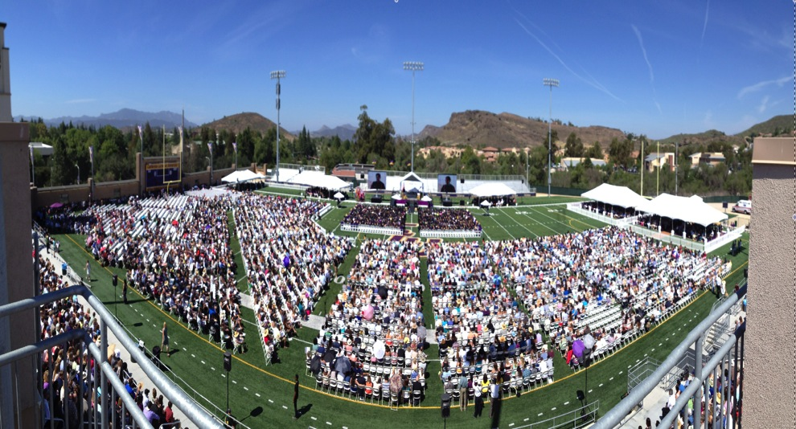
Senior Commencement Meeting 2016

Slide 2
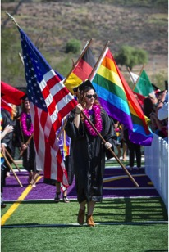
CONGRATULATIONS GRADUATES
CAP AND GOWN
BACCALAUREATE
TICKETS
COMMENCEMENT
PARKING
HONORS
PROUNCIATION
REVIEW OF THE COMMENCEMENT PROGRAM

Slide 3
BEFORE YOU LEAVE
PICK up and complete a Separation form and return to the Registrar’s Office.
This is mandatory!
Complete the graduating student exit survey at http://skylight.wsu.edu/s/

Slide 4
Did you pick up your tickets?
http://www.callutheran.edu/commencement
No one is admitted inside the stadium without a ticket.
Any guests who will require accommodations at the ceremony please contact Disability Support Services by April 30th dss@callutheran.edu

Slide 5
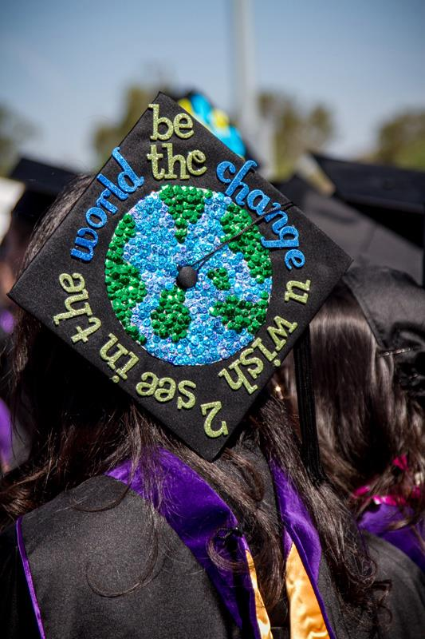
Cap and Gown
Take your Cap and Gown our the bag and
hang up your gown.
Check and make sure everything is in the bag.
If you have not ordered your Cap & Gown do this
ASAP.

Slide 6
HOW TO WEAR YOUR HOOD!

Slide 7
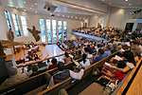
BACCALAUREATE
May 13th 8:00 PM in the Samuelson Chapel
Worship service for all graduates and their families
Graduates are asked to wear their cap and gown.
Meet at the Enormous Luther Statue at 7:45pm
Procession starts at 7:55pm

Slide 8
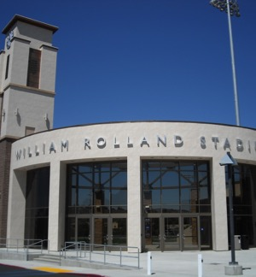
THE BIG DAY!
GATES OPEN AT 8:OO AM-ALL
Guests must have tickets and enter
through the gate printed on ticket.
Guests start lining up much earlier
than 8:00am.
Prepare for all weather conditions.

Slide 9
PARKING
PARKING LOTS OPEN AT 7:00 AM
There will be parking on Olsen Road on the side closet to Gilbert Arena.
There are spaces for handicapped parking.
There are shuttles available but if your party arrives late it may be better walk to save time and to get better seats.

Slide 11
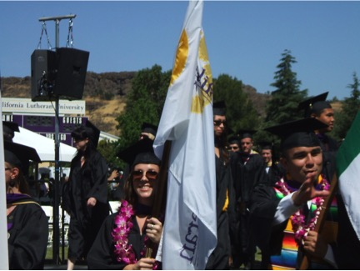
LINE UP
LINE UP-Soiland Practice Gym in the Gilbert Sports & Fitness Center at 9:00am
Enter Gilbert Sports & Fitness Center through the back doors.
Check in at the tables & pick up name card prior to entering line up area & keep card with you at all times.
Be in full academic attire
Remain in two lines as your process
There are 24 students per row.
NO family or guests in line up area.

Slide 14
BEHAVIOR STANDARDS
We reserve the right to remove anyone from the Commencement ceremony. Please respect your fellow graduates.
Inappropriate behavior will not be tolerated.
Reminder: Cal Lutheran is a dry campus.
Please No Cell Phone Calls- during the ceremony.

Slide 15
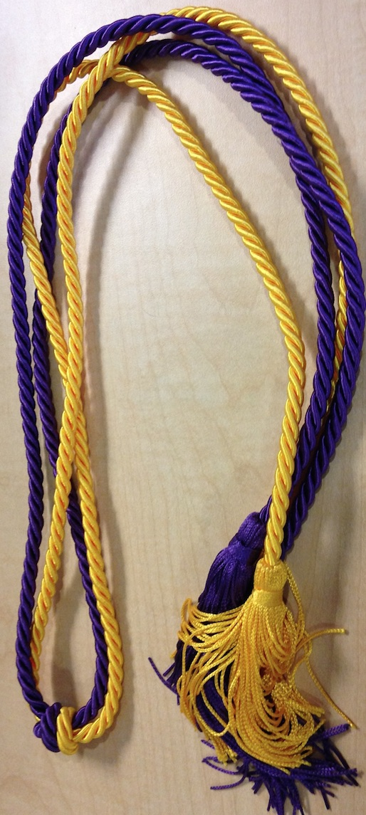
HONORS
SUMMA CUM LAUDE - Minimum GPA of 3.90
MAGNA CUM LAUDE – Minimum GPA of 3.70
CUM LAUDE – Minimum GPA of 3.50
Must be both CLU and cumulative GPAs.
Must have completed at least 30 graded credits at CLU.
Based on grades through Fall 2015.
Distinguished by Honor cords give out to the student only
with proper ID in the Registrar’s Office.

Slide 16
Honors Program
Departmental Honors
University Honors
Highest Honors (both)
Given medallions as opposed to Honor cords.
You must have turned in a signed checklist before these honors can be awarded.

Slide 17
PRONUNCIATION
When you arrive at the line-up area on graduation day you will check in. You will received a card with your name, honors and a line for pronunciation- fill it out if necessary.
You will be able to hand this note card and pronounce your name to the Readers before your name is actually read at the ceremony.

Slide 18
POST-COMMENCEMENT
While the platform party process out of the stadium remain in your seats.
Your family and guests will be allowed to join you on the field.

Slide 19
CONGRATULATIONS!

