Slide 1

PULSE:
Partnership for Undergraduate Life Sciences Education
Facilitating Students Success in the Classroom Through Course Transformation

Slide 2
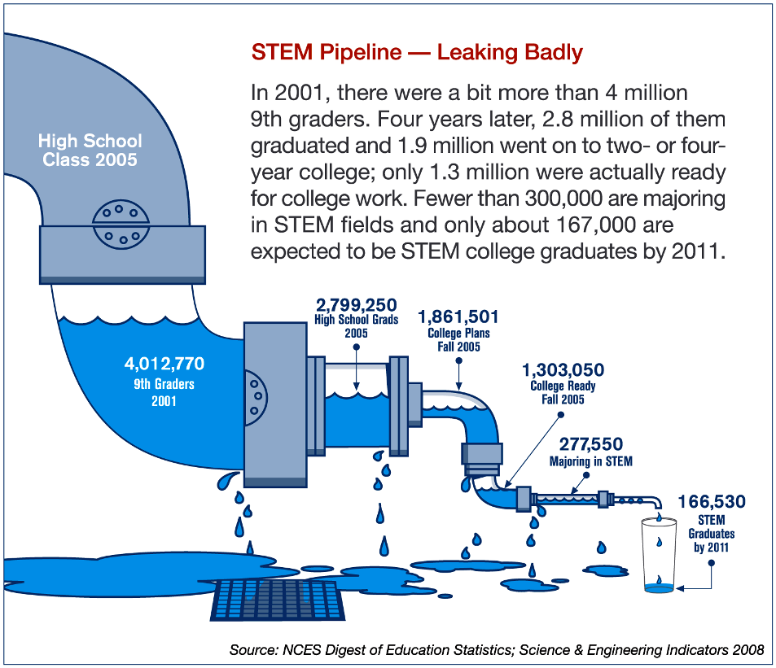
Why Change? What’s the Urgency?
STEM Pipeline --- Leaking Badly
www.pulsecommunity.org
Notes:
In 2001, there were a bit more than 4 million 9th graders. Four years later, 2.8 million of them graduated and 1.9 million went on to two- or four-year college; only 1.3 million were actually ready for collegge work. Fewer than 300,000 were majoring in STEM fields and only about 167,000 are expected to be STEM college graduates by 2011.

Slide 3
Why Change? What’s the Urgency?
Loss of students post-freshman Biology
  80% underrepresented
  60% for all others
US needs 1 million new STEM degrees for the next decade to maintain global leadership (PCAST, 2012)
1 Trillion dollars (est) has been spent on educational reform with little full-scale change
www.pulsecommunity.org
Notes:
80% of students from underrepresented groups do not pursue the major after freshman biology; 60% for all others
The US needs 1 million new STEM degrees over the next decade to maintain global leadership (PCAST, 2012)
Since Sputnik, an estimated 1 Trillion dollars has been spent on educational reform with little full-scale change in faculty or students

Slide 4
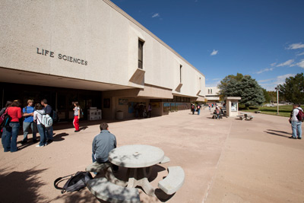
Vision and Change Report (V&C)
Focus on Faculty and Departments
Design Programs Based on Learning Outcomes
Innovative, Student-Centered Pedagogy
Integration of Authentic Research Experiences
Assessment of Student Success
Professional Development at All Institutional Levels
Resources and Tools
www.pulsecommunity.org

Slide 5

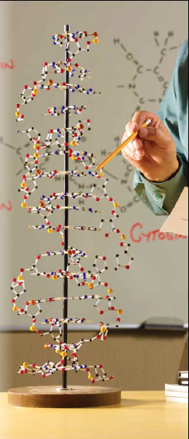



Implementation of V&C
Core Concepts
Competencies
Inquiry-Based Learning
Institutional Support
  Support for faculty development
  Faculty recognition
  Student engagement
  Infrastructure support
National Biology Community Engagement
www.pulsecommunity.org
Notes:
Core concepts and competencies must be integrated throughout the curriculum
Student-centered learning should be maximized in the curriculum
Campus-wide commitment needs to be promoted in order to provide support for faculty development, faculty recognition, student engagement, and infrastructural support
National Biology Community engagement will provide stimulation for vigorous implementation and sustainability

Slide 6
What is Active Learning?
The process of having students:
  Engage
  Reflect
  Think
  Problem solving
Notes:
The process of having students engage in some activity that forces them to reflect upon ideas and how they are using those ideas. Requiring students to regularly assess their own degree of understanding and skill at handling concepts or problems in a particular discipline. The attainment of knowledge by participating or contributing. The process of keeping students mentally, and often physically, active in their learning through activities that involve them in gathering information, thinking, and problem solving (Michael, 2006)

Slide 7
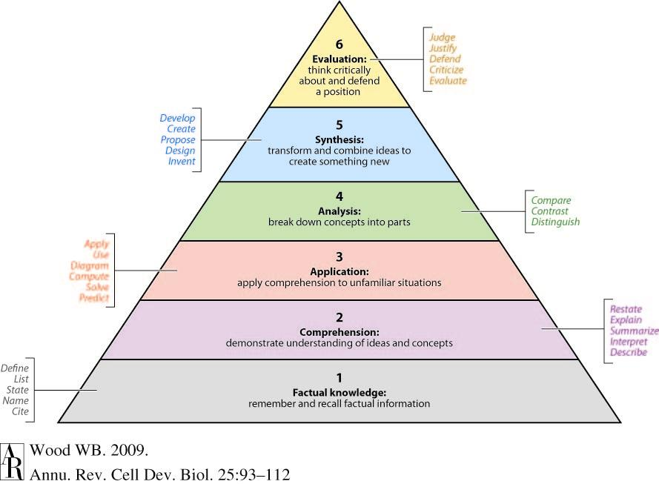
Bloom's Six Levels of Understanding
Notes:
Bloom's Taxonomy was created in 1956 under the leadership of educational psychologist Dr Benjamin Bloom in order to promote higher forms of thinking in education, such as analyzing and evaluating, rather than just remembering facts (rote learning).

Slide 8
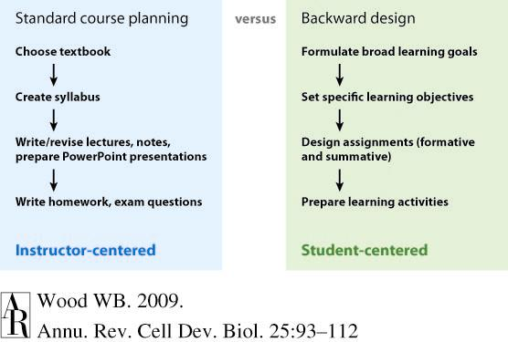
Traditional and Backward Design of STEM Courses
Annual Reviews
Notes:
Formative vs Summative Assessment
The assessment of teaching and learning can be viewed as two complementary and overlapping activities that aim to benefit both the quality of student learning and the professional development of the instructor. Assessing learning alone is not sufficient because the ultimate success of students is also dependent upon their motivation and commitment to learning. Similarly, assessing only teaching behaviors and course activities is not sufficient because qualities of the instructor may be appreciated by students but not optimally helpful to their learning and growth. Done in tandem, assessing teaching and learning can help instructors improve and refine their teaching practices and help improve students’ learning and performance.
Formative Assessment
The goal of formative assessment is to gather feedback that can be used by the instructor and the students to guide improvements in the ongoing teaching and learning context. These are low stakes assessments for students and instructors.
Examples:
Asking students to submit one or two sentences identifying the main point of a lecture
Have students submit an outline for a paper.
Early course evaluations
Summative Assessment
The goal of summative assessment is to measure the level of success or proficiency that has been obtained at the end of an instructional unit, by comparing it against some standard or benchmark.
Examples:
Assigning a grade to a final exam
Critique of a Senior recital
University Faculty Course Evaluations
The outcome of a summative assessment can be used formatively, however, when students or faculty take the results and use them to guide their efforts and activities in subsequent courses.
http://www.cmu.edu/teaching/assessment/howto/basics/formative-summative.html

Slide 9
Examples of Active Learning Methods
Think-Pair-Share
Two Minute Paper
Student-generated test questions
Problem-Based Learning (PBL)
Process-oriented guided-inquiry learning (POGIL)
Flipped Classroom
Notes:
Think-Pair-Share activities pose a question to students that they must consider alone and then discuss with a neighbor before settling on a final answer. This is a great way to motivate students and promote higher-level thinking.
Two minute paper-The instructor simply stops class two or three minutes early and asks students to respond briefly to the following two questions: "What was the most important thing you learned during this class" and "What important question remains unanswered for you?" Students they write their responses on index cards or half-sheets of scrap paper and hand them in.
Student-generated test questions -Allow students to write test questions and model answers for specified topics, in a format consistent with course exams. This will give students the opportunity to evaluate the course topics, reflect on what they understand, and what are good test items.
Problem-based learning (PBL) is a student-centered pedagogy in which students learn about a subject through the experience of problem solving. Students learn both thinking strategies and domain knowledge

Slide 10
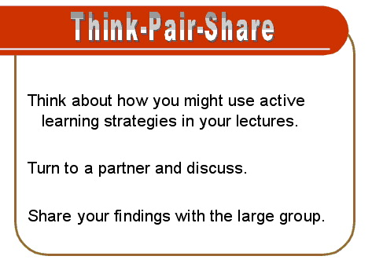
An Example

Slide 11
Process-Oriented Guided-Inquiry Learning (POGIL)
POGIL is a classroom/laboratory technique that seeks to:
  Teach content
  Teach key process skills
    Ability to think analytically
    Work effectively as part of a collaborative team
  Ensure all students are fully engaged in the learning process (Student-centered strategy).
Notes:
POGIL is a classroom and laboratory technique that seeks to simultaneously teach content and key process skills such as the ability to think analytically and work effectively as part of a collaborative team
POGIL is a student-centered strategy; students work in small groups with individual roles to ensure that all students are fully engaged in the learning process.

Slide 12
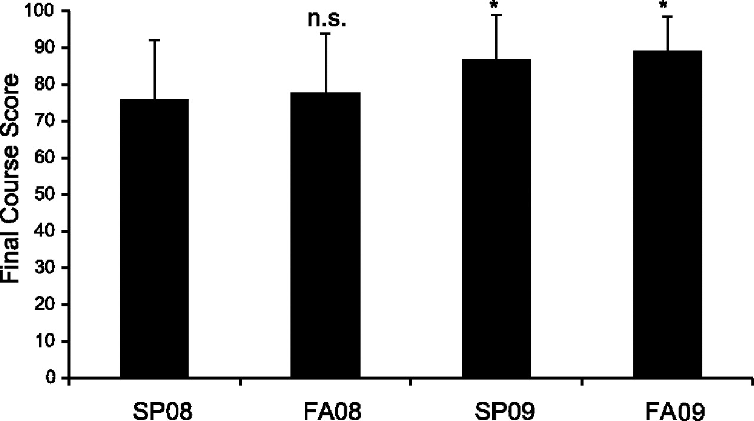

Mean final scores in the Anatomy and Physiology 2 (A&P 2) course from spring 2008 (SP08), fall 2008 (FA08), spring 2009 (SP09), and fall 2009 (FA09).
Brown P J P Advan in Physiol Edu 2010;34:150-155
©2010 by American Physiological Society
Notes:
Mean final scores in the Anatomy and Physiology 2 (A&P 2) course from spring 2008 (SP08), fall 2008 (FA08), spring 2009 (SP09), and fall 2009 (FA09). Values are means ± SD. NS, not significant (P ≥ 0.05). *P < 0.01 as measured using a two-tailed Student's t-test.
The last semester that was taught using lecture was spring 2008 (n 25). POGIL was introduced in fall 2008 (n 18) and continued through spring 2009 (n 31) and fall 2009 (n 17). The statistical significance of mean scores was determined using a two-tailed Student’s t-test in all cases. Results were considered significant if P values were below 0.05. The last semester the course was taught using lecture only (spring 2008); the mean final score was 76.04 16.16. In the first semester of the redesigned course (fall 2008), the mean final grade was not significantly different (77.79 16.11). During the next two semesters, the mean final score rose significantly to 86.89 12.16 in spring 2009 and 89.25 8.72 in fall 2009 (Fig. 1)

Slide 13
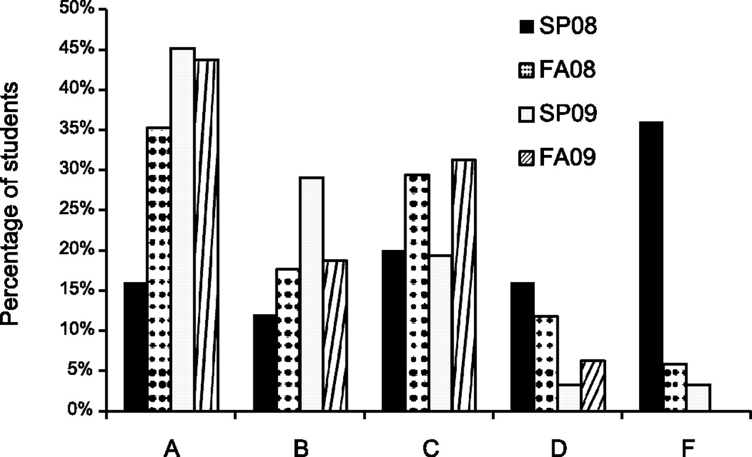
Final exam grade distributions in A&P 2 from SP08, FA08, SP09, and FA09.
Brown P J P Advan in Physiol Edu 2010;34:150-155
©2010 by American Physiological Society
Notes:
Final exam grade distributions in A&P 2 from SP08, FA08, SP09, and FA09.
Although the mean score was not significantly different between the lecture-only section and the first semester of POGIL (Fig 1), the difference in the grade distribution was striking. In spring 2008, the D/F rate for the course overall was 16% with an A/B ate of 52% (Fig. 2), but during the first semester of POGIL, the D/F rate fell to 5.88% but the A/B rate did not rise; in fact, it fell to 41.17%. The number of C grades rose from 32% to 52.94% in hat first semester. Over the next two semesters, the D/F rate fell to 0% in fall 2009, whereas the A/B rate rose to near 80% in both semesters (Fig. 2).

Slide 14
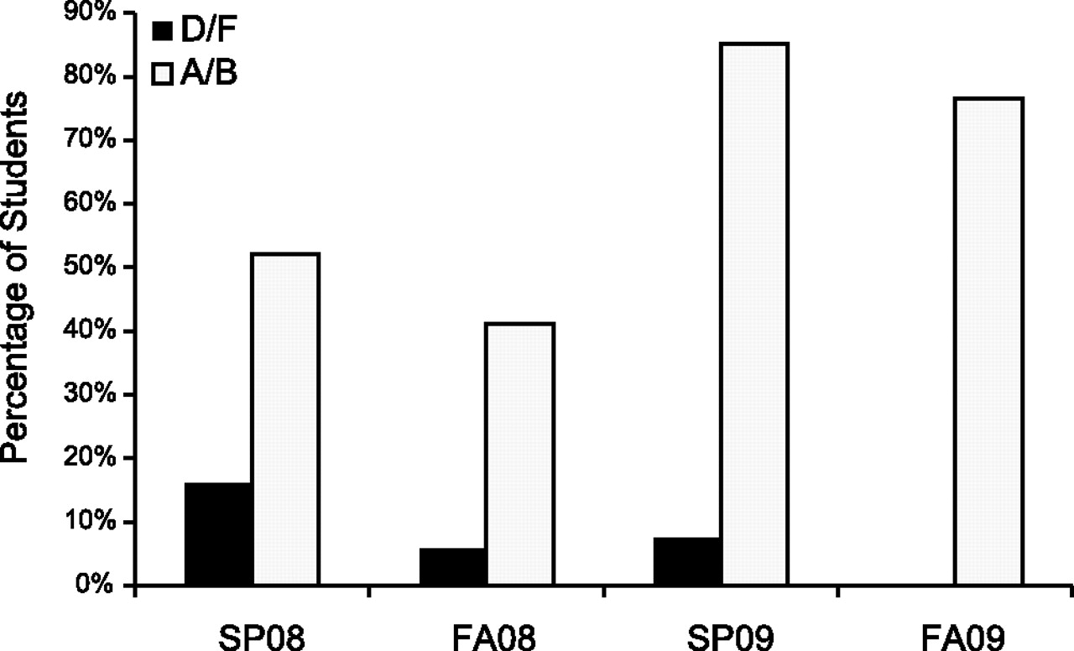
A/B and D/F rates in A&P 2 from SP08, FA08, SP09, and FA09.
Brown P J P Advan in Physiol Edu 2010;34:150-155
©2010 by American Physiological Society
Notes:
A/B and D/F rates in A&P 2 from SP08, FA08, SP09, and FA09.
Over the next two semesters, the D/F rate fell to 0% in fall 2009, whereas the A/B rate rose to near 80% in both semesters (Fig. 2). The percentage of students earning an A in the
course rose steadily over all POGIL semesters (Fig. 3).

Slide 15
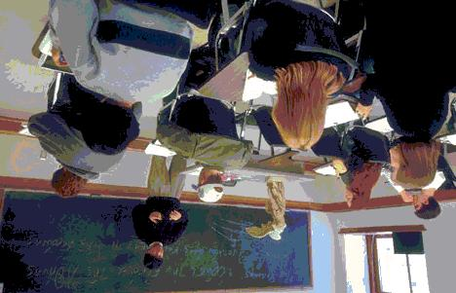
Flipped Classroom

Slide 16
Flipped Classroom
The flipped classroom is a pedagogical model in which the typical lecture and homework elements of a course are reversed.
  For example, a short video lecture is viewed by students at home
    In-class time is devoted to exercises, projects, or discussions.
Notes:
The flipped classroom is a pedagogical model in which the typical lecture and homework elements of a course are reversed.
Short video lectures are viewed by students at home before the class session, while in-class time is devoted to exercises, projects, or discussions.

Slide 17
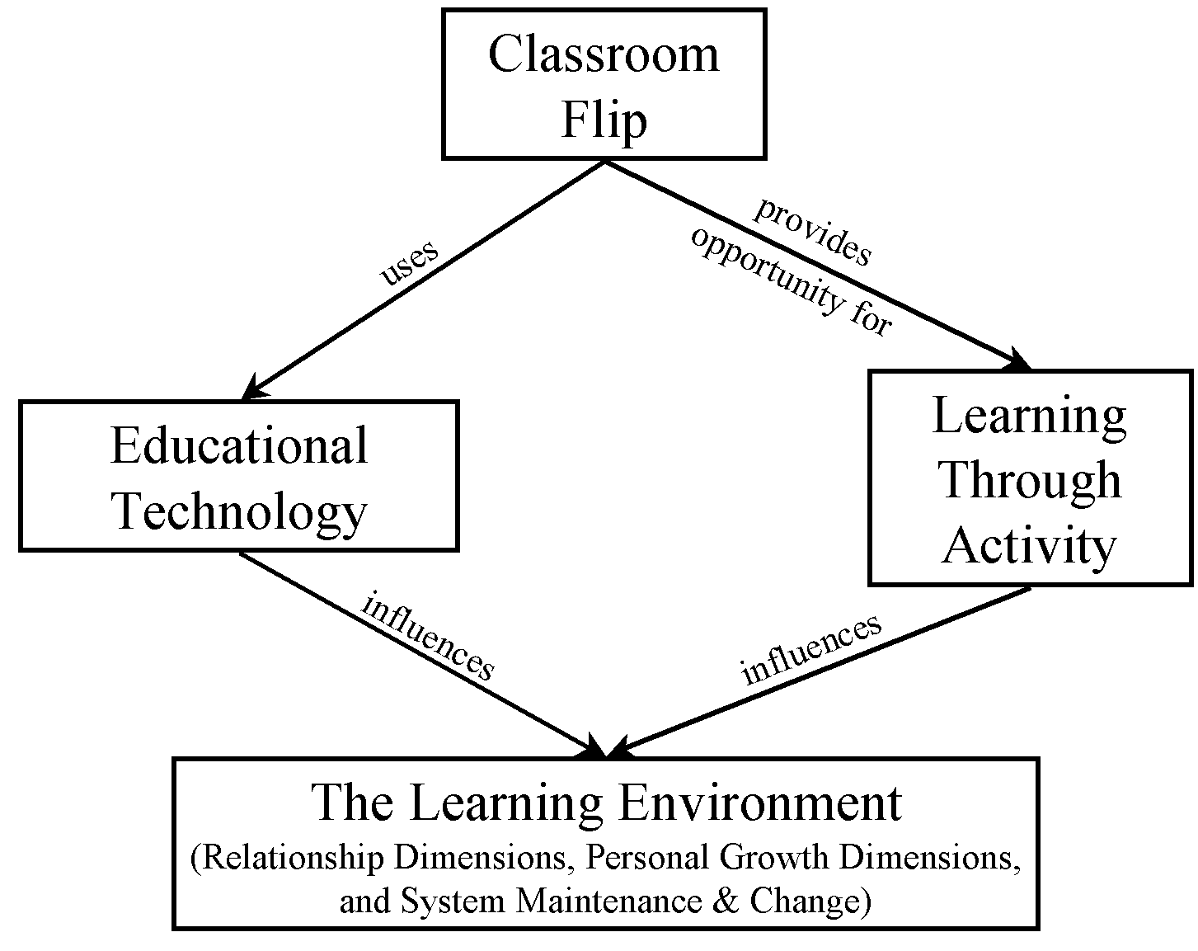
Flipped Classroom

Slide 18
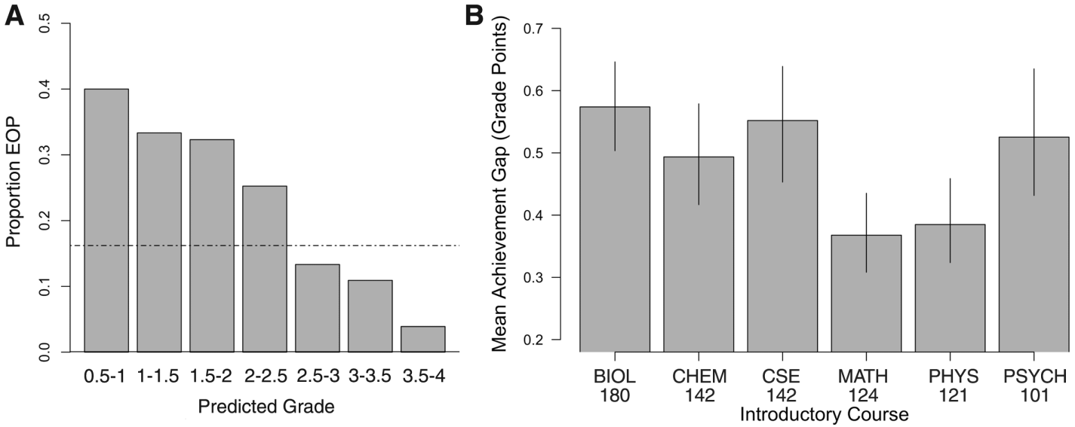
Students from disadvantaged backgrounds are at high risk for failure in introductory STEM courses.
Notes:
Fig. 1. Students from disadvantaged backgrounds are at high risk for failure in introductory STEM courses. (A) Frequency distribution of students in Biology 180, binned by predicted grade. The horizontal line indicates the overall proportion of EOP students in this course (16). EOP students are overrepresented at the low end of the distribution of predicted grades relative to non-EOP students (generalized linear model with binomial error distribution, P << 0.001). (B) Achievement gaps between EOP and non-EOP students in introductory STEM courses at the University of Washington. Means were calculated for gaps in each quarter, academic years 2003 to 2008; error bars represent bootstrapped 95% confidence intervals.

Slide 19
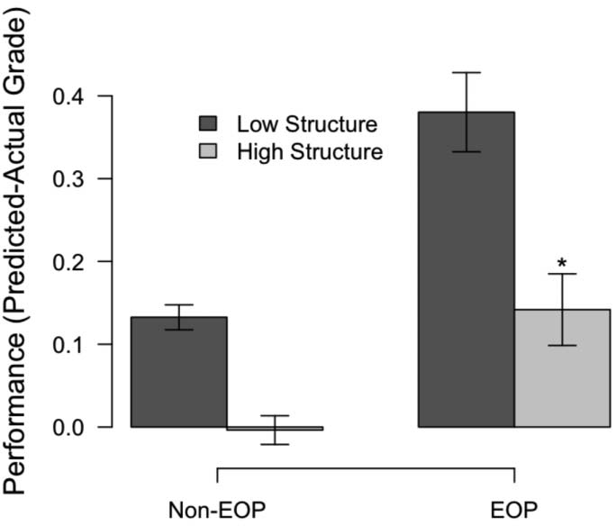
Highly structured course designs benefit all students, but especially disadvantaged students.
Notes:
Fig. 2. Highly structured course designs benefit all students, but especially disadvantaged students. The difference between predicted performance and actual performance is significantly decreased for all students, and EOP students in particular, in two highly structured courses relative to 27 low-structure versions of the same course with little to no active learning. The best-fit generalized linear mixed-effects models of performance include EOP as a fixed effect, likelihood ratio test, df = 13, c2 = 10.997, P = 0.0027; see Table 1. Error bars indicate T1 SE.

Slide 20
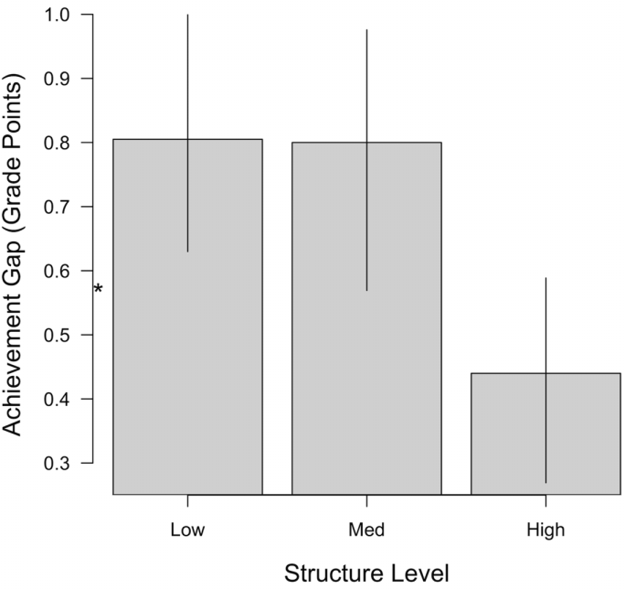
For quarters with a common instructor, the achievement gap is halved with increased structure.
Notes:
Fig. 3. For quarters with a common instructor, the achievement gap is halved with increased structure. Across six quarters of low, medium, and high structure (two quarters each), the achievement gap is the smallest under high structure. Controlling for differences in predicted student ability, we find a drop under the medium-structure course design as well (fig. S2). Means were calculated from 10,000 bootstrap iterations; error bars represent 95% bootstrapped confidence intervals. The asterisk near the vertical axis represents the average chievement
gap across all instructors, 2003 to 2008 (Fig. 1B).

Slide 21
Conclusions
This study shows that a highly structured course design, based on daily and weekly practice with problem-solving, data analysis, and other higher-order cognitive skills, improved the performance of all students in a college-level introductory biology class and reduced the achievement gap between disadvantaged and nondisadvantaged students—without increased expenditures.

Slide 22
References
Deslauriers, L., Schelew, E., and Wieman, C. (2011). Improved Learning in a Large-Enrollment Physics Class. Science 332, 862–864.
Freeman, S., O’Connor, E., Parks, J. W., Cunningham, M., Hurley, D., Haak, D., Dirks, C., and Wenderoth, M. P. (2007). Prescribed active learning increases performance in introductory biology. CBE—Life Sciences Education 6, 132.
Freeman, S., Haak, D., and Wenderoth, M. P. (2011). Increased course structure improves performance in introductory biology. CBE life sciences education 10, 175–86.
Haak, D. C., HilleRisLambers, J., Pitre, E., and Freeman, S. (2011). Increased Structure and Active Learning Reduce the Achievement Gap in Introductory Biology. Science 332, 1213–1216.
Lord, T. 2007. Society for College Science Teachers: Revisiting the Cone of Learning--Is it a Reliable Way to Link Instruction Method with Knowledge Recall? Journal of College Science Teaching. 37 (2): 14-17.
Michael, J. (2006). Where’s the evidence that active learning works? Advan. Physiol. Educ. 30, 159–167.
Prince, M. (2004). Does active learning work? A review of the research. J. Eng. Educ. 93, 223–231.
Wood, W. B. (2009). Innovations in teaching undergraduate biology and why we need them. Annual review of cell and developmental biology 25, 93–112.

