Slide 1
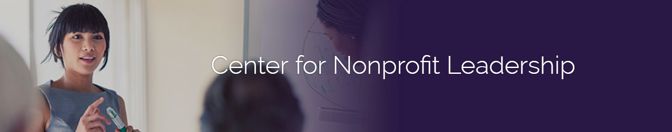
Board Leadership Institute
Module I: Board Service 101
Session 2

Slide 2
Pre-Session Networking
Share your insights:
Talk with someone that has newly joined your Board about the effectiveness of your onboarding process:
What was good?
How could the organization been more effective at welcoming and connecting them?
What is one thing you could implement to improve?

Slide 3
Module Learning Objectives
Understand the responsibilities of board members individually and collectively
Consider real-world issues faced by nonprofit boards
Learn how nonprofit boards exert influence through effective governance

Slide 4
Today’s Agenda
Session I Recap
Policy Governance Model
Board Culture
Board Engagement

Slide 5
Session I Recap
Though there are many types of nonprofits, effective nonprofit boards impact their organizations through:
Setting the strategic direction
Providing appropriate oversight
Building a presence in the community
Building and managing the board

Slide 6
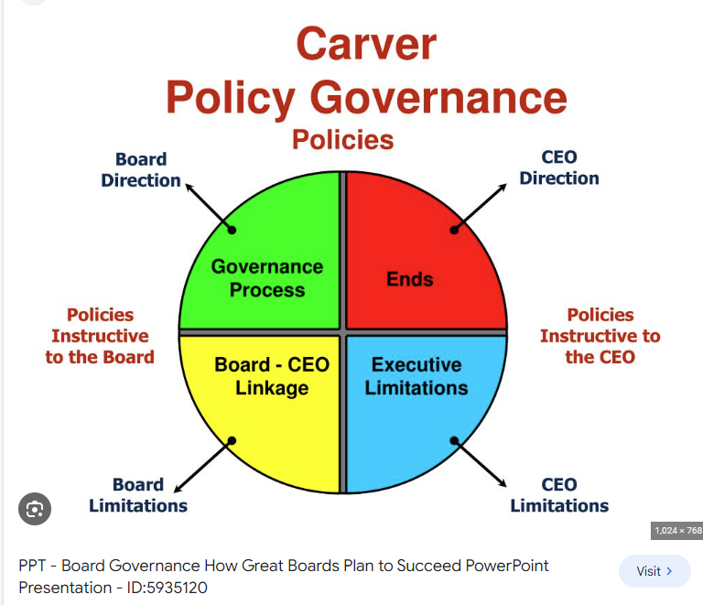
Policy Governance Model
Setting Goals
Setting Limits
Setting Expectations (of board members)

Slide 7
Setting Goals
Examples include:
Strategic goals included in the strategic plan
Revenue targets in a fundraising plan
Reserves policy
What is an example of a goal of your board?

Slide 8
Setting Limits
Examples include:
The organization’s annual budget
Check writing policy
Borrowing policy
Investment policy
Can you think of other ways the board sets limits on the staff or organization?

Slide 9

Setting Expectations
Examples include:
Conflict of Interest Policy
Board member position description
Term limits
Can you think of other ways boards set expectations for its members?

Slide 10
Board Culture
Often unspoken assumptions, beliefs, values, and processes that influence the goals, work habits, decision-making, conflict resolution, management, and perceived success of the organization.
Board culture is influenced by the beliefs and values of the dominant culture of board members and of the head of staff.
Examples:
How decisions are made.
How conflict is expressed and resolved.
How leadership is shared.

Slide 11
Board Culture
Inviting a Culture of Inquiry
Mutual respect, trust & inclusiveness among board members.
Capacity to explore divergent views in a respectful vs. adversarial manner.
Willingness to gather relevant information to inform decisions.
Equal access to information.
The presence of active feedback mechanisms that help the board engage in continuous improvement
Individual and collective commitment to decisions, plans of action & accountability to follow through on the board’s agreements.

Slide 12
Case Study
A mid-sized social service nonprofit serving marginalized people across the county was founded in 2010 by a White woman in her 70s. She brought together a group of people with a passion for the mission. The 10-person board is mostly older, White, and well-off. Much of the board’s time is spent organizing an annual gala event. Board meetings are held mid-morning and in person at one end of the county.
The board is aware that it needs to diversify and has actually recruited more diverse board members, but they have all left before their terms were up.

Slide 13
Breakout Rooms: 6 minutes
How might this board’s culture be creating barriers to achieving a more diverse, equitable and inclusive team?
If you were on this board, how could you contribute to improving its practices?

Slide 14
Promoting a Healthy Balance
Task vs. Relationship
Relationship
Task

Slide 15

Group Maintenance
Task Behaviors
Planning
Setting Objectives
Organizing
Data Gathering
Promoting Decisions
Monitoring Progress
Fundraising

Slide 16

Group Maintenance
Relationship Behaviors
Encouraging Others
Expressing Group Feelings
Harmonizing
Offering Compromises
Process Checks
Instilling Humor
Arranging Gatherings & Celebrations

Slide 17
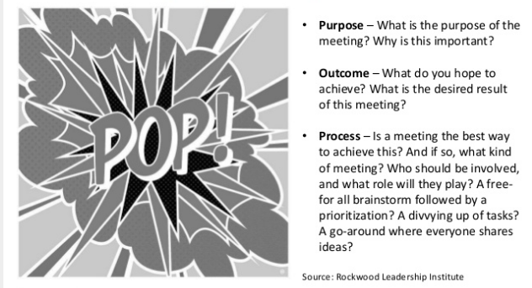
Purpose, Outcome, Process

Slide 18
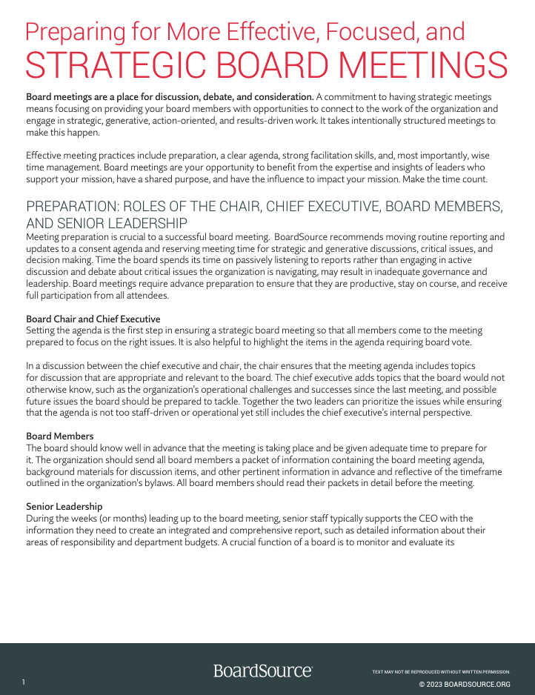
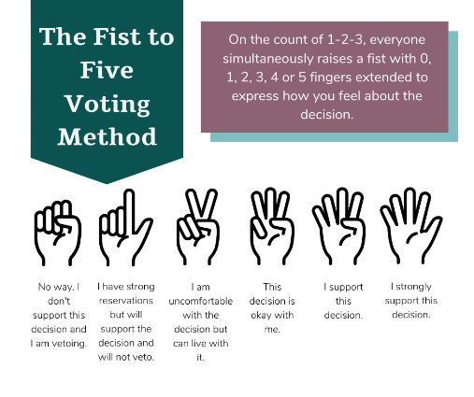
Meeting Tips
Ground rules
Agendas out in advance
Consent agenda
Strategic agenda
Decision-making. Fist to Five
Question: Ideas for how to make meetings better (zoom or in-person)?

Slide 19
Board Development
Retreats
Mentorship
Learning Opportunities
Evaluation
Succession Planning

Slide 20
Case Study
The newly elected president of the board of Newton Visiting Nurses, you arrive at your first board meeting after elections with a spring in your step and a determination to move the organization’s 18-member board in a positive new direction. Having spent the better part of the afternoon constructing an agenda, you place copies of it on the table and make small talk with the five board members who arrive on time. Four more members arrive between fifteen and twenty minutes after the scheduled start time. You wait until twenty-five minutes after the hour for the immediate past-president, who is notoriously late for meetings – even those for which he is the designated chair. You call the meeting to order by thanking everyone for taking time to be at the board meeting and recognizing the many competing interests that each of the board members faces. The secretary immediately apologizes for not completing the minutes from the last meeting prior to this one. During the committee reports the fundraising committee chair spends a full half-hour reviewing a discussion that committee had about whether or not to hold a dinner dance next summer, causing the meeting to run past the scheduled closing time. A board member who has only been to two meetings prior to this one sits in silence, appearing increasingly uncomfortable. During a staff presentation on the merits of hiring a strategic planning consultant two of the board members excuse themselves, citing other commitments.

Slide 21
Breakout Rooms: 6 minutes
What are three simple things you can do to inject life into the next board meeting?

Slide 22
Closing
In your teams, pick one thing relating to governance that you will work on in the next month. Be prepared to report at the next meeting.
Is there anything from these sessions you would like to discuss further?

