Slide 1
BLI Networking Breakout
8:45 a.m. – 9:00 a.m.
Discussion Prompts:
  Introduce yourselves & your organization
  Discuss: 1-2 identified strengths your organization / team possess that help you uniquely pursue your mission’s success
  Discuss: Goals your team has regarding general board expectations, structure and operational effectiveness

Slide 2
Digital Community Agreements
Start and end on time.
Commit to participate in sessions and do the work.
Be present. Come prepared. Be vulnerable. Have the courage to engage and share.
Be open-minded and stay engaged.
Avoid multi-tasking.
Keep camera on, if you can. If not, feel free to turn off Zoom video and microphone as you need. Trust that all participants are doing what is best for them.
Treat all participants and facilitators with respect. Meet each other where they are.
Avoid multiple people speaking at once, no interrupting.
Everyone has a voice and deserves to be heard. Share space with one another. Contribute and listen.
Listen to understand. Embrace transparency.
Talk straight and speak truth. Speak up if you have something to say. Share as openly as possible. Speak to your own experiences.
Put the health and safety of the community as top priority.
Extend trust when possible, assume positive intent. Trust the process.
Maintain and honor confidentiality. What is said here, stays here.
Ask open, honest questions. Free of judgement.
Embrace difficult conversations, lean into discomfort.
THINK…is it true, helpful, inspiring, necessary, kind?
There are no dumb questions. Invite inquisitiveness.
Be generative and use “Yes…and” thinking (not, “Yes…but”)
Look at the entire picture, not just through you own lens.
Listen and lead with empathy and grace.
Articulate hidden assumptions. Challenge cherished beliefs.
Seek common ground and understanding (not problems and conflict)
Take stretch breaks, bio breaks and grab refreshments as you need.
Take what we learn and share with others, seek input from board colleagues not participating.

Slide 3
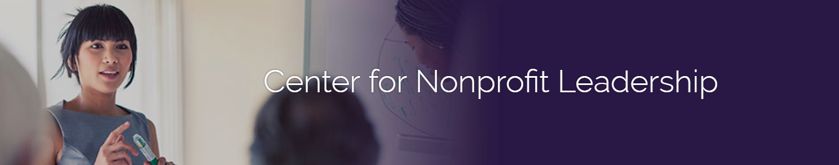
Board Leadership Institute
Module I: Board Service 101
Session 1

Slide 4
Module Learning Objectives
Understand the responsibilities of board members individually and collectively
Consider real-world issues faced by nonprofit boards
Learn how nonprofit boards exert influence through effective governance

Slide 5
Agenda
Session I:
Ground Rules, Types of Nonprofits, Types of Boards
Board Nuts & Bolts: Legal Obligations, Function
Establishing an Effective Board: Structure, Composition, Diversity, Recruitment, Orientation
Session II:
Governance: Policy as Influence
Board Culture: Aspects of Culture, Inclusion
Keeping the Board Engaged: Group Maintenance, Effective Meetings, Board Development, Evaluation

Slide 6
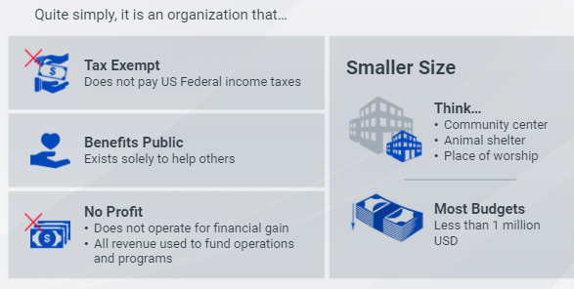
What is a Nonprofit Corporation?

Slide 7
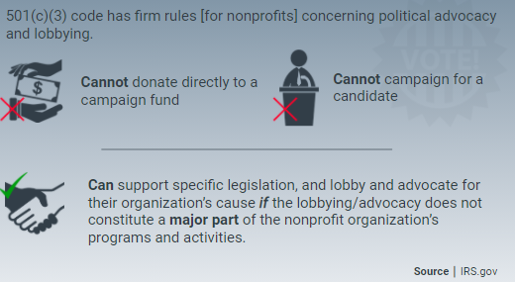
What is a Nonprofit Corporation?

Slide 8
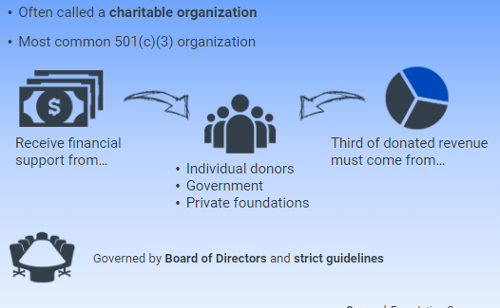
What is a Nonprofit Corporation?

Slide 9
Key Facts About Nonprofits
Over 1.8 million in the U.S.
Primarily
  Public Charities (your “typical” nonprofit, both large & small)
  Private Foundations (grantmaking institutions typically supported by a small number of donors)
Also includes more than 30 other types, including
  Membership Associations
  Fraternities & Sororities
  Civic leagues
  Faith-based institutions
  Business Associations
  Veterans’ Organizations
  Labor Unions
  Federal Credit Unions

Slide 10
What Makes Nonprofits Different?
Society’s way of addressing needs and aspirations.
Mission-focused rather than profit-focused.
Owned by the community, not the shareholders.
Often address issues the “free” market does not

Slide 11
The Board Lifecycle
The nature and structure of Boards evolve over time.

Slide 12
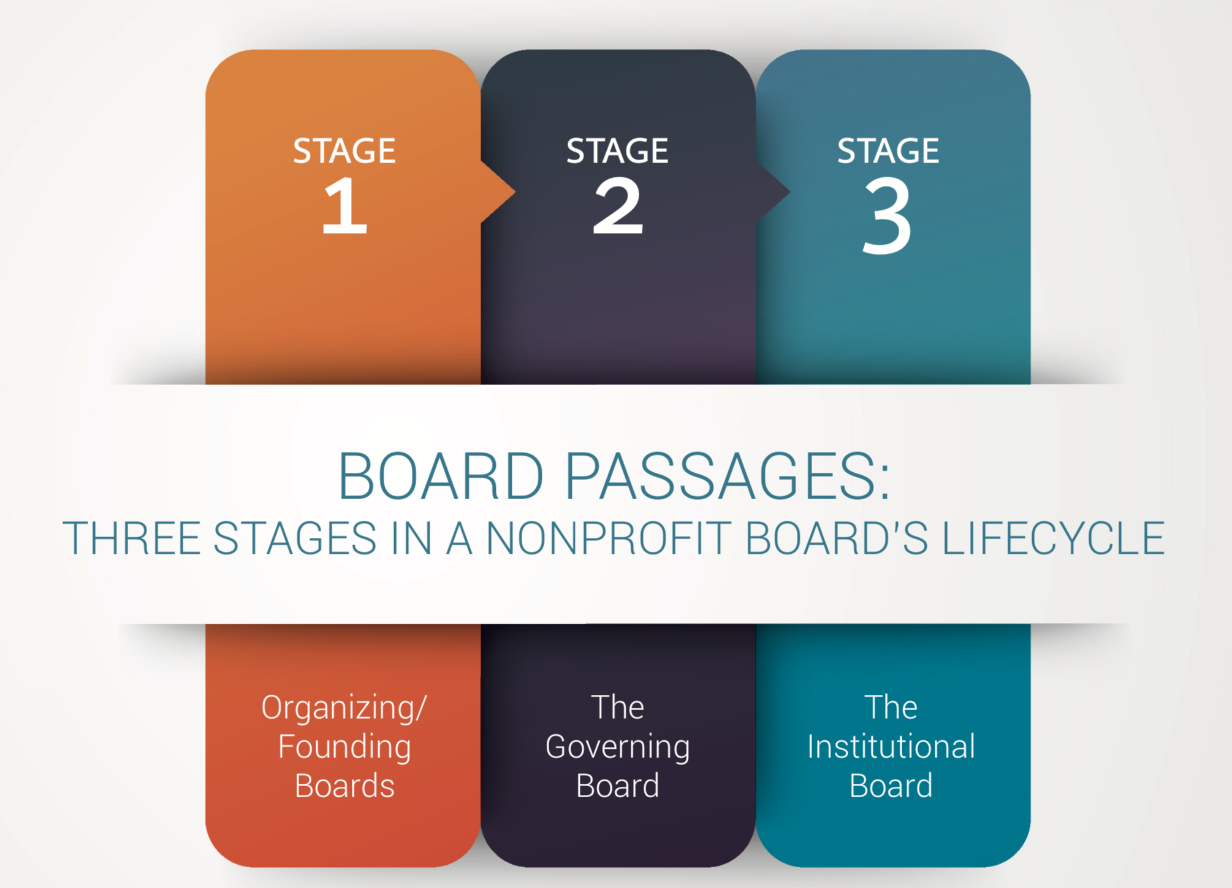
Board Lifecycle
Governance vs. Management: Depends on life stage of organization

Slide 13
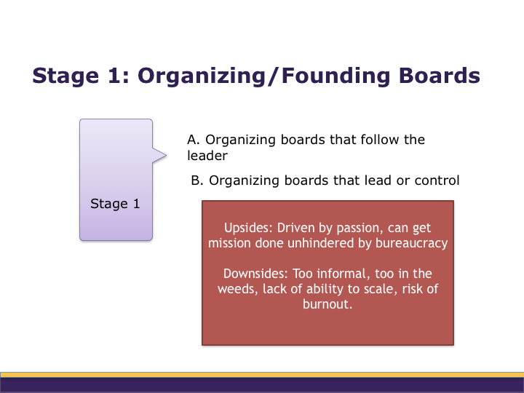
Board Lifecycle

Slide 14
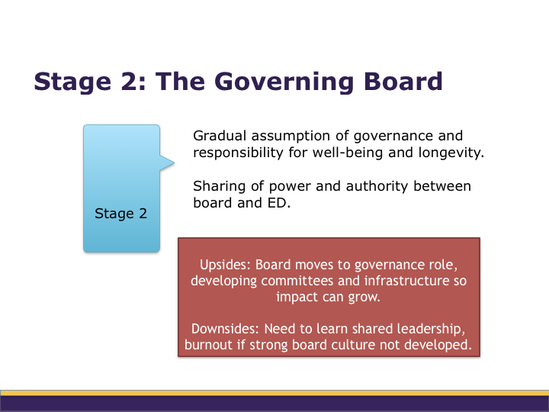
Board Lifecycle

Slide 15
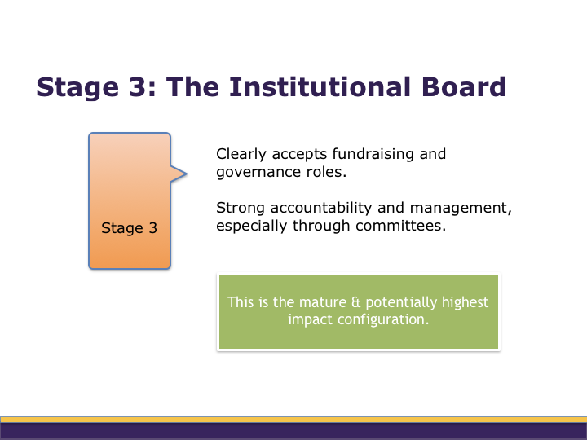
Board Lifecycle

Slide 16
Board Lifecycle
POLL:
  Which of the three stages of the board lifecycle best describes your board.

Slide 17
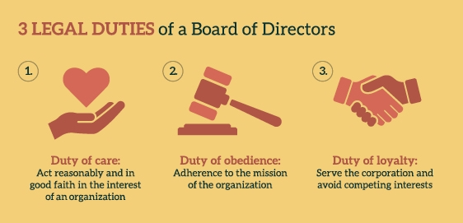
Board Member Duties
Notes:
For Duty of obedience….it is really about adherence to the law and Board policies / bylaws (not just the mission)

Slide 18
Duty of Care
Participate actively
Make reasonable inquiries
Make reasonable decisions
Participate in financial oversight
Establish policies
Investigate suspicious circumstances
Manage risk
Notes:
DEBBIE short!
All corporate powers must be exercised by or under the direction of the Board of Directors.

Slide 19
Duty of Obedience
Follow Articles of Incorporation, Bylaws, Policies
Obey federal and state laws
Keep satisfactory corporate documents and records
Establish financial records and controls
Observe donor restrictions

Slide 20
Duty of Loyalty
Act in corporation’s best interest
Manage conflicts of interest
Safeguard organization resources
Avoid private benefit
Be true to the mission

Slide 21
10 Responsibilities of Nonprofit Boards
Determine mission & purpose
Select the chief executive
Support & evaluate the chief executive
Ensure effective planning
Monitor & strengthen programs and services
Ensure adequate financial resources
Protect assets and provide proper financial oversight
Build a competent board
Ensure legal and ethical integrity
Enhance the organization’s public standing
Source: BoardSource

Slide 22
Case Study
Your executive director has decided to step down from her current role and stay on with your agency in the capacity of program manager. Following a six-month search for the right new executive director, you have hired someone who the board thinks is a perfect match for the organization and the community.
Six weeks after you hire the new executive, you receive a call from the program manager (formerly the executive director) complaining that the new E.D. is micro-managing her programs. The program manager adds that she doesn’t like the new E.D.’s communication style either and wants “someone from the board to speak with” the new E.D.

Slide 23
Breakout Rooms: 6 minutes
What do you do?
What, if anything, will you say to the former E.D./program manager?
What, if anything, will you say to the new Executive Director?

Slide 24
10 Responsibilities: Areas of Impact
Set Strategic Direction
1. Determine mission & purpose
2. Select the chief executive
3. Ensure Effective Planning
Provide Oversight
1. Support & evaluate the chief executive
2. Protect assets and provide proper financial oversight
3. Monitor Programs/Services
Engage the Community
1. Enhance the organization’s public standing
2. Ensure adequate financial resources
Develop the Board
1. Build a competent board through recruitment and training
2. Ensure legal and ethical integrity

Slide 25
Case Study
Your organization has developed a fundraising plan. Board and staff are working together to meet fund development goals. Mid-way through the year you are accomplishing 90% of what you intended to accomplish under the plan.
An officer of the board identifies an opportunity for a new fundraising event. Without consulting the E.D. or the rest of the board, the board officer commits the organization to the event and to the payment of deposits and other up-front costs because she sees this as a “can’t miss opportunity.” The officer presents the idea as a fait accompli at the next board meeting.

Slide 26
Breakout Rooms: 6 minutes
What do you do?
How will you address the board officer’s actions?
How will you handle the commitment of organization funds?

Slide 27
Developing the Board: Structure
What’s the right size?
How many committees should there be? What are they?
What should Board–Committee interaction look like?
Should there be term limits?
What officers do we need? How should they be selected?

Slide 28
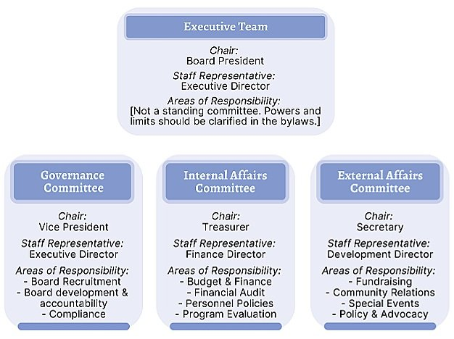
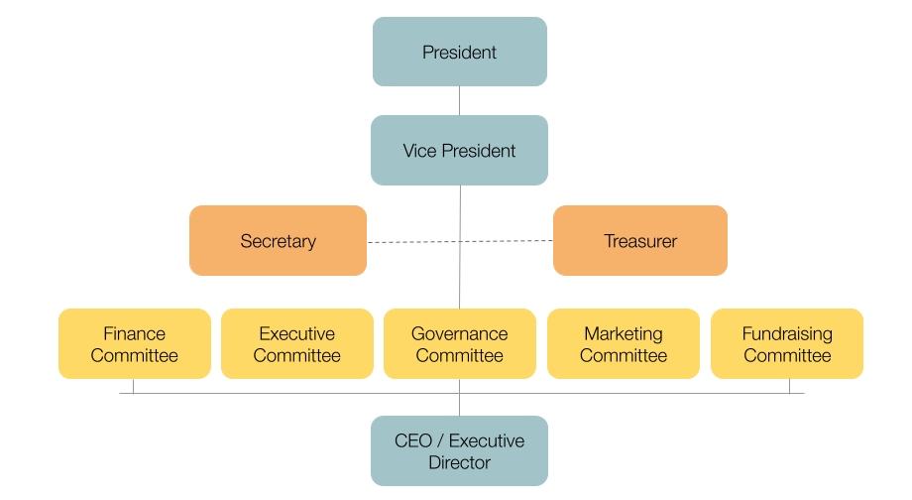
Developing the Board: Structure
3 Committee Model
Traditional Model

Slide 29

Do we have the right people on the board now?
Who or what are we missing?
- bouquet
Developing the Board: Composition
A lot of different flowers make a bouquet
- Muslim origin

Slide 30
The structure of your Board will be driven by your organization’s mission and goals
Developing the Board: Setting Goals

Slide 31
Breakout Rooms: 8 minutes
Discuss:
  What are your goals for your BOARD and your ORGANIZATION over the next 2-3 years?
  What skills, attributes, identities, or styles are needed on your board to reach those goals?
  Which of these is currently missing on your board?
  What strategies might you use to recruit to fill those gaps?
  Be prepared to share one strategic goal for board development or one characteristic you are trying to recruit for currently (in the chat).

Slide 32
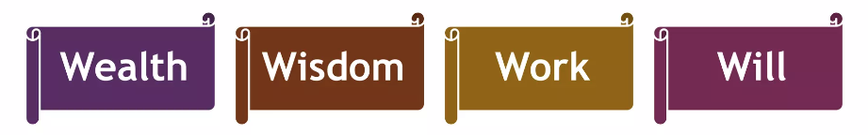
Developing the Board: Taking Stock
Resource Development
Fundraising
Special Events
Marketing
Lived Experience
Legal
Finance & Accounting
HR & Personnel
Science
Facility Management
Risk Management
Program Expertise
Evaluation
Planning
Access / Network
Passion
Connection

Slide 33
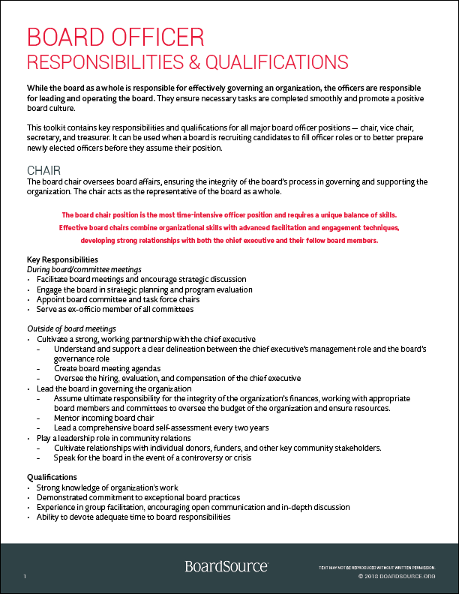
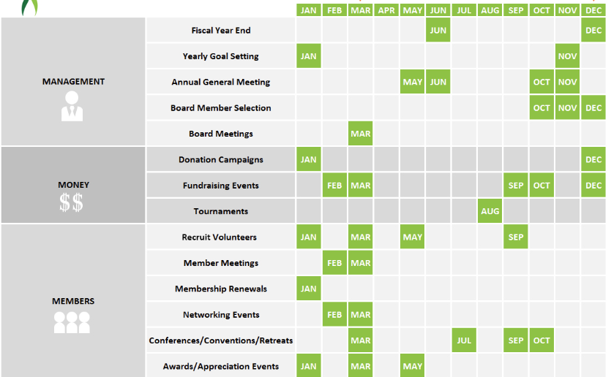

Developing the Board: Before you recruit
  Job Descriptions
  Board Calendar
  Organization Description

Slide 34
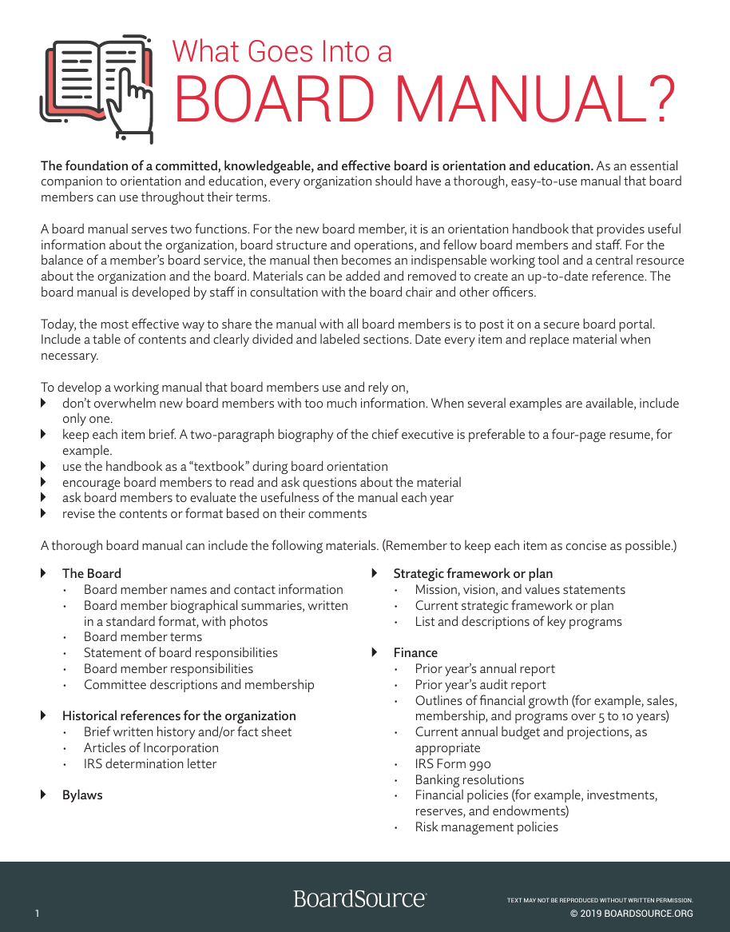
Developing the Board: Onboarding
  The board binder (physical or electronic) should include:
  Organizational documents (articles of incorporation, bylaws, vision & mission, strategic plan, descriptive documents)
  Board & Committee Rosters
  Board Member Agreement
  Board Calendar
  Recent Meeting Minutes
  Financial information
    Current budget
    Current financial statements
  Policies & Procedures
    Conflict of Interest
    Confidentiality Agreement

Slide 35
Onboarding: Orientation Process
Share the board position description and answer any questions
In a formal orientation session (with one or a small group of new board members):
Introduce board and staff leaders
Share the organization’s strategic plan
Review and explain policies and programs
Review basic board roles and responsibilities
Share best practices in board service
Be direct about the board culture (how things are accomplished by the board)
Outline committees and other opportunities to serve

Slide 36
Onboarding (continued)
After the formal orientation:
Conduct an evaluation of the session with the goal of continuous improvement
Match the new member(s) with committee assignments
Engage the new member(s) at meetings (encourage questions and contributions)
Consider assigning a buddy/mentor
Check in with the new member(s) after their first few meetings

Slide 37
Next Session
Session II:
  Governance: Policy as Influence
  Board Culture: Aspects of Culture, Inclusion
  Keeping the Board Engaged: Group Maintenance, Effective Meetings, Board Development, Evaluation
Discussion Prompt for next session:
Talk with someone that has newly joined your Board about the effectiveness of your onboarding process:
What was good?
How could the organization been more effective at welcoming and connecting them?
What is one thing you could implement to improve?

