Slide 1
The Fall 2020 Degree Completion/Senior Audit Process
Degree Completion Agreements (DCA) for Traditional Undergraduate Students

Slide 2
The Process Before this Year
Degree Completion Agreement (DCA) Fall 19 and Before
To Do Item | Notes
1. Student Submits their Application for Degree via Student Planning | Priority deadline for filing for May and August is October 1
2. Student Pays the Graduation Fee | The fee increases by $25 after the priority application deadline.
3. An appointment with the appropriate Student Success Counselor was made. | Students were expected to come to the meeting with a plan for what was required to complete the degree.
4. During the meeting, the student and Student Success Counselor audit the file, adjust the student’s plan, register the student for Spring and Summer and draft the Degree Completion form.
5. Student schedules an advising meeting with their faculty advisor to review the Degree Completion form | Adjustments to students’ schedule could occur if determined by the faculty advisor
6.The completed form and any needed paperwork returned to Academic Services.

Slide 3
Why this process is needed
Seniors, left on their own do not register for Spring on time.
Before the Degree Completion process was created a very low percentage of seniors enrolled in the Fall semester successfully graduated as intended in May or August.
The majority of students who did not graduate were less than one semester away from graduation. Not only did they not graduate on time, but most never graduated.
For a variety of reasons, seniors often enter their senior year with one thought about their remaining requirements, their faculty advisors thinking something else about their status and their Student Success Counselor reflecting something else in their file.

Slide 4
Why part 2
If some additional coursework is needed, something is missing or some petition process is needed, it is better to panic and deal with it in Fall than to be meeting with me in the Spring.
In the Fall, there is time to change plans and adjust a student’s class schedule for Spring. In Spring, it is often too late.

Slide 5
Why make changes to the process
With the hiring freeze, there is an open Student Success Counselor position that will not be refilled until the freeze is lifted
There are three Counselors with pregnancy related leaves.
A couple came back early from leave because of short staffing.
Data on Impact:
College/SOM | # of Seniors | # of Faculty Advisors | Average # of Seniors | # with < 5 Seniors | # with 20 or more seniors | # seniors per SSC | # of Weeks for DCA meetings | Average meetings per week for faculty advisors
COAS | 568 | 81 | 7 | 39 | 5 | 95 | 5.5 | 1.3
SOM | 129 | 12 | 10.1 | 2 | 2 | 21 | 5.5 | 1.8
Total | 697 | 93 | 17.1 | 41 | 7 | 116 | 5.5 | 3.1

Slide 6
The Process this Fall
To Do Item | Notes
1. Student Submits their Application for Degree via Student Planning | Priority deadline for filing for May and August is October 1
2. Student Pays the Graduation Fee | The fee increases by $25 after the priority application deadline.
3. Student schedules an advising meeting with their faculty advisor to review their degree completion plan, including their schedule for Intersession, Spring and Summer. | Students should be expected to come to the meeting with a plan for what was required to complete the degree.
4. After the meeting, the student initiates the Degree Completion form and sends it to their faculty advisor. | If the faculty advisor has cleared the student to register, the student should register for all applicable terms after the advising meeting.
5. The faculty advisor reviews the form and either approves or rejects it for changes. | If the plan does not match your discussion or the student has not registered, the form should be rejected.
6.The completed form comes to the Student Success Counselor. | The Counselor will do a complete audit of the file to make sure that the plan will complete all degree requirements
7. If desired the student can then schedule a meeting with their Student Success Counselor.

Slide 7
Suggested Process
Establish the expectation that your seniors should come to the advising meeting with a plan for their remaining credits. That includes a schedule for Intersession, Spring and Summer.
If they are required to enter this into Student Planning, your checking will be more straightforward.
Check the degree requirements that are non-petitionable:
Will the student have at least 124 credits completed?
Will the student have at least a 2.0 GPA overall, at CLU and in the major/minor?
Will the student have 40 credits of upper division?
Will every Core 21 requirement be completed?
Check the major or majors, with any emphases for completion:
Will every requirement be completed?
If there are courses not plugging in, are any substitution forms needed?
If a requirement is needed that will not be offered is there a substitution that will work?
Do the same for any minors

Slide 8
Things that can trip up students
Requirements that are ignored, do not go away on their own.
PE Activity
Students can count a maximum of 3 credits toward the degree
Athletes often do not sign up for credit every semester they play. This is petitionable if a student is short credits.
Only 25% of any major or minor can be duplicated with any other major or minor.
No duplication is allowed between majors and minors in the same department.
Lower division transfer courses can satisfy upper division major/minor requirements, but the student will not receive upper division credit.
Be sure to check the minimum credits required in the major and minor, including upper division for the major/minor. The degree audit is not set up to automatically check all of those credits.
Majors with required emphases have to be checked manually
Core 21 issues:
Double dipping is not allowed within the Perspectives portion of Core 21.
Selected Topics courses that are approved for Core 21, often need to be forced into the requirements
Approval of courses for Core 21 usually goes from the time of approval forward.
Petitions to count Cal Lutheran courses for Core 21 that have not been submitted by the department are very rarely approved.

Slide 9
Strategies I use for Common Problems
When a student is short of 124 credits:
Was the student an athlete? Often an additional credit can be found
Did the student complete an internship or research without registering?
Do we have all of the students transcripts?
If a Core 21 requirement is missing:
Does the student have transfer work? If yes, is there a course that might apply?
Is there a remaining major course that can double dip?
If a student will be short the minimum credits required in the major/minor
Is there a course that the student has already completed that might be able to substitute in as an additional electives?
If a student is short upper division credits:
Sometimes students have choices for courses between lower division and upper division. Switching a lower division course for an upper division course can work
Did the student complete an internship or research without registering?
If a course is needed that does not fit here or is not scheduled, BYU’s online courses are open entry/open exit.
You can always contact me to look at the student’s record. Sometimes I can find a unique answer to a problem.

Slide 10
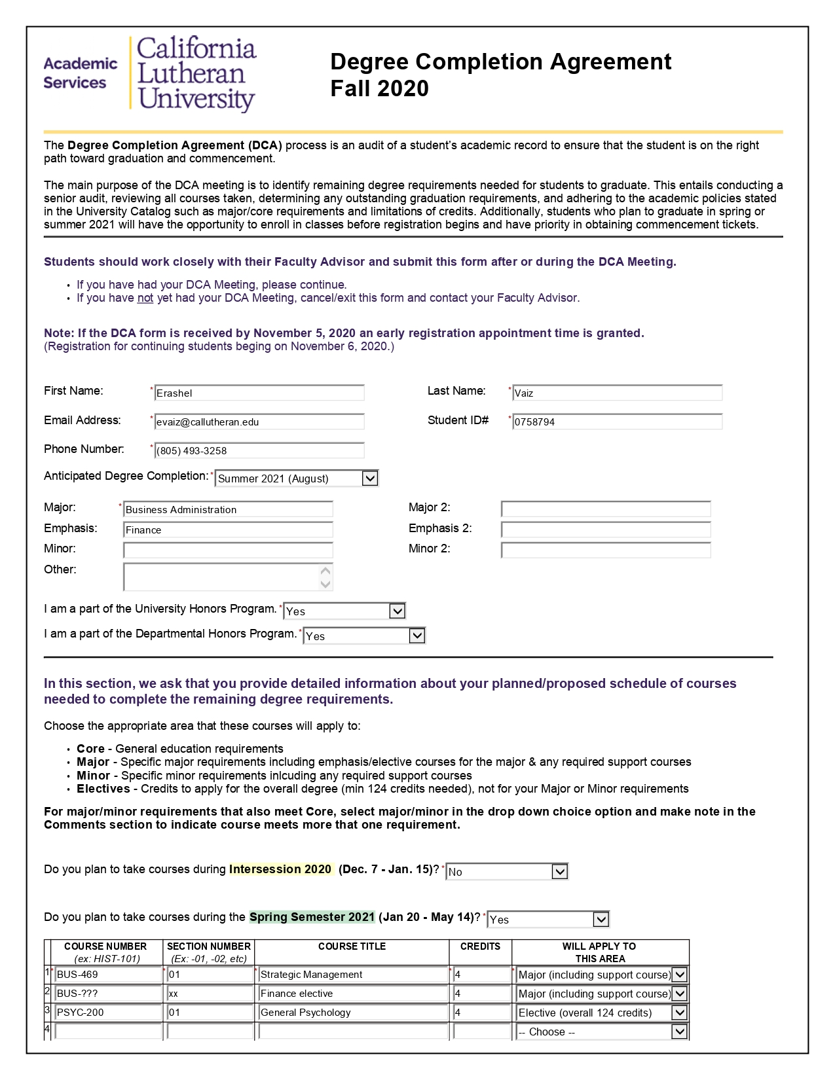
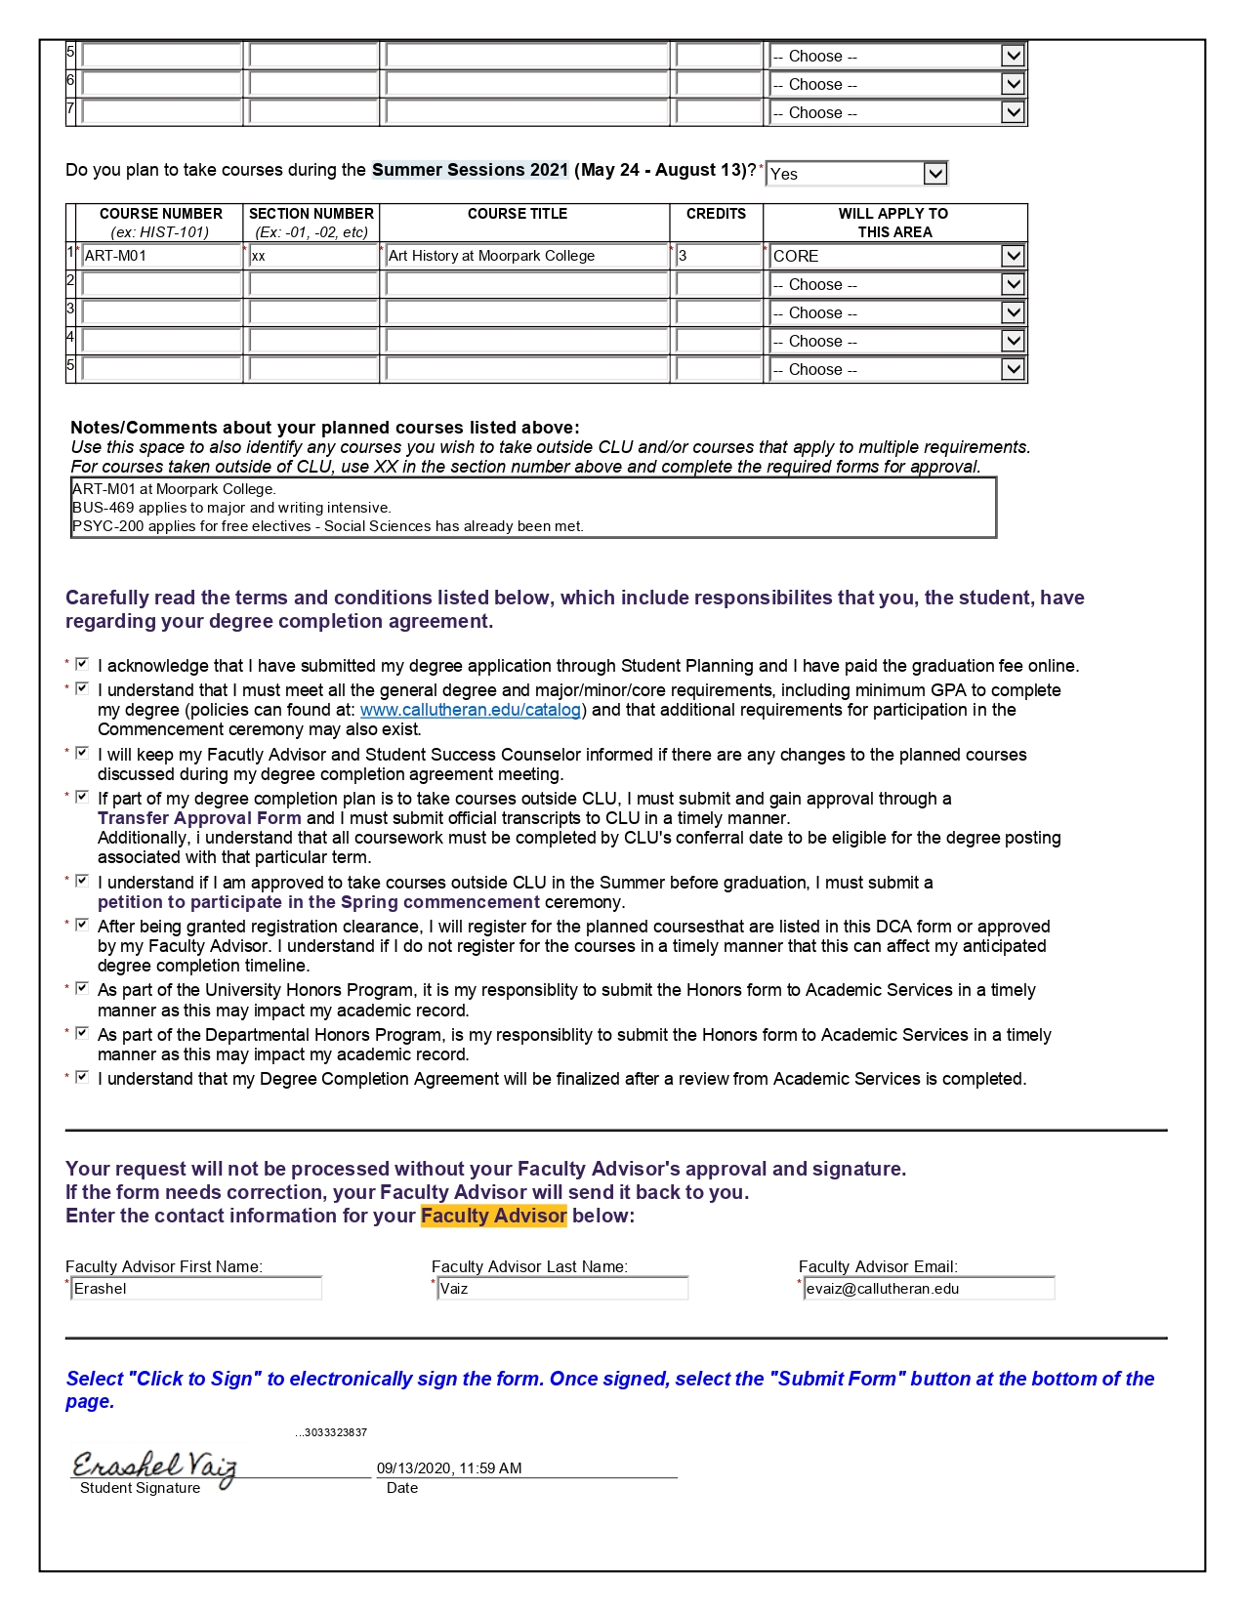

Slide 11
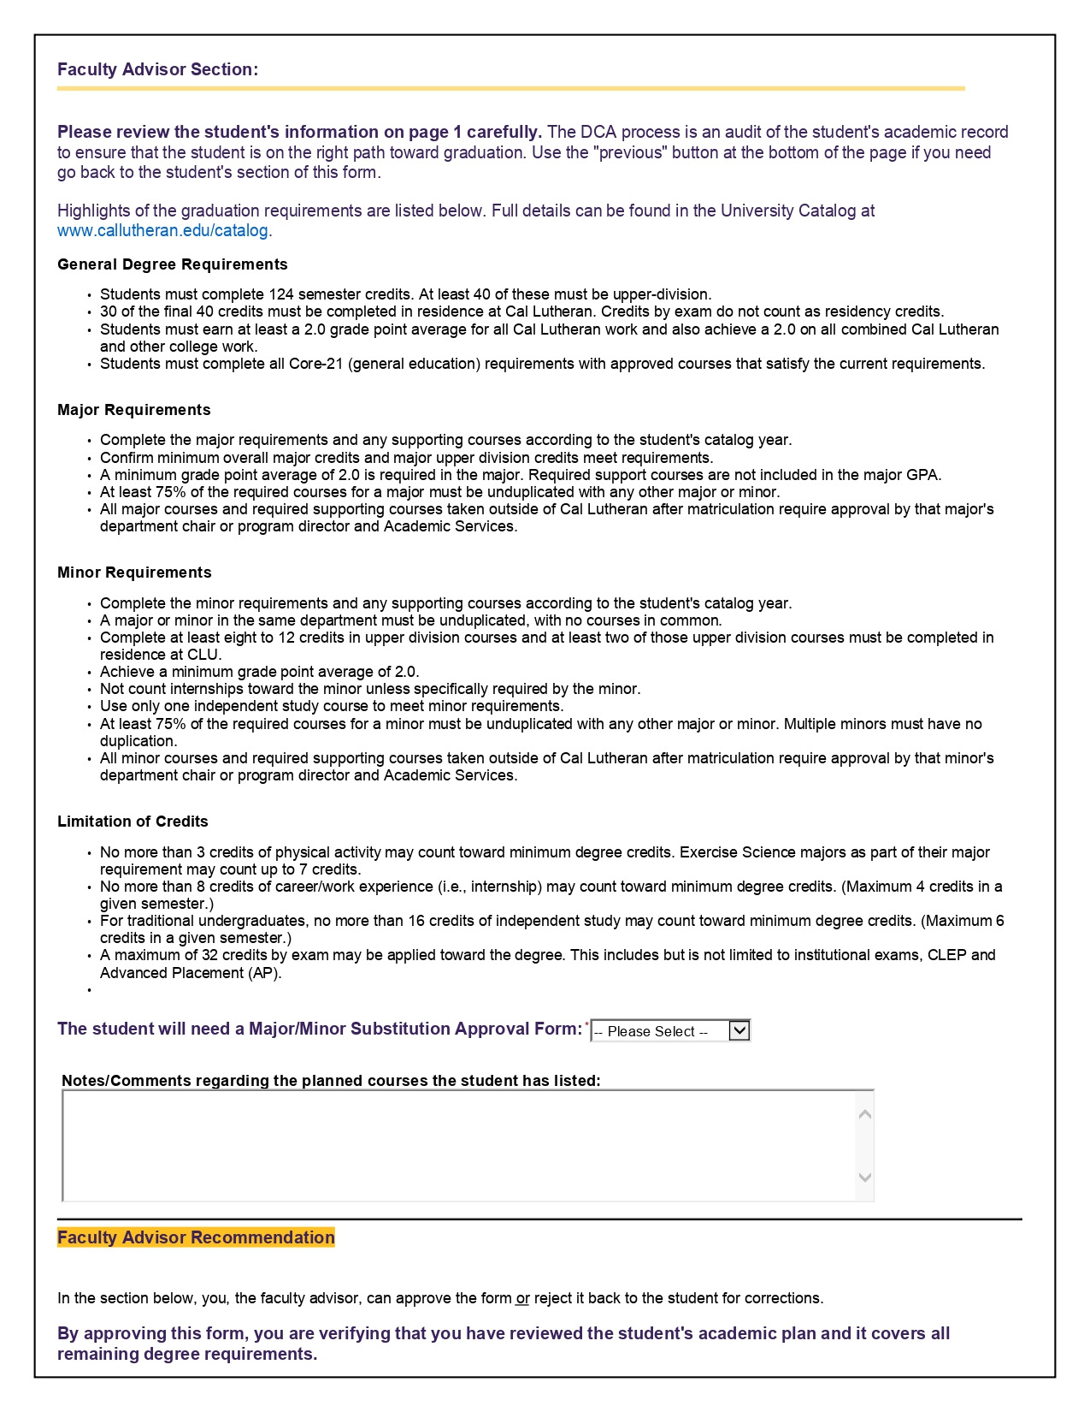
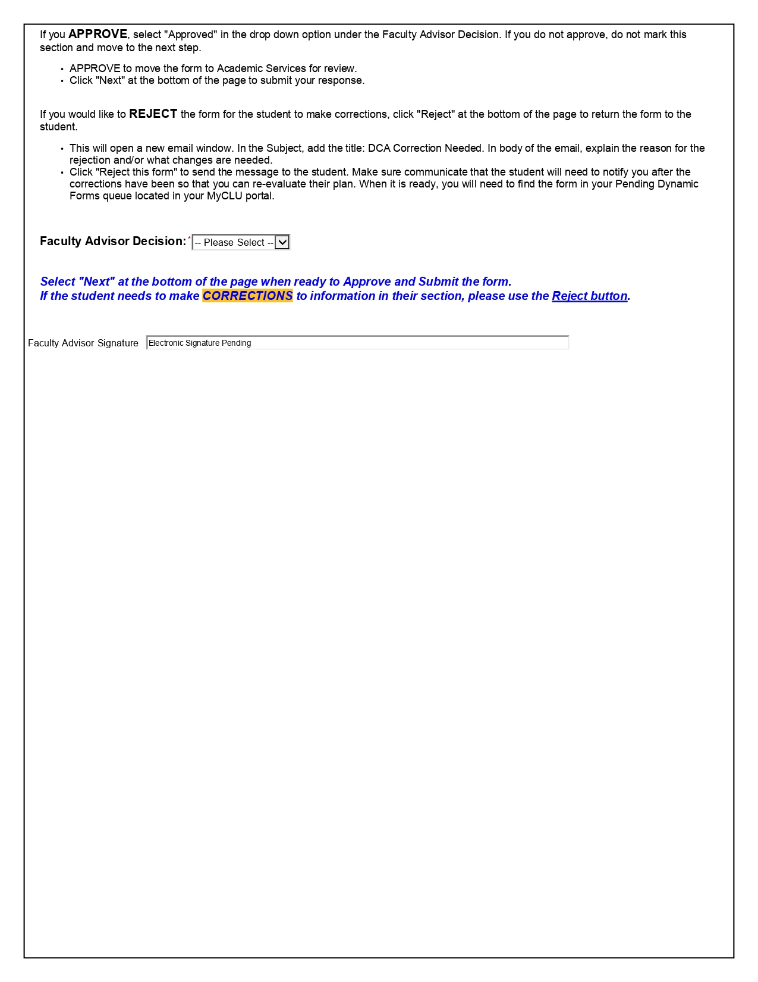

Slide 12
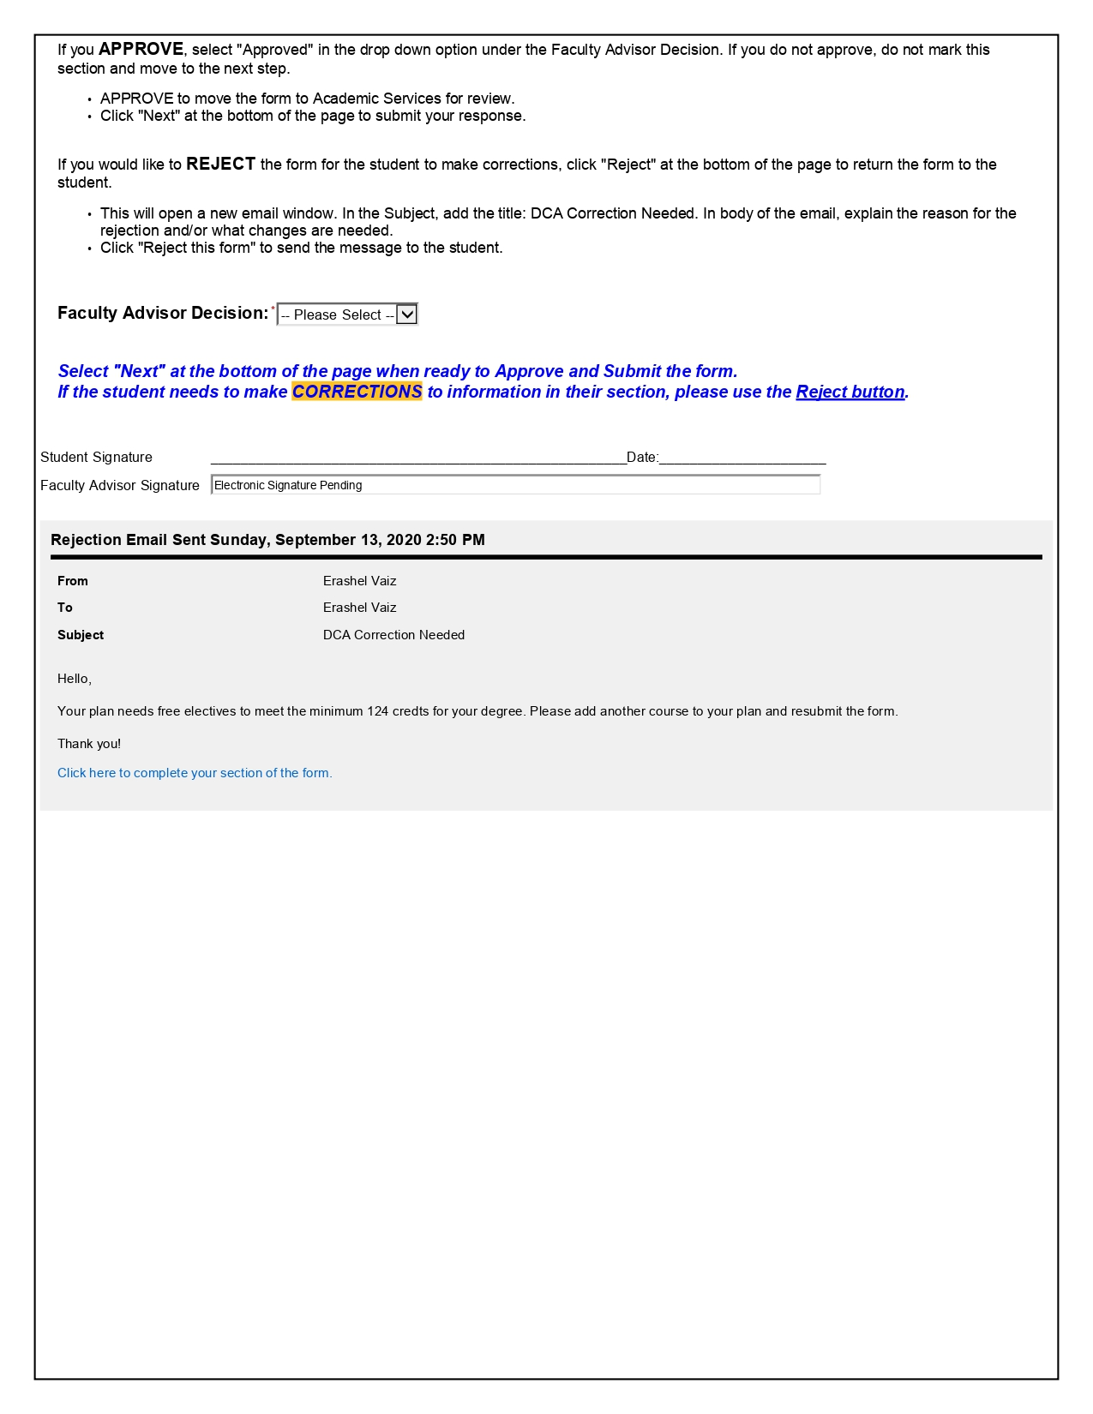
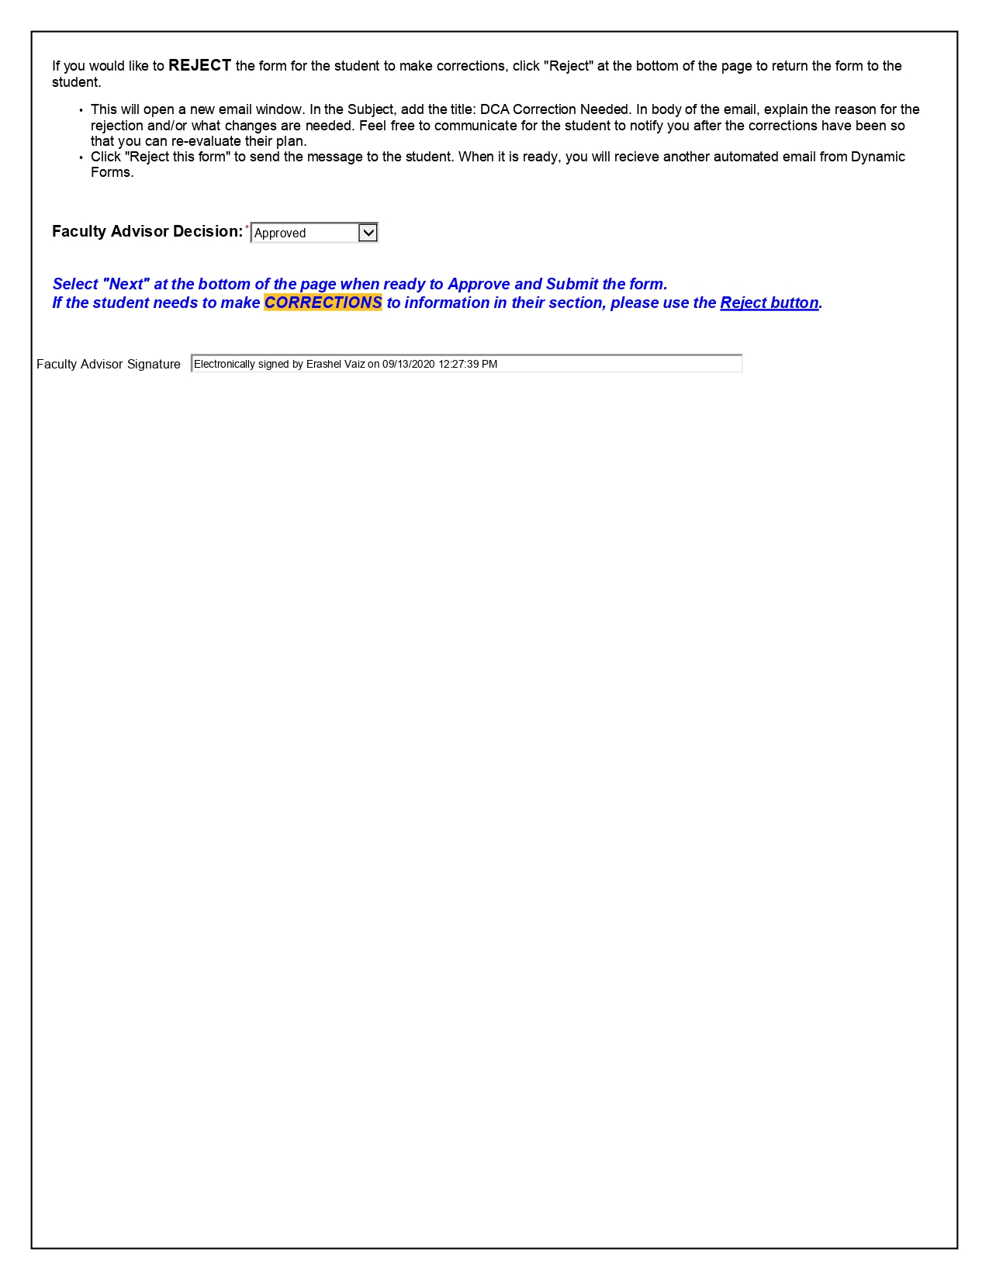

Slide 13
Graduation Process Information available to Students
Academic Services has created a web site for seniors with information related to the graduation process. It can be found here:
Graduation Process: www.callutheran.edu/gradprocess
Degree Completion Agreement (DCA): www.callutheran.edu/dca

Slide 14
Questions?
Please feel free to contact either Angela or me if you have any questions.
Students can be referred to their Student Success Counselor if there are specific questions regarding their degree.

