Slide 1



Institute for Executive Leadership in Education
Marketing & Media
In Good Times and Bad:
Building A Communications Plan
Module 4
Ann Bonitatibus
Superintendent, Conejo Valley USD
Terilyn Finders
Director of Communications, F3

Slide 2

Communications
Proactive Communication
  Day-to-Day
  Engagement/Support
  Publicity
  Social Media
Situation
  Issues
  Incidents
Media
  Ongoing
  Situations
  Interviews
Crisis
  Planning

Slide 3

Building a Communications Plan
Clarify Objective

Slide 4
Kill that Rumor!
Think of a rumor related to work you have led and communicated
Do you know why the rumor started?
How long did it last?
Can rumors be avoided?
Read the article. What resonates for you?

Slide 5
Communications Plan
Situation analysis
  Changes or support required/desired and from whom
Target audiences
  Who will support
  Who will oppose
“Circles”
  Timing
Listening/refining message

Slide 6
Well, MA’AMM?
Think of an initiative you are currently working on that has systemic impact
What is the message?
List all possible audiences
Who will deliver the message to each audience?
What will the mode be for each audience?

Slide 7
Think & Act In Concentric Circles
Choose words/tone from the outside in.
Community & Media
Parents & Students
  1) Site Administrators & Union Leadership
  2) Staff
Empathy
Humility
Accessible
Confident
Cabinet
Superintendent &
Board

Slide 8
Communications Plan
Situation analysis
  Changes or support required/desired and from whom
Target audiences
  Who will support
  Who will oppose
“Circles”
  Timing
Listening/refining message

Slide 9
Communication Protocols
Internal / External
Establish a protocol for notifying people when incidents occur
Use ongoing communication modes to clarify the process
“Situation Updates”
Concentric Circles

Slide 10

Message Development
What they need to hear
What you need to say
Anticipate the most difficult questions
Speak to a parent

Slide 11
Message Development
Connect, clarify and accountability
Short
Uncomplicated, everyday language
  (no edu-speak)
See the bigger picture/trends
Do not repeat words you don’t want to hear/read
Every sentence can stand alone

Slide 12

C
A
S
E
S
T
U
D
Y
What you are about to witness is real
The subjects are not actors
These are actual cases
The parties have agreed to have the matters settled here in your forum…
The District Leader’s Court!

Slide 13
C
A
S
E
S
T
U
D
Y
Issue / Incident
Suspicious Van
Situation:
  Suspicious car/driver traveling near school site
  Reported by parent to principal
  Principal notifies law enforcement and issues message to staff and parents
Message
Dissemination

Slide 14
C
A
S
E
S
T
U
D
Y
Issue / Incident
Facts
Primary grade student walking to school with group of children
Hit near school by an automobile that fled the scene
Child died at the hospital
Have not yet heard from the media
City/district “disputing” funding for crossing guards

Slide 15
Tough Questions

Slide 16
Student Killed, Hit and Run
With profound sadness, I must inform our community a (school name) student was the tragic victim of a hit and run while walking to school this morning. The child, whose name is being withheld from district statements based on the family’s request for privacy, was transported by emergency services to X Hospital. His family was by his side when he passed away.
This tragedy took place at (location) at approximately (time). At this time, local law enforcement is aggressively searching for the driver of (car), and anyone with information that may help the investigation is urged to contact.
District counselors and support staff are on campus to provide additional … I will provide our school community with information on immediate steps that we will be taking to examine pedestrian safety. At this time, I ask everyone to join me in respecting the family’s privacy.

Slide 17
Internal
Situation Update – “inside out”
Provide statement for staff use
Discourage e-chatter
Direct all questions/concerns to…
Empathy – support their colleagues
When appropriate, provide updates and close the loop after the incident

Slide 18

Consider the Role of…
Site Leaders
Parent Leaders
Student Leaders
Board Members
Employee Association Leaders
City/Local Leadership
Neighboring District Leadership
Media

Slide 19
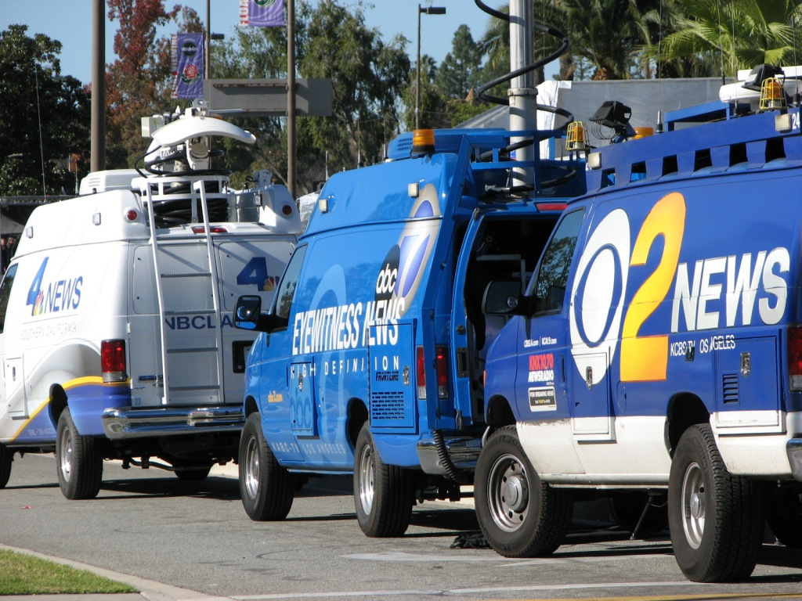

Slide 20
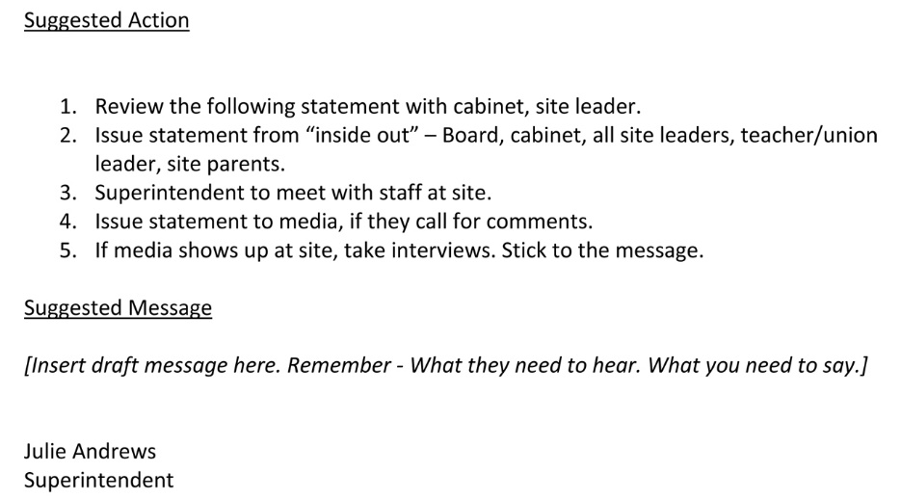

Holding Statement
Press Release

Slide 21

Interview Tips
Stick to the messages
Have two or three points that you want to make
Acknowledge question and pivot to message
Question is opportunity to make your point
Repeat, until the interview concludes
Audience – not reporters, your school community
Calm, confident, empathic leadership
Pause
Do not speculate
Do not answer for others
Practice
Body language is over 80% of what people hear
Look at reporter, not camera, minimize blinking

Slide 22
C
A
S
E
S
T
U
D
Y
Issue / Incident
Middle School Students “Popping Pills”
Students reported to school health office
Emergency services called
Parents contacted
Students/friends, said they took medications before school
Media on campus, social media is ablaze
  Consider: Message, Messenger, Mode
  Consider: Where do people take their questions?

Slide 23
Pill Popping Message
This morning, we received word that six students reported to the health office indicating they felt nauseated and weak, and they informed the school nurse they had taken “pills” before they came to school, and I want to thank our school nurse for taking immediate action to call emergency services. All students have been safely transported to X hospital, and their parents have been notified. We are in contact with the hospital, but do not yet have details on their condition. At this time, we are outlining a plan to discuss will all students the importance of healthy choices. I will hope to report to you soon that all students are doing well. For now, please join me in respecting their privacy and focusing on stressing to all children the important message that they should never take medication that is not prescribed to them or given to them by anyone other than their parent or a health professional.
Tips:
If you know the number of students say it.
If those impacted have been notified, say so.
Signal that you want to refrain from rumors and discussion.

Slide 24

C
A
S
E
S
T
U
D
Y
Issue / Incident
Textbook Adoption
Staff recommends Mommy, Mama, and Me
Teachers have reviewed book
and approve its adoption
The Board President objects
LGBTQ supports the text
Media is asking why staff is
recommending this resource
  Consider: Message, Messenger, Mode
  Consider: Where do people take their questions?

Slide 25
When to Hold a Press Conference
You own the story
Volume of inquiries
Prepared statement
Tape press conference
Trusted resource on-site (in the back)
Trusted translator
One-on-one interviews
Capture media names
Inform your Board members

Slide 26
Managing Interview Requests
What’s the story?
Request questions in advance
Interview or issue statement
Respond, deliver your message
Offer to fact check/do not ask to review
Media shows up unannounced
Media at event

Slide 27
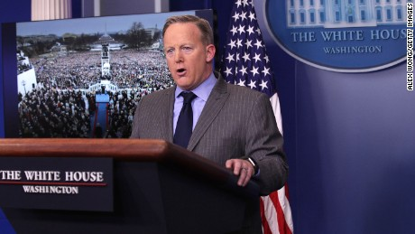
Who’s Ready to Take the Heat?

