Slide 1



Institute for Executive Leadership in Education
Marketing & Media
Module 4
Ann Bonitatibus
Superintendent, Conejo Valley USD
Terilyn Finders
Director of Communications, F3

Slide 2

Effective Communication:
From Purpose and Process to Publicity and Media Relations

Slide 3
Role of Communications in a Healthy Organization
Strong leadership
Clarity of purpose
Connecting people to the mission
Trust
Rumors

Slide 4

Do you think of communication
as a goal or a tool?

Slide 5

“There is no question that communication is one of the least developed skills of executives, professionals and managers, yet it is one of the most powerful leadership tools.”
Jack Welch
General Electric Company

Slide 6
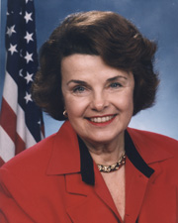
“Ninety percent of leadership is the ability to communicate something people want.”
Dianne Feinstein
United States Senator (CA)

Slide 7
Why is communication a powerful leadership tool?
Describe a great communicator

Slide 8
Communication Skills - Forbes
Excellent Public Speaking
Ability to Command a Room
Assertiveness
Emotional Intelligence
Sense of Humor
Good Posture and Body Language

Slide 9
Communications
Proactive Communication
  Day-to-Day
  Engagement/Support
  Publicity
  Social Media
Situation
  Issues
  Incidents
Media
  Ongoing
  Situations
  Interviews
Crisis
  Planning

Slide 10

Building a Communications Plan
Clarify Objective

Slide 11
Proactive/Publicity
Target Audience(s)
Objective
Messenger(s)
Mode
Action plan

Slide 12
Communications Plan
Situation analysis
  Changes or support required/desired and from whom
Target audiences
  Who will support
  Who will oppose
“Circles”
  Timing
Listening/refining message

Slide 13
Yes, MA’AMM
Message All Audiences Messenger Mode
Message
  Connect
  Clarify
  Accountability
  List difficult questions/ incorporate “frontload”
All Audiences
Messenger
  Who will deliver to whom
Mode
  How it will be delivered

Slide 14

A massage, MA’AMM?

Slide 15
Well, MA’AMM?
Think of an initiative you are currently working on that has systemic impact
What is the message?
List all possible audiences
Who will deliver the message to each audience?
What will the mode be for each audience?

Slide 16

A Question, Waiting to be Answered

Slide 17
Think & Act In Concentric Circles
Choose words/tone from the outside in.
Community & Media
Parents & Students
  1) Site Administrators & Union Leadership
  2) Staff
Empathy
Humility
Accessible
Confident
Cabinet
Superintendent &
Board

Slide 18
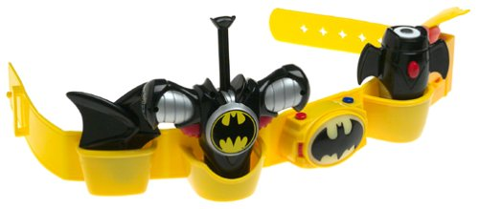
Your Super Hero Tool Belt
Which communications platforms/modes are readily available to you now?
What turf do you own?
What is available that you do not currently use? Why?

Slide 19


Social Media 101
Start simple
Focus on one of the most common apps
  Twitter
  Facebook
  Instagram
  LinkedIn
Learn from an experienced user
Maintain a professional voice

Slide 20
Share the Good Stuff!
Rule of Thirds:
School news and events
Ideas and facts
Human interest and inspiration

Slide 21
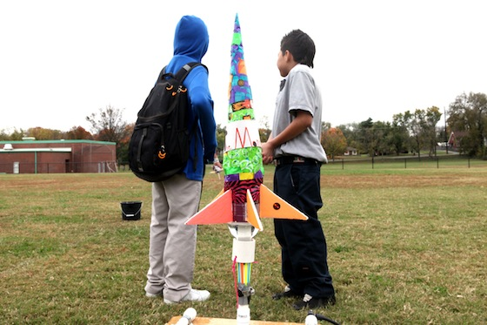

School News and Events
Wondering what STEM looks like? Fifth grade blasts off with hands-on learning.
Thanks to voters for supporting Prop. C! Coming soon – new classrooms, science lab update, improved fencing.

Slide 22

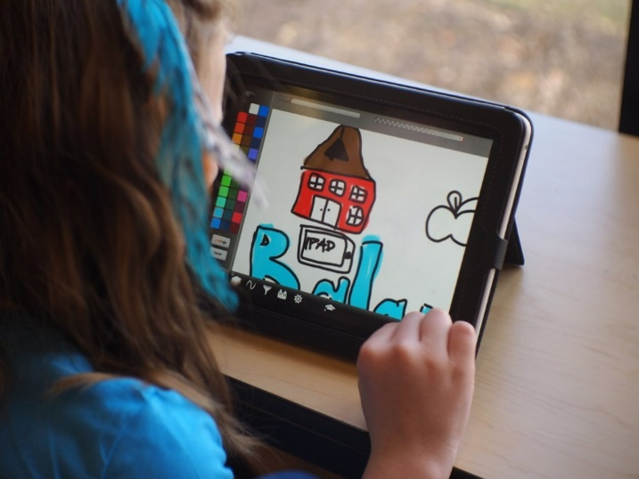
Ideas and Facts
First day of school in Lakeside! 27 new teachers in our district – welcome aboard!
Technology by the numbers: 7469=current number of computers, Chromebooks and iPads for students in our district.

Slide 23
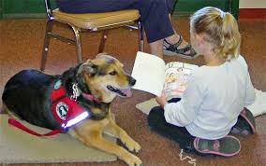
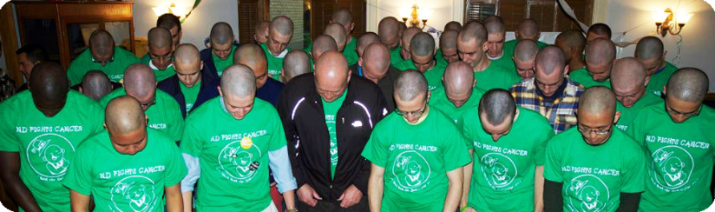
Human Interest and Inspiration
Got an hour? Learn to code. Today’s kids, preparing for tomorrow’s jobs. #HourofCode
Paws to Read pups visit Einstein Elementary.
Kennedy High soccer team shaves their heads to support teammate fighting cancer.

Slide 24
Ask for Stuff!
Pull In verses Push Out
Question of the week
Survey
Does anyone have…?

Slide 25
If You Can’t Say Something Nice…
“Supt. Jones is ugly and smells funny.”
  Ignore
“Traffic is a mess every day at Polk Elementary. Someone should fix that.”
  Invite them to share thoughts with principal
“Our old district had a whole week off for Thanksgiving. Why don’t they do that here?”
  Direct them to the Calendar Committee

Slide 26
Situations
Issues / Incidents

Slide 27
Communications Plan
Situation analysis
  Changes or support required/desired and from whom
Target audiences
  Who will support
  Who will oppose
“Circles”
  Timing
Listening/refining message

Slide 28

Message Development
What they need to hear
What you need to say
Anticipate the most difficult questions
Speak to a parent

Slide 29
Think & Act In Concentric Circles
Choose words/tone from the outside in.
Community & Media
Parents & Students
  1) Site Administrators & Union Leadership
  2) Staff
Empathy
Humility
Accessible
Confident
Cabinet
Superintendent &
Board

Slide 30
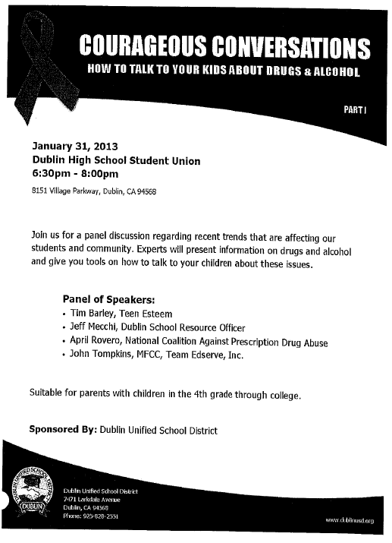

Slide 31
Communication Protocols
Internal / External
Establish a protocol for notifying people when incidents occur
Use ongoing communication modes to clarify the process
“Situation Updates”
Concentric Circles

Slide 32
Ready to Commit Murder?
Kill that Rumor!
Think of a rumor related to work you have led and communicated
Do you know why the rumor started?
How long did it last?
Can rumors be avoided?
Read the article. What resonates for you?

Slide 33
C
A
S
E
S
T
U
D
Y
Issue / Incident
Suspicious Van
Situation:
  Suspicious car/driver traveling near school site
  Reported by parent to principal
  Principal notifies law enforcement and issues message to staff and parents
Message
Dissemination

Slide 34
Message Development
Connect, clarify and accountability
Short
Uncomplicated, everyday language
  (no edu-speak)
See the bigger picture/trends
Do not repeat words you don’t want to hear/read
Every sentence can stand alone

Slide 35
Internal
Situation Update – “inside out”
Provide statement for staff use
Discourage e-chatter
Direct all questions/concerns to…
Empathy – support their colleagues
When appropriate, provide updates and close the loop after the incident

Slide 36
C
A
S
E
S
T
U
D
Y
Issue / Incident
Facts
Primary grade student walking to school with group of children
Hit near school by an automobile that fled the scene
Child died at the hospital
Have not yet heard from the media
City/district “disputing” funding for crossing guards

Slide 37
Tough Questions

Slide 38
Student Killed, Hit and Run
With profound sadness, I must inform our community a (school name) student was the tragic victim of a hit and run while walking to school this morning. The child, whose name is being withheld from district statements based on the family’s request for privacy, was transported by emergency services to X Hospital. His family was by his side when he passed away.
This tragedy took place at (location) at approximately (time). At this time, local law enforcement is aggressively searching for the driver of (car), and anyone with information that may help the investigation is urged to contact.
District counselors and support staff are on campus to provide additional … I will provide our school community with information on immediate steps that we will be taking to examine pedestrian safety. At this time, I ask everyone to join me in respecting the family’s privacy.

Slide 39


Slide 40
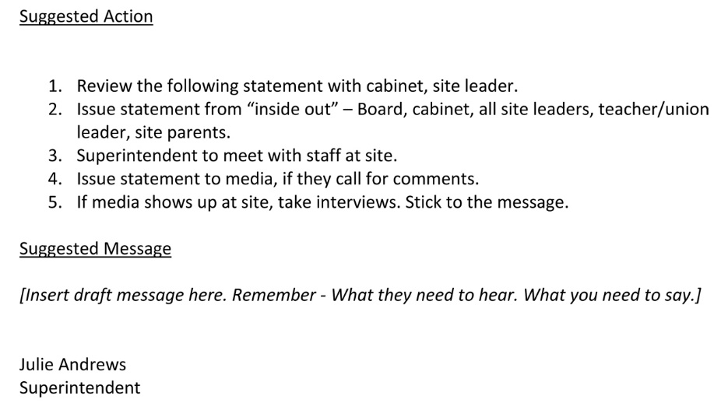

Holding Statement
Press Release

Slide 41

Interview Tips
Stick to the messages
Have two or three points that you want to make
Acknowledge question and pivot to message
Question is opportunity to make your point
Repeat, until the interview concludes
Audience – not reporters, your school community
Calm, confident, empathic leadership
Pause
Do not speculate
Do not answer for others
Practice
Body language is over 80% of what people hear
Look at reporter, not camera, minimize blinking

Slide 42
C
A
S
E
S
T
U
D
Y
Middle School Students “Popping Pills”
Students reported to school health office
Emergency services called
Parents contacted
Students/friends, said they took medications before school
Media on campus, social media is ablaze
  Consider: Message, Messenger, Mode
  Consider: Where do people take their questions?

Slide 43
Pill Popping Message
This morning, we received word that six students reported to the health office indicating they felt nauseated and weak, and they informed the school nurse they had taken “pills” before they came to school, and I want to thank our school nurse for taking immediate action to call emergency services. All students have been safely transported to X hospital, and their parents have been notified. We are in contact with the hospital, but do not yet have details on their condition. At this time, we are outlining a plan to discuss will all students the importance of healthy choices. I will hope to report to you soon that all students are doing well. For now, please join me in respecting their privacy and focusing on stressing to all children the important message that they should never take medication that is not prescribed to them or given to them by anyone other than their parent or a health professional.
Tips:
If you know the number of students say it.
If those impacted have been notified, say so.
Signal that you want to refrain from rumors and discussion.

Slide 44
When to Hold a Press Conference
You own the story
Volume of inquiries
Prepared statement
Tape press conference
Trusted resource on-site (in the back)
Trusted translator
One-on-one interviews
Capture media names
Inform your Board members

Slide 45
Managing Interview Requests
What’s the story?
Request questions in advance
Interview or issue statement
Respond, deliver your message
Offer to fact check/do not ask to review
Media shows up unannounced
Media at event

Slide 46
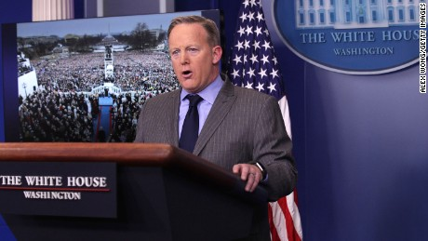
Who’s Ready to Take the Heat?

