Slide 1
Interfaith Colloquium
19th August 2015

Slide 2
Why do we use “interfaith”?
Interfaith
signifies our commitment to common life—
a civic purpose of sharing space and goals
in which all values contributing toward this purpose are welcomed and respected

Slide 3
GOAL: to foster more inclusive campus community by working across all lines of religious difference

Slide 4
Learning to be together
VOICE
ENGAGE
ACT

Slide 5
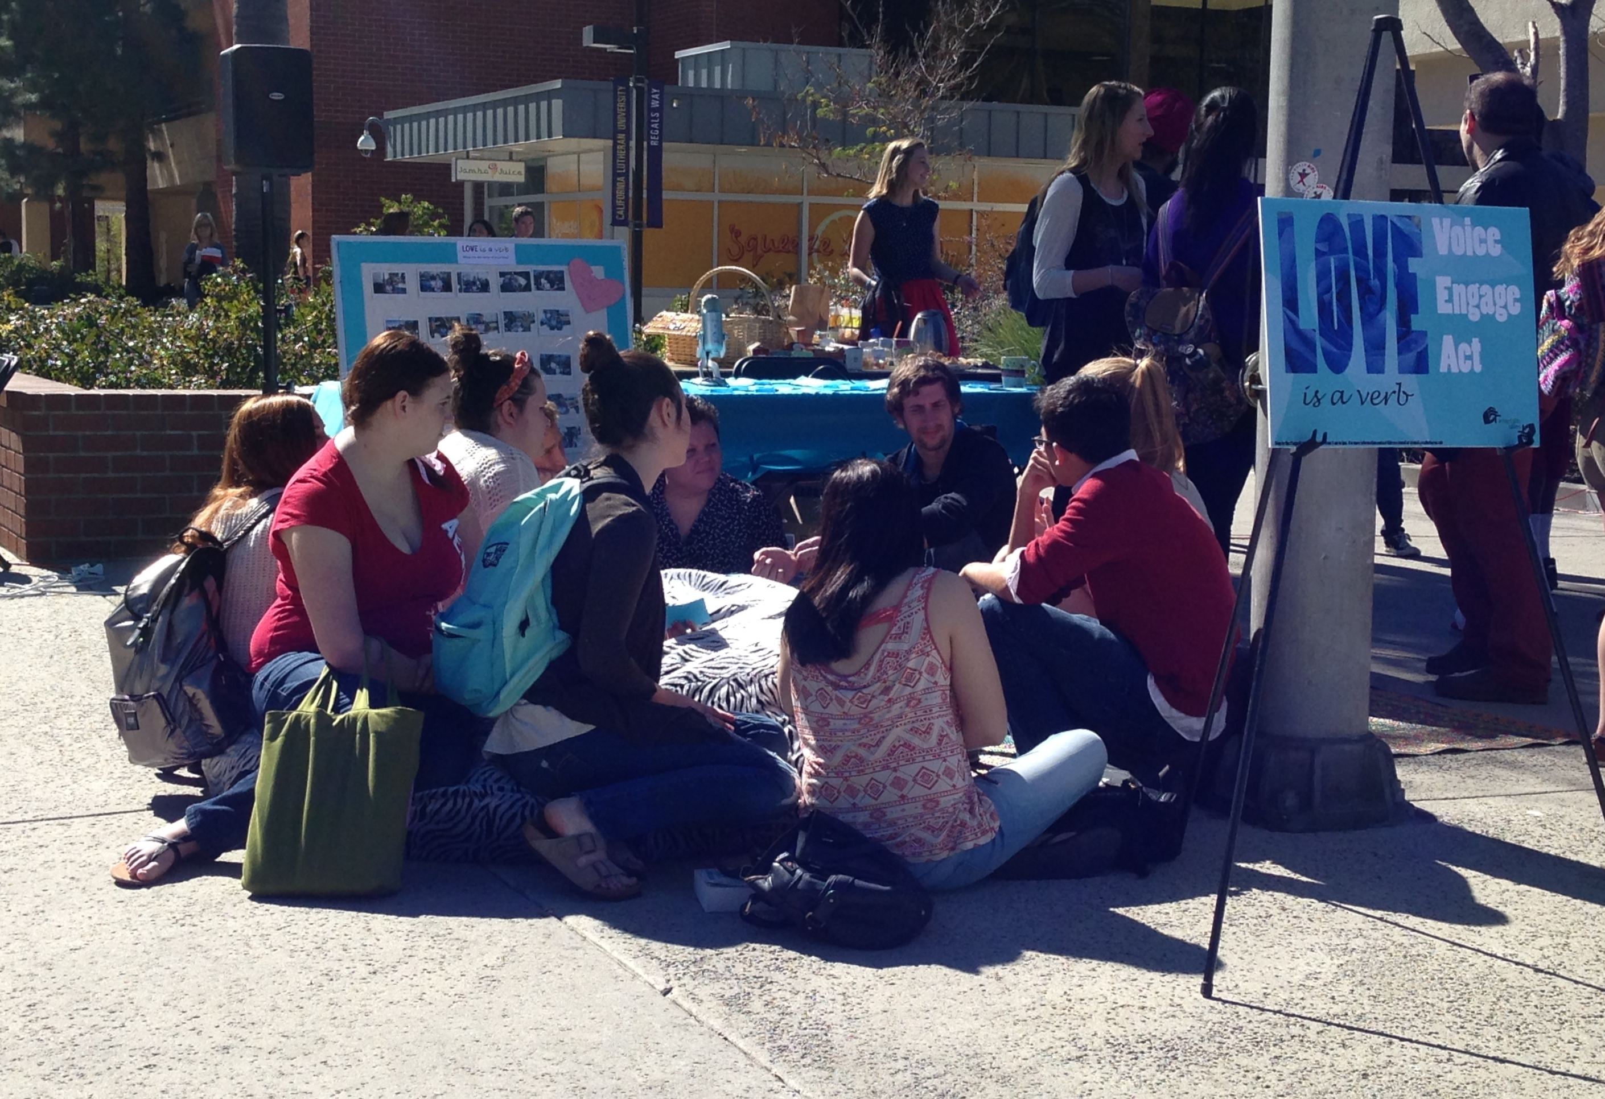
Alternative Tabling

Slide 6
LUNCH: engaged pluralism
My own definition of pluralism has three parts:
respect for different identities,
positive relationships between
diverse communities,
and a collective commitment
to the common good.
--Eboo Patel

Slide 7
Interfaith at Cal Lutheran
began as response to student needs
  Campus Rabbi
  Training by InterFaith Youth Core
Fall 2012: campus movement
Interfaith Allies
• Fall 2015: broaden & deepen our commitment
job descriptions, campus strategist, Mission & Identity

Slide 8
Lutheran and Interfaith
https://www.augustana.edu/Documents/Intersections/Intersections_fall_2014.pdf

Slide 9
“Why Interfaith Understanding is Integral to the Lutheran Tradition,” Jason A. Mahn
educate whole persons
respond to the deep needs of the world
recognize God in others
work together for the common good
tell the truth about painful realities/confess sin

Slide 10
Common Conversation

Slide 11
Diana Eck http://www.pluralism.org/encounter/challenges
Diversity is a fact
Pluralism is a norm or value of engagement

Slide 12
Going Deeper: Truth and Behavior

Slide 13
Responses to diversity (truth claims)
Exclusivism—only one belief is true
Inclusivism—one belief is true but other
beliefs may resemble the one truth
Universalism—all traditions are the same truth
Syncretism—truth is assembled from many beliefs; Subjectivism—belief is hyper-personal
Pluralism—more than one truth is possible

Slide 14
Behavioral patterns
Confrontation
Isolation
Assimilation
Transformation

Slide 15
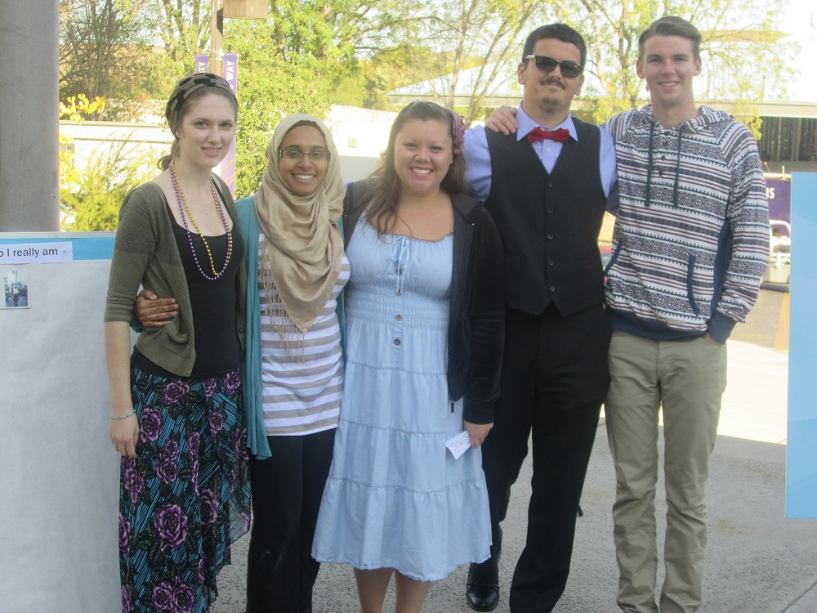
Connecting the Core Team

Slide 16
What is pluralism, according to Eck?
1- active engagement with diversity
2- knowledge of differences
3- real & different religious commitments
4- based on 1st Amendment “ground rules”
5- constructive dialogue at “tables”

Slide 17
a few more terms
appreciative knowledge
attitudes • knowledge • relationships
solidarity/engagement/cooperation

Slide 18
“we named the stages of transformation we see on our campus moving from curiosity to empathy, then to civic engagement, and finally to vulnerability. In other words, students are often ready to act before they are ready to do the deep learning that exposes their beliefs to others and makes understanding possible.”

Slide 19
Grant Activity

Slide 20
Grant Proposal
content & character => community
(academic pursuit & personal practice in relation to truth)
developing & sustaining relationships across difference
personal reflection on the purpose of education
experiential learning
“lead with global awareness in local settings”

Slide 21
the work involves
✓critical analysis
✓personal, interpersonal, collective, and institutional reflexivity
✓leadership development
✓assessment of power dynamics
✓strategies for communicating the need and promise of interfaith engagement

Slide 22
Pedagogy: Practices & Principles
prioritize analysis, communication, self-reflection
demonstrate methods of study and evaluation of sources

Slide 23
1st Amendment
Congress shall make no law respecting an establishment of religion, or prohibiting the free exercise thereof;
or abridging the freedom of speech, or of the press; or the right of the people peaceably to assemble, and to petition the Government for a redress of grievances.

Slide 24
How is this freedom lived out?
Public Square

Slide 25
Orienting aims
Speaking and Writing in Public
Three kinds of literacy
Content- about religious people and interfaith cooperation
Relational- personal skills to engage difference and speak one’s own view
Procedural- knowledge of how to ask questions and evaluate sources

Slide 26
Classroom Community
situating personal experience
defining terms for common conversation
distinguishing between truth claims and behavioral patterns

Slide 27
Case study
http://www.pluralism.org/casestudy
What is the civic purpose or public need?
How can this be framed by 1st Amendment?
How do truth claims and behavioral patterns play out?
Is it possible to reconcile religious freedom and religious diversity?

Slide 28
Models for Interfaith in REL 100
STAND ALONE CLASS SESSIONS
Diana Eck’s “From Diversity to Pluralism” with contemporary examples from media
CTT, Ch. 26: “Christianity and Interreligious Dialogue” paired with primary sources on interfaith dialogue/cooperation
Media analysis (see Rose Aslan’s assignment)
Use Truth/Behavior distinction to analyze case studies, speeches or events

Slide 29
Models for Interfaith in REL 100
ACTS OF FAITH
excerpt to discuss civic goal or launch spiritual autobiography
weekly basis as “review”
unit that explores multiple dimensions in 2-3 weeks

Slide 30
Assessment

Slide 31
What can be examined for letter grades?
Textual argument and analysis—
e.g., Eck’s distinction between diversity/pluralism; Acts of Faith; primary documents of interfaith dialogue
Responses to religious diversity
Behavioral patterns
Media analysis

Slide 32
Rubric for Self-Development
http://www.ifyc.org/sites/default/files/u4/PluralismWorldviewEngagementRubric2.pdf

