Slide 1
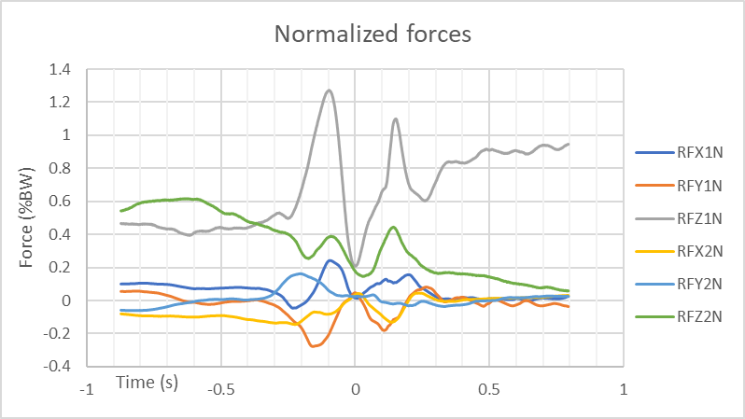
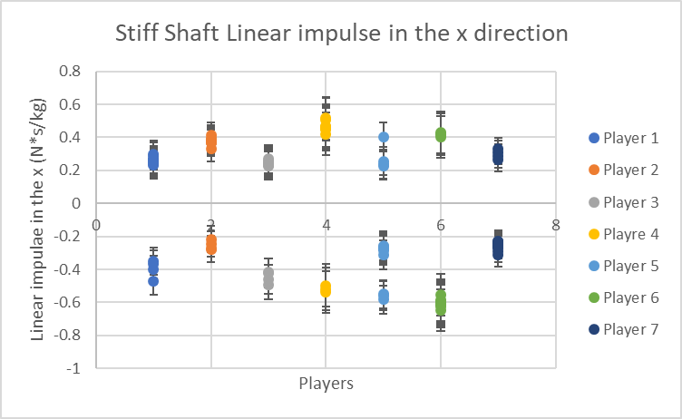
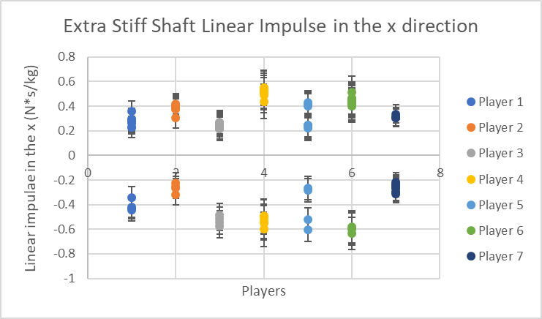
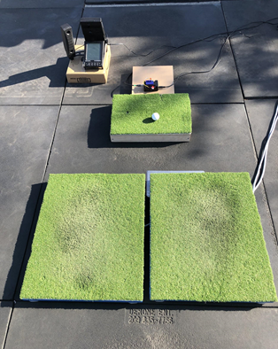
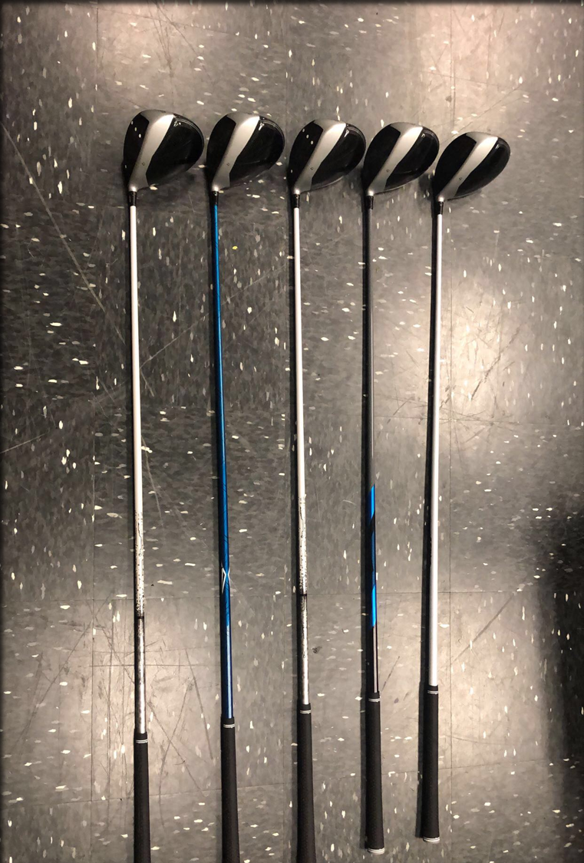
Golf Shaft Stiffness Affects Reaction Force Generation
Luke VanKeersbilck; Travis Peterson, PhD
California Lutheran University
Introduction
Results
To complete a golf swing, players need to regulate reaction forces to stay balanced (Egret et al. 2003).
Reaction forces can be changed when modifying shot distance with the same club (Peterson; McNitt-Gray, 2016).
Players have a choice in their equipment and can choose from shafts of varying overall stiffness, weight, butt flex, tip flex and many other characteristics
Players do not respond predictably to changes in shaft mass (Haeufle et al., 2012)
Players often can not tell the difference between shafts of differing stiffness (Milne & Davis, 1992).
Studies looking at the effect of shaft stiffness on golf head speed found that there was not a large affect on the club head speed only the clubhead angle (Mackenzie, 2009).
It is important to understand how a player’s equipment can change the way a player completes the golf swing
This study aims to determine if golf club shaft properties influence player kinetics during a golf swing.
We hypothesized golf shaft stiffness will influence reaction force generation.
Target leg mediolateral (ML) linear impulse was amplified away from the target with the extra stiff shaft (0.357 ± 0.096 N*s/kg) compared to the stiff shaft (0.340 ± .083 N*s/kg, p = 0.041) (Figures 3&4)
Rear leg ML linear impulse was amplified toward the target with the extra stiff shaft (0.436 ± 0.142 N*s/kg) compared to the stiff shaft (0.405 ± 0.132 N*s/kg, p = 0.070)
No change in net ML linear impulse with the extra stiff shaft (p = 0.46)
No change in the impulse in the vertical (target leg p=0.324, rear leg p=0.117) or anterior posterior direction (target leg p=0.261, rear leg p=0.268)
No change in target leg x force (p=0.992) but a significant difference in the rear leg force in the x direction (p=0.042)
No change in the total time of the period of interest (p= 0.891)
Figure 5. Example of normalized reaction forces. The dotted lines represent the start and stop of the period of interest. RFX1 represents the reaction force in the x direction for the target leg
Discussion
Target Leg
The results for the linear impulses were consistent with previous studies in magnitude and direction (Peterson, 2016)
The linear impulse in the target leg mediolateral direction increased when using the extra stiff club but it is unclear where this difference came from
There was only a statistically significant increase in force for the rear leg in the mediolateral direction
Although there was no statistical significance in the time of the period of interest, we did see an increase in time when using the extra stiff club for five out of the seven participants.
There may be a change in both the time and the force, but our sample size may have been to small to detect them
Methods and Materials
Highly skilled NCAA Division III right-handed men’s and women’s golf players (3 male, 4 female (21.57± 3.51 years, 6 ± 0.632 handicap, 174.37±6.93 cm, 80.95 ±17.5 kg)
Players performed 10 golf shots toward a target downrange with drivers of different shaft overall stiffness (S vs XS). (Figure 2)
Players stood with each foot supported by a force plate (Figure 1)
The period of interest was defined as the time when the player’s target leg reaction force becomes posterior until ball contact (Figure 5). This period coincides with the down swing.
Linear impulse was calculated as the area under the force–time curves during the interval of interest and was normalized by body mass.
Differences between conditions were determined by a dependent t-test (α = .05).
Rear Leg
Figure 3. Linear Impulse in the mediolateral (x) direction for the stiff shaft
Conclusions
These results suggest that increases in shaft stiffness may affect the way a player produces force
Players may unintentionally adjust force generation strategies as a result of a stiffer shaft
This force regulation may appear in one or both legs which could result in a change in their shot outcome
Tailoring the club characteristics based on a player’s force generation could help increase performance
Players used individual specific linear impulse strategies which reinforces the need to balance the equipment choices with the force generation demands placed on the player
Target Leg
Figure 2. Golf clubs of varying shaft properties used in our study
+Y
+X
Rear Leg
Acknowledgments
Figure 1. Force Plate setup with reference system
Figure 4. Linear Impulse in the mediolateral (x) direction for the extra stiff shaft, the value for the target leg are higher than Figure 2
Thank you to the ALLIES in STEM for funding this research and the Office of Undergraduate Research for all their support.
Contact
Luke VanKeersbilck
California Lutheran University
Email: lvankeersbilck@callutheran.edu
References
Egret, Claire & Vincent, O & Weber, J & Dujardin, F & Didier, Chollet. (2003). Analysis of 3D Kinematics Concerning Three Different Clubs in Golf Swing. International journal of sports medicine. 24. 465-70. 10.1055/s-2003-41175.
Haeufle, D.F.B., Worobets, J., Wright, I. et al. Golfers do not respond to changes in shaft mass properties in a mechanically predictable way. Sports Eng 15, 215–220 (2012). https://doi.org/10.1007/s12283-012-0104-9
Mackenzie, Sasho & Sprigings, Eric. (2009). Understanding the role of shaft stiffness in the golf swing. Sports Engineering. 12. 13-19. 10.1007/s12283-009-0028-1.
Milne, R. D., & Davis, J. P. (1992). The role of the shaft in the golf swing. Journal of Biomechanics, 25(9), 975–83.
Peterson, Travis & Wilcox, Rand & McNitt-Gray, Jill. (2016). Angular Impulse and Balance Regulation During the Golf Swing. Journal of Applied Biomechanics. 32. 10.1123/jab.2015-0131.

