Slide 1
Oxford 2023
Cal Lutheran England Program:

Slide 2
Presentation Overview
01.
Previous Oxford Program
04.
Oxford Curriculum
Oxford 2023
London Curriculum
02.
05.
Professor
Application Process
03.
06..

Slide 3
Program Structure
Program led by a selected faculty member from Cal Lutheran faculty who will direct a hybrid, semester-long course (4 units).
First half in Oxford with two tutorials provided by Oxford University Faculty, referred to as Dons (3 units each).
Second half in the bustling city of London, taking:
2 CIEE courses (in-person or virtual); or
1 CIEE course (in-person or virtual) and an internship.
(CIEE courses/internships 3 units each)
Total of 16 Cal Lutheran Credits

Slide 4
Fall 2023 Faculty Leader
Academic scholarship in Medieval Religious History and Gender & Sexuality
Expertise includes Medieval and Early Modern Britain
Past Huntington Fellow at Lincoln College, Oxford; and Scholar-in-Residence at Stonyhurst College, Lancashire
Dr. Peter Carlson
Associate Professor, Religion
They/Them/Their, He/Him/His

Slide 6
Oxford Tutorials
Tutorials are 1 Don to 1-3 students.
Dons do not lecture: Students research independently and present papers for review. For a 2 hour weekly tutorial, you can expect to spend twenty hours or more in preparation!
Preparation begins this spring, long before you arrive in Oxford.
Dates in Oxford: late August to late September 2023
Potential Tutorial Topics:
International Law and Human Rights
Master Class on Shakespeare
International Social Injustice
Governing the Global Economy
Philosophical Topics
Landscape, Place, and Nature
Neuroscience
All tutorials satisfy the Upper-Division Honors Seminar requirement for Honors students.

Slide 7
Dr. Carlson will lead a term-long course, and will also be on-site to help navigate academics and life at Oxford.
Oxford Course: Fall 2023
Mythology and Twentieth Century Myth-Makers: The Inklings (for U.D. Religion or Literature credit)
This course will study the role of myth in religion and society, and investigate the mythologies and mythological themes inherent in the writings of the Inklings, a famous literary discussion group that met in Oxford at the Eagle & Child Pub, from the late 1930s through the 1940s.
Literary and Religious themes will include: Hero Mythology; The Arthurian Legend; Race and Racism in European Myth; and Myth and Nature.

Slide 8
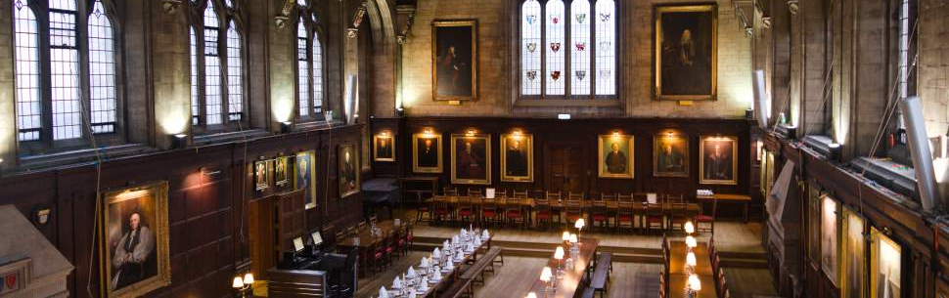
Life in Oxford
Reside in Balliol College
Breakfast and dinner in college hall included
Access to the Bodleian Library (the Bodleian).
Sample excursions include:
Stratford on Avon - Royal Shakespeare Company
Punting on the river
Ashmolean Museum
The Kilns (C. S. Lewis’ home)

Slide 9
London
CIEE Global Institute in London. Located in Russell Square – next to the British Museum!
On-site support by CIEE, local faculty teaching courses.
Time in London: late September to early November 2023
Remember: Dr Carlson’s course continues!
Option to take two courses or to participate in one course with linked internship.
Course offerings vary, but a range of courses are offered, including public health, management, international relations, literature, environmental science, and communications.
Courses are usually twice a week, Monday-Thursday. CIEE offers some optional excursions. The rest of your time is free to explore London!
Courses will be virtual or in-person, and you will join classmates from universities around the USA.

Slide 10
Life in London
Excursions included:
Two day trips
Two to three local excursions around London
London is a vibrant, international city with so much to do!
You will live in a modern residence hall with kitchenette
CIEE is in Russell Square - easily within reach of the Tube (the subway) and the British Museum!

Slide 11
Costs of Attendance
Students are responsible and manage costs related to travel, meals, books, and personal expenses. Below are estimates for consideration.
Meals in London are not included in program fee = $900-1,200
International Airfare = Approximately $1,300
Local Transportation = $200
Books & Supplies = $100
Personal expenses = $1,000-$2,500.
Costs vary depending on personal spending habits.
Cal Lutheran Tuition: All financial aid you receive is transferable (not including work study!)
Housing: Mogen Rate
Meal Plan: Combo 50 meal rate
Airfare: not included

Slide 12
Application
Open now on the OEA website
Application requires an essay question
Closes: November 1, 2022
November interviews conducted to select participants

Slide 13
Contact Us.
oea@callutheran.edu
pcarlson@callutheran.edu
805.493.3751
@cluabroad

Slide 14
Flexibility required...
This program is in the process of final arrangements. (COVID!)
Changes will likely take place over the next several weeks, and will be communicated to interested students.

