Slide 1


Presentation by Tammy L. Whitlow, TESOL Specialist

Slide 2

APA Format
In-text Citations

Slide 3
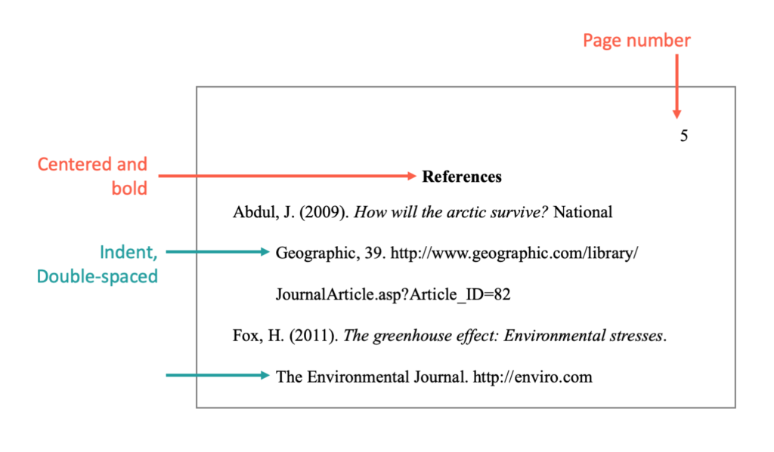
Last Workshop
APA Overview
What do you remember?
Paper format
Title page
Reference page
Notes:
Answer the question through chat

Slide 4
Goals
Understand the relationship between the reference page and in-text citations
Determine when and how to cite sources
Use resources to assist with citing sources

Slide 5
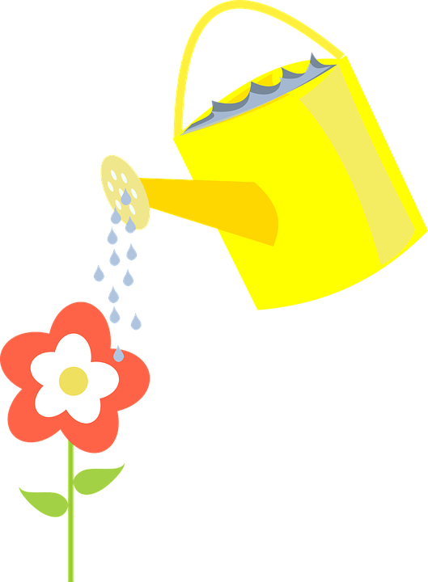
Imagine...
Notes:
Imagine you are the flower.
Look at the water. (each drop of water)
Each drop of water are all the researchers/authors, sources/different types of text you’ve read.
Each drop of water has helped you grow and understand your topic better(contributed to your understanding).
Thi is where in-text citations come in. You want to give credit or honor to those who’ve helped you grow in your knowledge of a topic.

Slide 6

What are in-text citations?
The acknowledgement of who contributed to your work/writing.
Shows who influenced your thinking.
Notes:
acknowledgement - mentioning someone’s contribution, to honor, to give credit, showing gratitude,appreciation
influenced - help shape, develop, and give you another perspective

Slide 7
Why are in-text citations important?
Meets publication requirements
Establishes credibility and shows you are a knowledgeable scholar
Helps to avoid plagiarism
Clearly displays your research
Allows the reader to follow your idea and identify your main point
Makes it easier for other scholars to read your work

Slide 8

When do I need to use in-text citations?
Information is not your own idea
Information is not common knowledge
https://libguides.eckerd.edu/c.php?g=731676&p=5226758
direct quoting, paraphrasing, or summarizing
Notes:
What is common knowledge? Depends on the audience. Common Knowledge is information that appears across many sources without clear origin or discipline specific knowledge that everyone in a specific field knows. For example….

Slide 9

So, where does it all begin?
References
Achterberg, J. (1985). Imagery in healing. Shambhala Publications. American Psychological Association. (2017). Stress in America: The state of our nation. https://www.apa.org/news/press/releases/stress/2017/state-nation.pdf
Baider, L., Uziely, B., & Kaplan De-Nour, A. (1994). Progressive muscle relaxation and guided imagery in cancer patients. General Hospital Psychiatry, 16(5), 340–347. https://doi.org/10.1016/0163-8343(94)90021-3
Ball, T. M., Shapiro, D. E., Monheim, C. J., & Weydert, J. A. (2003). A pilot study other use of guided imagery for the treatment of recurrent abdominal pain in children. Clinical Pediatrics, 42(6), 527–532. https://doi.org/10.1177/000992280304200607
Bernstein, D. A., & Borkovec, T. D. (1973). Progressive relaxation training: A manual for the helping professions. Research Press.
Bottomley, A. (1996). Group cognitive behavioural therapy interventions with cancer patients: A review of the literature. European Journal of Cancer Cure, 5(3), 143–146. https://doi.org/10.1111/j.1365-2354.1996.tb00225.x
Reference page!
Notes:
It all begins with the reference page; names of authors/organizational authors, year, and page numbers.

Slide 10
References
Achterberg, J. (1985). Imagery in healing. Shambhala Publications. American Psychological Association. (2017). Stress in America: The state of our nation. https://www.apa.org/news/press/releases/stress/2017/state-nation.pdf
Baider, L., Uziely, B., & Kaplan De-Nour, A. (1994). Progressive muscle relaxation and guided imagery in cancer patients. General Hospital Psychiatry, 16(5), 340–347. https://doi.org/10.1016/0163-8343(94)90021-3
Ball, T. M., Shapiro, D. E., Monheim, C. J., & Weydert, J. A. (2003). A pilot study other use of guided imagery for the treatment of recurrent abdominal pain in children. Clinical Pediatrics, 42(6), 527–532. https://doi.org/10.1177/000992280304200607
Bernstein, D. A., & Borkovec, T. D. (1973). Progressive relaxation training: A manual for the helping professions. Research Press
Bottomley, A. (1996). Group cognitive behavioural therapy interventions with cancer patients: A review of the literature. European Journal of Cancer Cure, 5(3), 143–146. https://doi.org/10.1111/j.1365-2354.1996.tb00225.x
What sources did you use?
Notes:
Titles of the sources used. Draw students attention to the highlighted areas of citations. Discuss as needed.

Slide 11

Parenthetical Citations
Use these citations when referencing sources at the end of a paraphrased or summarized statement.
(author, date)
Notes:
Base word or root word - parenthesis

Slide 12
Parenthetical Citation
Author and date format
Author’s name and date separated by a comma
In parentheses at end of sentence
…(Author, date).
Achterberg, J. (1985). Imagery in healing. Shambhala Publications.
American Psychological Association. (2017). Stress in America: The state of our nation. https://www.apa.org/news/press/releases/stress/2017/state-nation.pdf
Guided Imagery
Features of Guided Imagery
Guided imagery involves a person visualizing a mental image and engaging each sense (e.g., sight, smell, touch) in the process. Guided imagery was first examined in a psychological context in the 1960s, when the behavior theorist Joseph Wolpe helped pioneer the use of relaxation techniques such as aversive imagery, exposure, and imaginal flooding in behavior therapy (Achterberg, 1985; Utay & Miller, 2006). Patients learn to relax their bodies in the presence of stimuli that previously distressed them, to the point where further exposure to the stimuli no longer provokes a negative response (Achterberg, 1985).
Contemporary research supports the efficacy of guided imagery interventions for treating medical, psychiatric, and psychological disorders (Utay & Miller, 2006). Guided imagery is typically used to pursue treatment goals such as improved relaxation, sports achievement, and pain reduction. Guided imagery techniques are often paired with breathing techniques and other forms of relaxation, such as mindfulness (see Freebird Meditations, 2012). The evidence is sufficient to call guided imagery an effective, evidence-based treatment for a variety of stress-related psychological concerns (Utay & Miller, 2006).
purdueowl.com - student sample paper
Notes:
Parenthetical Citations - Author and date format; the author(s) name(s) separated by a comma and date in parenthesis at the end of a sentence.
Notice the circled exception. Explain why. The ideas/theories of two sources have been connected. Both sources must to be acknowledged. Done by separating with semicolon.

Slide 13

Narrative Citations
Use these citations when referencing sources within the text as part of a sentence.
Notes:
Olivia starts. 7th edition APA Manual. TALK ABOUT THE WORD “NARRATOR”

Slide 14
Narrative Citation
Author’s last/surname
year of publication in parenthesis
***signal word(s) or phrase
sometimes a comma
Yu, S. F. (2004). Effects of progressive muscle relaxation training on psychological and health-related quality of life outcomes in elderly patients with heart failure (Publication No. 3182156) [Doctoral dissertation, The Chinese University of Hong Kong]. ProQuest Dissertations and Theses Global.
Rausch, S. M., Gramling, S. E., & Auerbach, S. M. (2006). Effects of a single session of large-group meditation and progressive muscle relaxation training on stress reduction, reactivity, and recovery. International Journal of Stress Management, 13(3), 273–290. https://doi.org/10.1037/1072-5245.13.3.273
Yu (2004) examined the effects of multimodal progressive muscle relaxation on psychological distress in 121 elderly patients with heart failure. Participants were randomized into experimental and control groups. The experimental group received biweekly group sessions on progressive muscle relaxation, as well as tape-directed self-practice and a revision workshop. The control group received follow-up phone calls as a placebo. Results indicated that the experimental group exhibited significant improvement in reports of psychological distress compared with the control group. Although this study incorporated a multimodal form of progressive muscle relaxation, the experimental group met biweekly in a group format; thus, the results may be applicable to group psychotherapy. Progressive muscle relaxation has also been examined as a stress-reduction intervention with large groups, albeit not therapy groups. Rausch et al. (2006) exposed a group of 387 college students to 20 min of either meditation, progressive muscle relaxation, or waiting as a control condition. Students exposed to meditation and progressive muscle relaxation recovered more quickly from subsequent stressors than did students in the control condition
Notes:
SIGNAL WORDS/PHRASES (examined, exposed) are part of academic language. These are some of the words we can use when we’re about to paraphrase someone else’s words/ideas. Explain Non- parenthetical Citations - Authors last/surname separated by a comma followed by the year of publication in parenthesis.

Slide 15
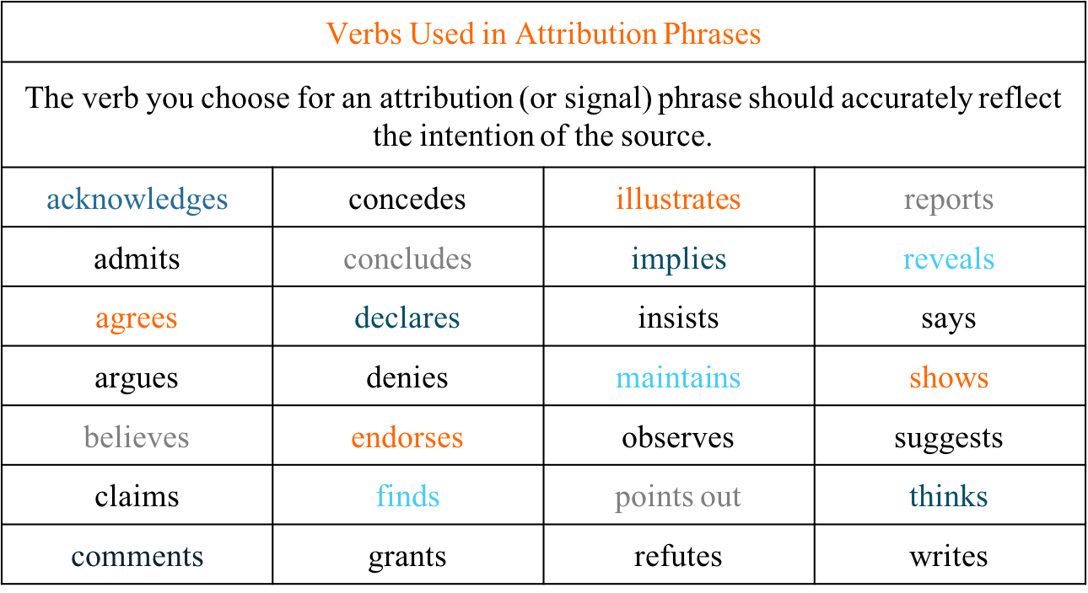
More
Verbs for Attribution Phrases...
Notes:
Be sure to have copies of this resource page for students.
Remind participants of some of the words and phrases we’ve seen throughout this presentation.
Explain meaning of attribution. Acknowledging something (in the case of academic writing - the words and ideas) belongs to someone else. These words assists in communicating this in writing.

Slide 16
More examples…
In-Text citations
  Paraphrase – rephrasing text from sources read in your own words
  Guided imagery exercises improve treatment outcomes and prognosis in group psychotherapy contexts (Skovholt & Thoen, 1987). Lange (1982) underscored two such benefits by showing (a) the role of the group psychotherapy leader in facilitating reflection on the guided imagery experience, including difficulties and stuck points, and (b) the benefits achieved by social comparison of guided imagery experiences between group members. Teaching techniques and reflecting on the group process are unique components of guided imagery received in a group context (Yalom & Leszcz, 2005).
  Summary – a broad synopsis/overview of the main ideas in a book, article, or other text
  Smith’s study (2011) argues for increased writing support for graduate students.
Notes:
Olivia: How is paraphrasing going for you? It’ll keep improving as you write more. Signal words and phrases. Inform students we will discuss direct quotes a little bit more on the next slide.

Slide 17
Two types of Direct Quotations
1. a few words/sentences within a sentence in quotations with citations. (less than 40 words)
2. block quotation - a direct quote containing more than 40 words with citations.
0.5’ from left margin
Double space entire block
Notes:
Tammy picks up.

Slide 18
Direct Quotes
Empirical research focused on guided imagery interventions supports the efficacy of the technique with a variety of populations within hospital settings, with positive outcomes for individuals diagnosed with depression, anxiety, and eating disorders (Utay & Miller, 2006). Guided imagery and relaxation techniques have even been found to “reduce distress and allow the immune system to function more effectively” (Trakhtenberg, 2008, p. 850). For example, Holden-Lund (1988) examined effects of a guided imagery intervention on surgical stress and wound healing in a group of 24 patients. Patients listened to guided imagery recordings and reported reduced state anxiety, lower cortisol levels following surgery, and less irritation in wound healing compared with a control group. Holden-Lund concluded that the guided imagery recordings contributed to improved surgical recovery. It would be interesting to see how the results might differ if guided imagery was practiced continually in a group context.
a few words/sentences within a sentence in quotations with citations. (less than 40 words)
Notes:
Bring participants attention to underlined signal phrases and signal words.

Slide 19
Direct Quotes
Progressive muscle relaxation has also been examined as a stress-reduction intervention with large groups, albeit not therapy groups. Rausch et al. (2006) exposed a group of 387 college students to 20 min of either meditation, progressive muscle relaxation, or waiting as a control condition. Students exposed to meditation and progressive muscle relaxation recovered more quickly from subsequent stressors than did students in the control condition. Rausch et al. (2006) concluded the following:
A mere 20 min of these group interventions was effective in reducing anxiety to normal levels. . . merely 10 min of the interventions allowed [the high-anxiety group] to recover from the stressor. Thus, brief interventions of meditation and progressive muscle relaxation may be effective for those with clinical levels of anxiety and for stress recovery when exposed to brief, transitory stressors. (p. 287)
block quotation - a direct quote containing more than 40 words with citations.
0.5’ from left margin
Double space entire block
Notes:
Academic Writer

Slide 20
Keep this close by when writing!
https://owl.purdue.edu/owl/research_and_citation/apa_style/apa_formatting_and_style_guide/in_text_citations_author_authors.html
Notes:
Olivia: Walk through the website. Explain that “et al.” means “and others”. Show how when writing with one or more authors how in-text citations should look. Scroll down to electronic sources

Slide 21

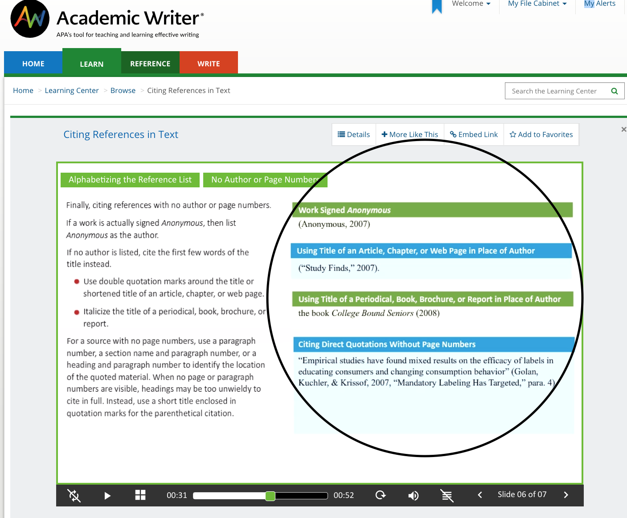
https://academicwriter-apa-org.ezproxy.callutheran.edu/learn/browse/QG-29
Notes:
Tammy: This link takes you to Academic Writer. Share with students how they can access it and how everything they need to know pertaining to APA is right at their fingertips (MyCLU homepage, next to the yellow WC tab). As the presenter, model how you might find what you’re looking for. It’ll be important for you to be prepared ahead of time.

Slide 22
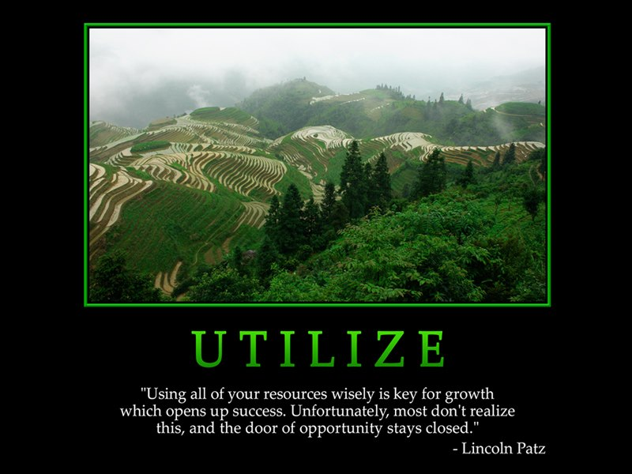
Academic Writer on the MyCLU homepage
purdueowl.org
apa.org
The Writing Center website resource pages

Slide 23

https://create.kahoot.it/plus/reports/result?gameOptions=0&hostId=cef26052-08c1-4f89-9af5-d2540623666e&kahootId=649c07af-29a1-402c-bbf3-ee4270ddccb3&startTime=1582758152098
Using your phone or device
Go to kahoot.it
Type in Tammy’s Game PIN
Notes:
Click the link on this slide.
You will be offered to purchase. Click “Thanks, maybe later.”
Click APA Overview and In-text Citations (twhitlow109).
**** In case it doesn’t let you in: Go to kahoot.com - username: twhitlow109, password: workshops2020

Slide 24

Do you have more questions?
Schedule an online appointment
The Writing Center!
Email me at
twhitlow@callutheran.edu

Slide 25
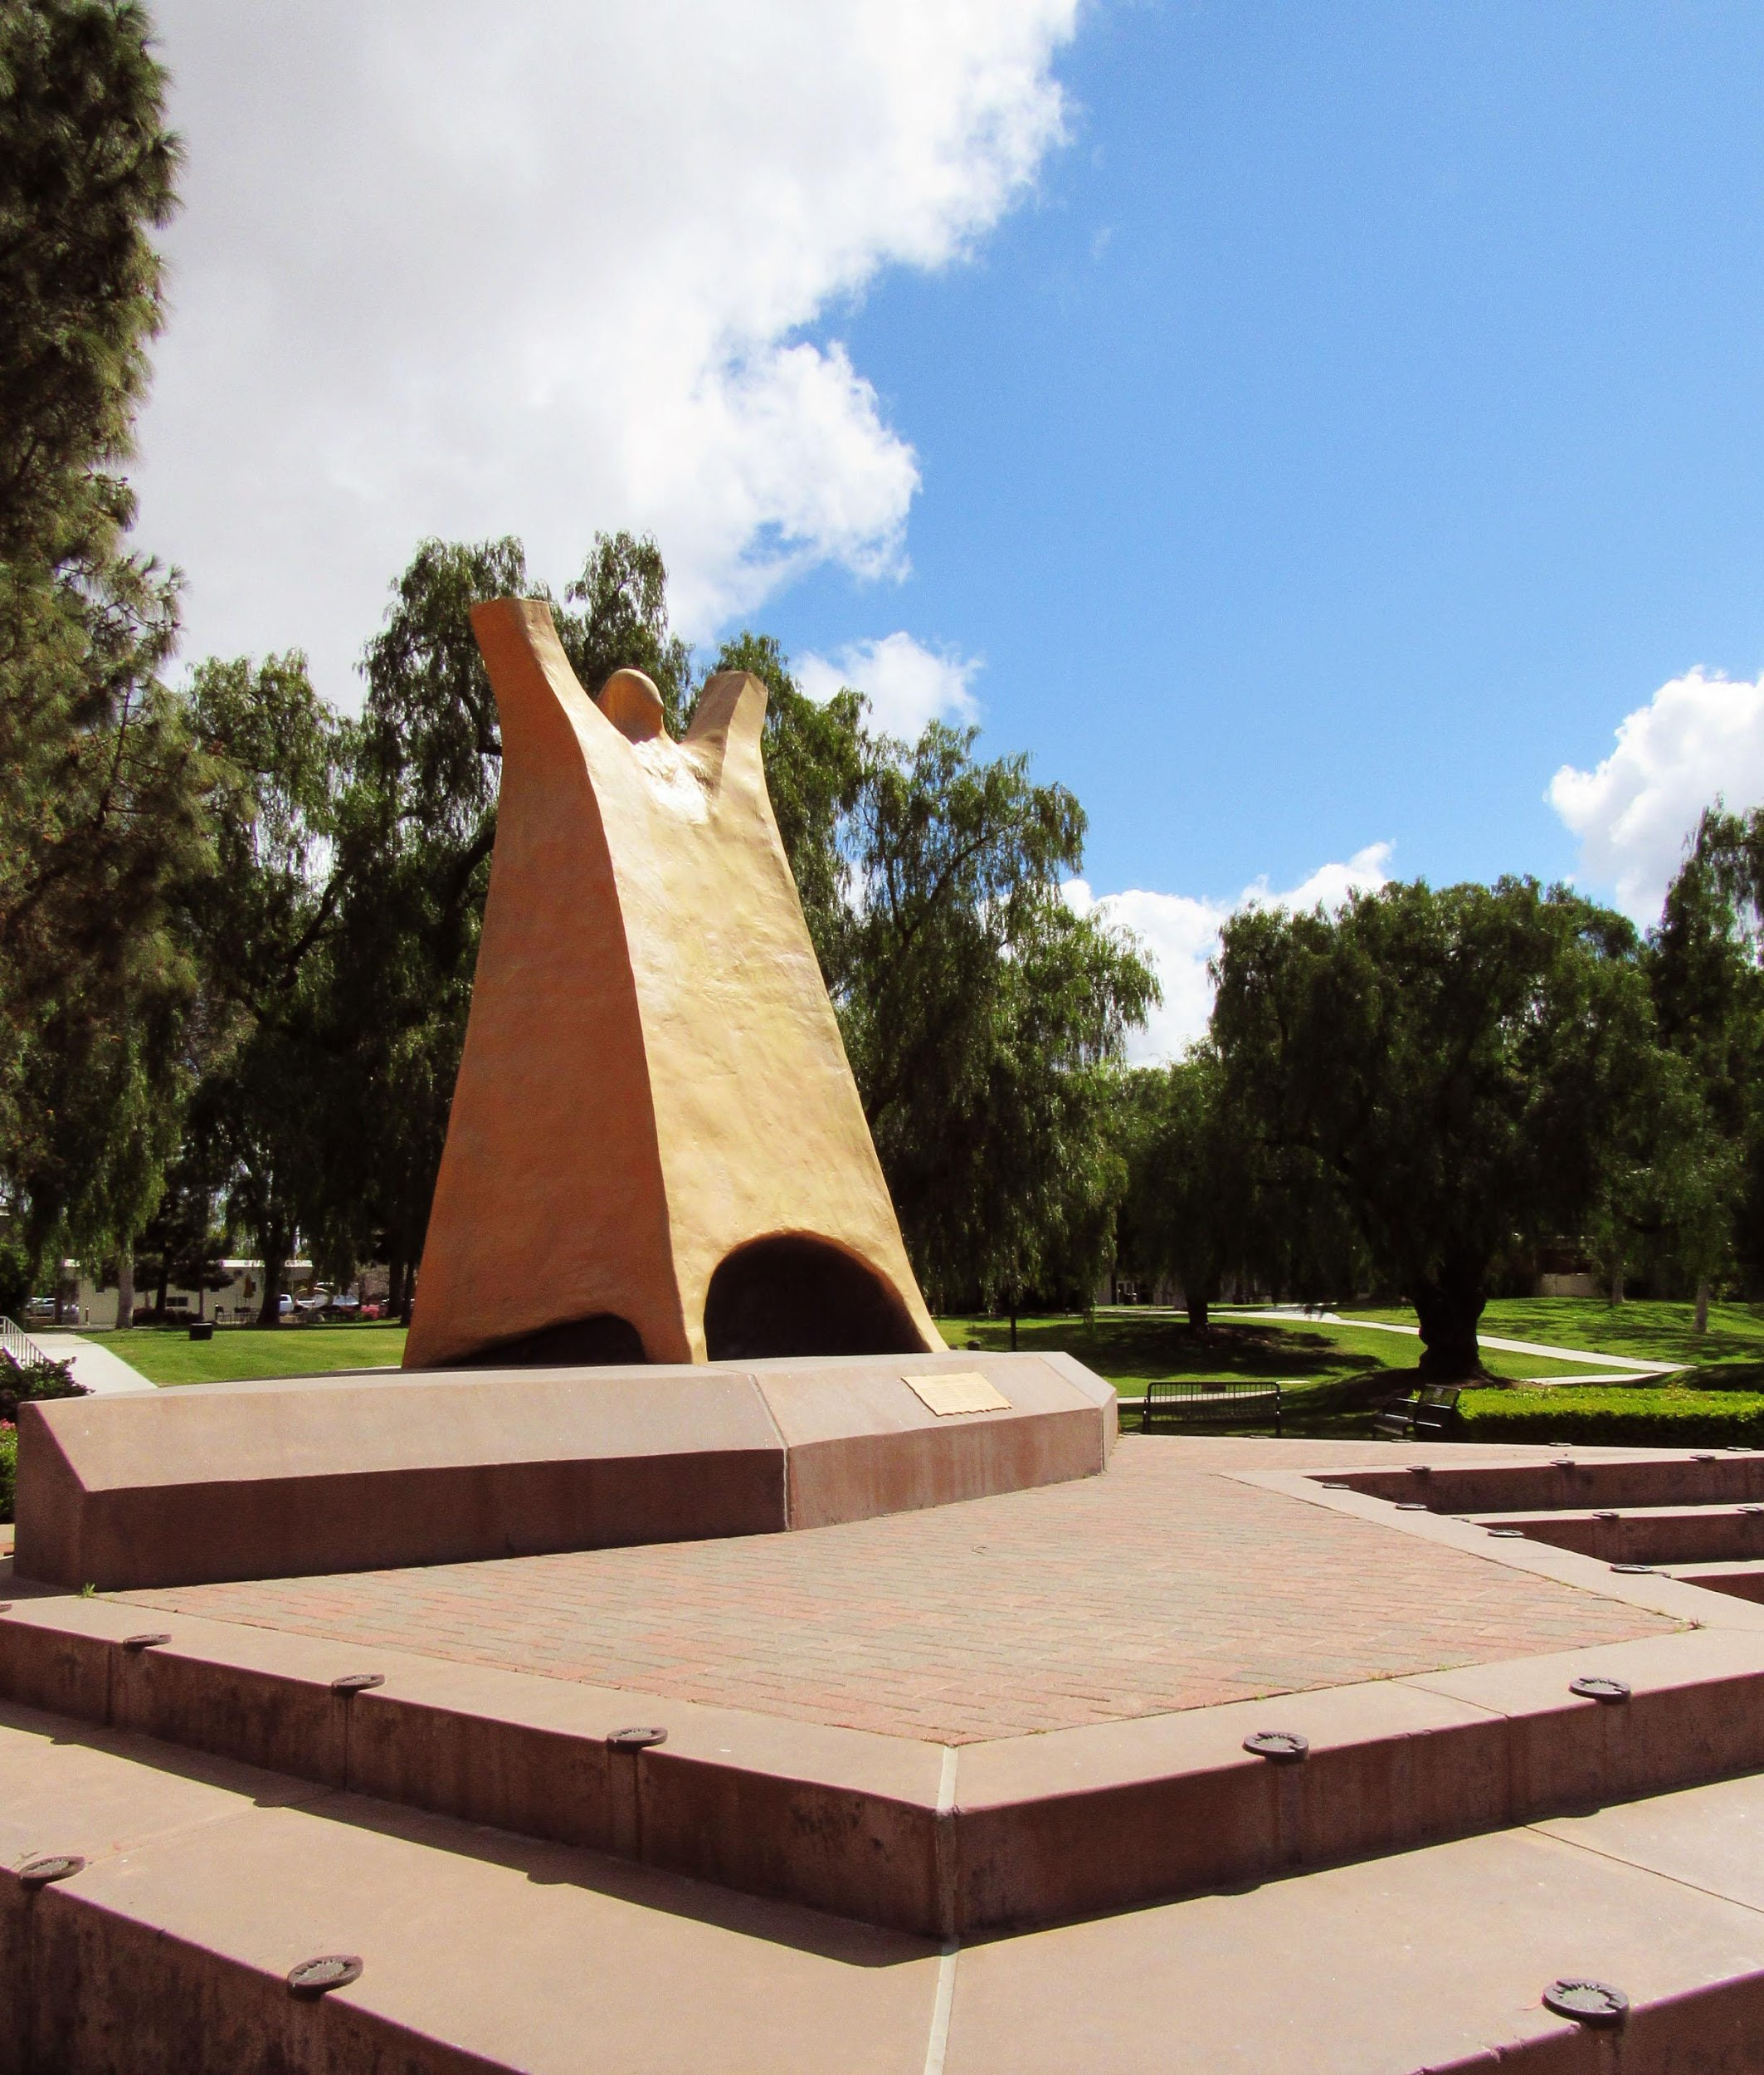
Thank you !

