Slide 1
Essay Structure
Presentation by
The Writing Center
Brenda Solis
Tammy Whitlow
Olivia Becker
Brianna Zaragoza
Notes:
Tammy. This workshop is a basic structure of how a essay may be written. Keep in mind your professor will provide you with specific instructions to follow.

Slide 2
Introduction
In the beginning….
To start your paper…
Notes:
Tammy.

Slide 3
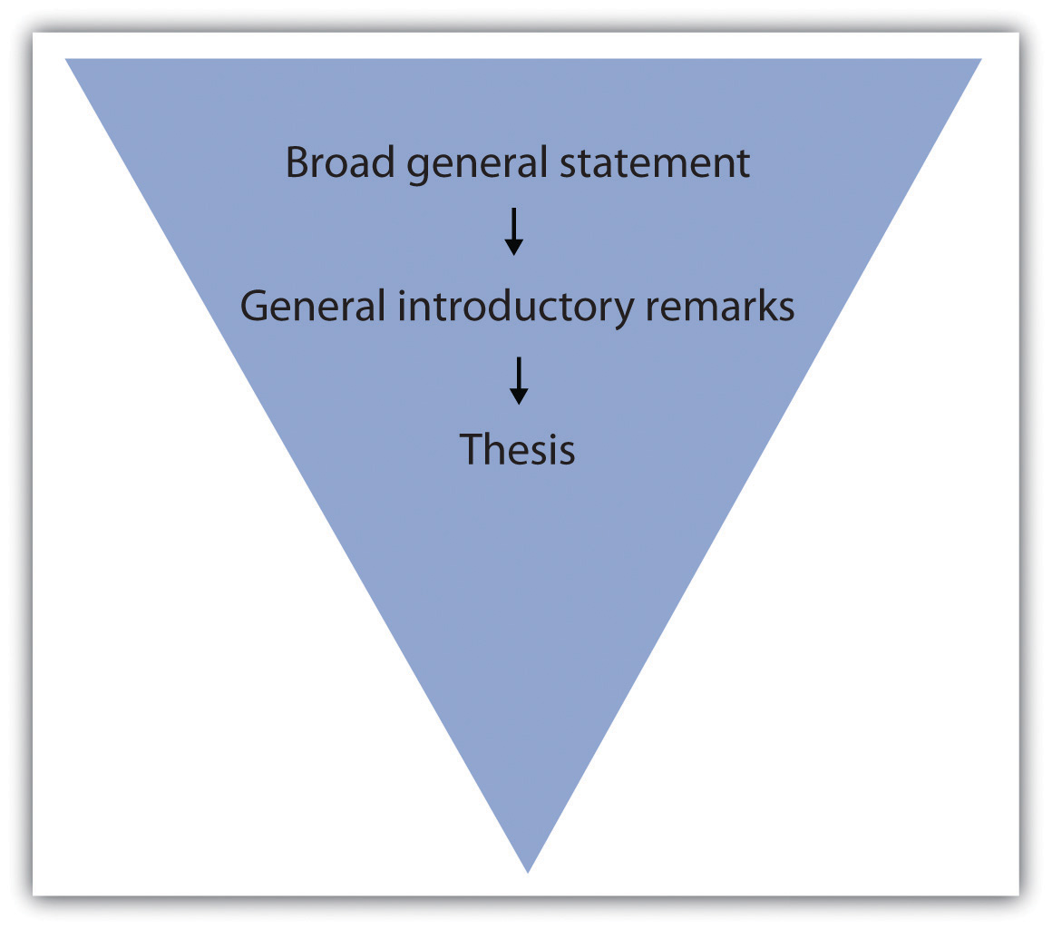
Introduction
Give background
tell a story
explain an example
Go from general to specific
Expose a problem
Take a stand on an issue
Notes:
Tammy. Broad general statement - speaking of something/topic as a whole
As you continue writing, notice the triangle become more narrow, indicating you must
If audience is business refer to how a problem might be exposed or researched - case studies SWOT (Strengths, Weaknesses, Opportunites, Threats)

Slide 4
Introduction
What is your topic?
Why is it important?
Capture reader’s attention
How you plan to discuss
topic/research (roadmap)
Notes:
Tammy. Again in your introduction...

Slide 5
Introduction
BREAK DOWN WHAT YOUR TOPIC WILL COVER.
THESIS
Included within your introduction (usually towards end).
Clearly informs your reader how your writing will flow or will be organized. ROADMAP!
Notes:
Brianna. Also in the introduction …
Remind students - thesis is the main idea of paper

Slide 6
Introduction
A THESIS STATEMENT MUST...
Include your topic
Include your argument
Be clear
Be specific
Be debatable
Outline your paper
Uses effective word choices
Notes:
Brianna. So, what is a thesis statement? When do you need one? In case, you are writing ______________ kind of paper, be sure your thesis statement is all of the above. Next slides will show examples.

Slide 7
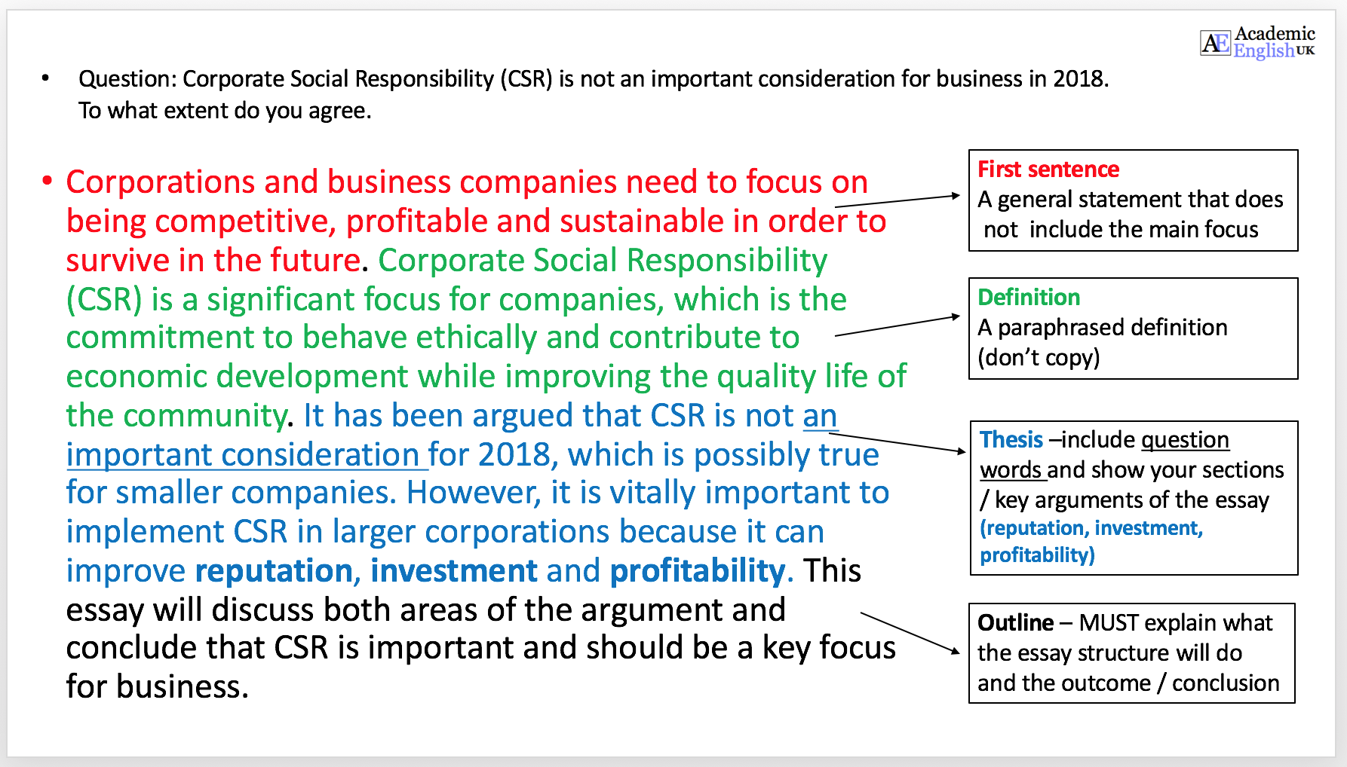
Example
Include your topic
Include argument
Be clear
Be specific
Be debatable
Outline your paper
Uses effective word choices
Notes:
Brianna. https://www.academic-englishuk.com/thesis-statements
https://writingcenter.unc.edu/tips-and-tools/thesis-statements/

Slide 8
Include your topic
Include an opinion
Be clear
Be specific
Be arguable
Outline your paper
Uses effective word choices
Notes:
Brianna

Slide 9
Good or Bad?
Include your topic
Include an opinion
Be clear
Be specific
Be arguable
Outline your paper
Uses effective word choices
Technology has decreased our level of connectedness to others because it allows us to disconnect from the people in our physical environment and it does not foster the social skills needed in order to help us to connect to those around us.
Notes:
Brianna. Poll.

Slide 10
Quick Review
Introductions should include...
Topic
Why is it important?
Go from general to specific
Expose a problem
Take a stand on an issue
Thesis - Roadmap
Notes:
Tammy

Slide 11
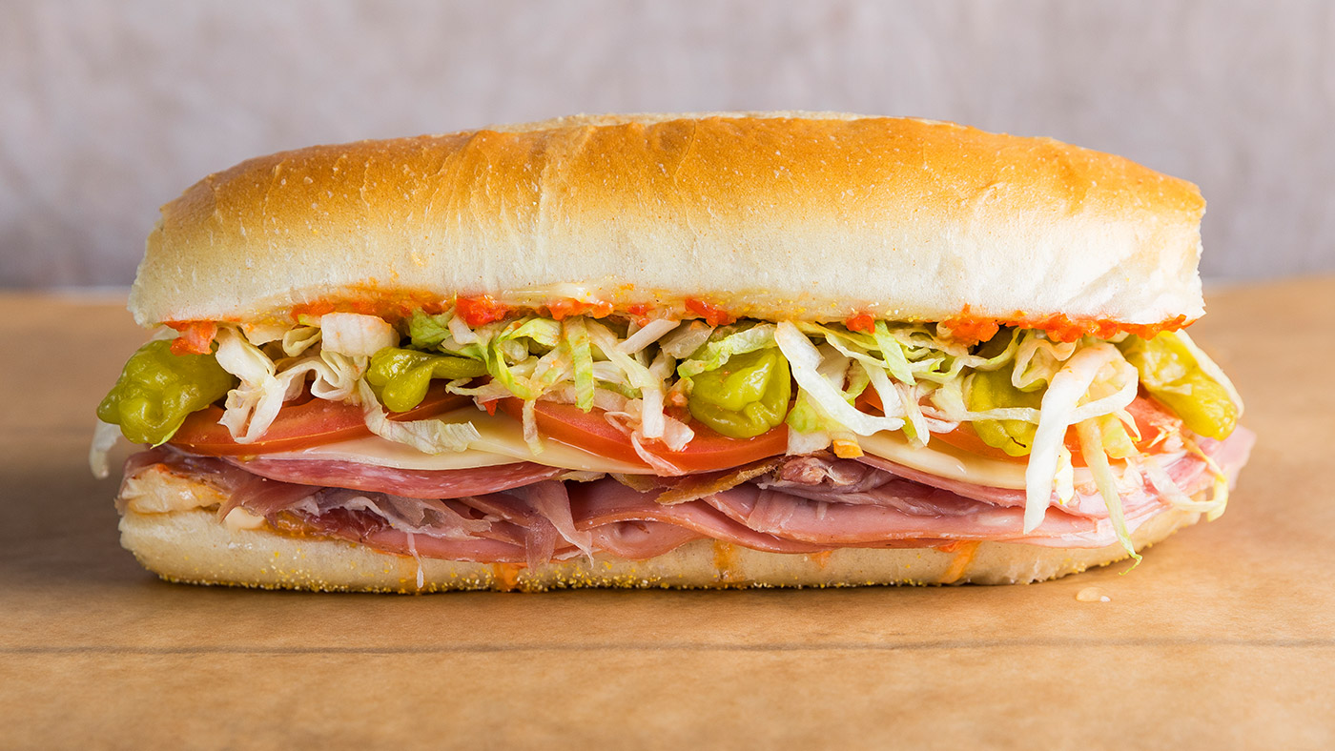
Body Paragraphs
TOPIC SENTENCE
Informs reader the main idea/thesis the paragraph will focus on
Organizes entire paragraph
INTEGRATE SUPPORTING EVIDENCE
Integrate new understandings/learnings into your paper
Proves your idea is based off research
Use proper in-text citations, appropriate signal phrases, and transitions
PROVIDE ANALYSIS OR FURTHER EXPLANATION
Give examples
Explain the examples
Cite facts, statistics, quote authors, paraphrase, summarize
CONCLUDE
Close the paragraph (remind reader of relevant points)
Transition to the next paragraph
Notes:
Olivia. Let’s move further to the main portion of your paper. All body paragraphs need to have structure. “The meat” phrase=the main part. In the middle of this sandwich.

Slide 12
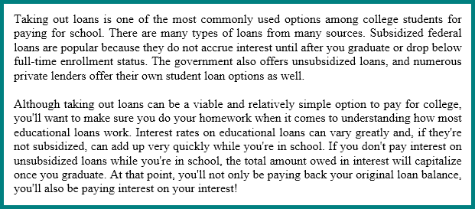
Link Paragraphs
Notes:
Olivia. Focus in on the underlined sentences to demonstrate/show how the first and second paragraphs connect. Draw attention to transition word.

Slide 13
Link Paragraphs
As the global operations of a multinational corporation surge, the need for expatriates grows, too. An expatriate, also referred to as an “expat,” is a person assigned to work in a foreign country for a certain period of time. Hiring people from another country can aid in completing strategically critical tasks as these people provide and transfer knowledge, skills, and expertise. They might also help companies establish operations internationally and succeed in competitive markets. The role of expats makes it vital to study the factors that increase their overall success level.
In addition to a good salary, the expatriation package can include attractive benefits, such as relocation assistance, a housing allowance, and school tuition for their children. Some expats may accept an assignment abroad simply as a chance for career development. A standardized approach to international assignments is not effective (Codings et ah, 2007), but all companies strive for the same result: more employee motivation and retention and less employee dissatisfaction and turnover.
The transfer process can be an emotionally difficult phase for the expat since it involves separation from friends and family and adjusting to an unfamiliar culture and work environment. The focal concerns of expatriates relate to their uncertainties and anxieties (Jassawalla et al., 2004). Employees face many obstacles in the host country such as culture shock, homesickness, and isolation. These challenges can cause them to feel dissatisfied, to underperform, or to quit the assignment all together.
1
2
3
Notes:
Olivia. Focus in on the underlined sentences to demonstrate/show how the first, second, and third paragraphs connect. Draw attention to transition word and discuss how it connects links/connects paragraph together (making for a smooth transition from one paragraph to another).

Slide 14
Transitions
CONNECT IDEAS AND THOUGHTS TOGETHER
From one paragraph to the next paragraph
Within a sentence
Addition | Opposition | Condition | Effect | Conclusion | Time | Sequence | Location
additionally | On the contrary... | For the purpose of... | therefore | In the final analysis... | At the present time... | to begin with, | In the center of...
furthermore | whereas | In the event that... | consequently | As has been noted... | occasionally | during | alongside
In the same way.. | despite | due to | As a result | To sum it up... | henceforth | eventually | between
Notes:
Olivia. Remind students of the words. Choose a few to talk about: due to and eventually meanings. Plug for next week! Presentation all about transitions

Slide 15
Conclusion
Connect new understandings/insights about your topic to end your paper.
Notes:
Olivia. Conclusion is part 3 of the presentation and of your paper. https://writingcenter.fas.harvard.edu/pages/ending-essay-conclusions
https://www.time4writing.com/writing-resources/writing-a-good-conclusion-paragraph/
https://writingcenter.unc.edu/tips-and-tools/conclusions/

Slide 16
Conclusion
Restate thesis or topic in different words
Summarize the main points
Give reader new insights or something to think about
State final words about your topic
Notes:
Olivia https://writingcenter.fas.harvard.edu/pages/ending-essay-conclusions
https://www.time4writing.com/writing-resources/writing-a-good-conclusion-paragraph/
https://writingcenter.unc.edu/tips-and-tools/conclusions/

Slide 17
Conclusion
DO NOT start a new topic or idea
DO NOT use overused phrases: in conclusion, in summary, in closing
DO NOT restate your thesis word for word. Say it in another way.
PLEASE DO NOT…..
Notes:
Olivia https://writingcenter.fas.harvard.edu/pages/ending-essay-conclusions
https://www.time4writing.com/writing-resources/writing-a-good-conclusion-paragraph/
https://writingcenter.unc.edu/tips-and-tools/conclusions/

Slide 18
Basic Essay Structure
INTRODUCTION
BODY PARAGRAPHS
CONCLUSION
Notes:
Olivia. Remind about the 3 parts. This applies to the essay and to each paragraph.

Slide 19
Take a closer look
Sample Essays
Notes:
At this time pass out sample essays for students to glance over.
Have students notice/read introduction, 2-3 body paragraphs, and conclusion paragraphs.
Discuss what they notice about the essay based off previous slides.

Slide 20
Activity
Mixed-up version (students)
https://docs.google.com/document/d/11w1_Dv1zmEpPfV8-Q75FJ4v7FoLaejhNeuGxK4tjTlc/edit
Correct Version
https://docs.google.com/document/d/1647wi_C4gzIzsi_8k9gdFV9EvcZv_mw8obgWjKyV3xc/edit
Notes:
Tammy. Send this prior to the workshop. Breakout rooms. Write in the chat boxes what order the colors should go in

Slide 21
Make an appointment today.
ONLINE
The Writing Center!
https://www.callutheran.edu/students/writing-center/
805-493-3257
Notes:
Thank you! Tammy jumps in for questions/all 3 chime in for answers

Slide 22
References
American Academic English (2018). Thesis statements. https://www.academic-englishuk.com/thesis-statements
Hacker, D., & Sommers, N. (2019). Instructor’s edition rules for writers (9th ed.). Boston, MA: Bedford/St. Martin’s.
Harvard University Writing Center (2020). Ending the essay: Conclusions. Harvard University. https://writingcenter.fas.harvard.edu/pages/ending-essay-conclusions
Kassar, A. N., Rouhana, A., & Lythreatis, S. (2015). Cross-cultural Training: Its Effects on the Satisfaction and Turnover of Expatriate Employees. SAM Advanced Management Journal (07497075). 80(4), 4-18.
Silverman, J., Hughes, E., & Wienbroer, D. R. (2005). Shortcuts for the student writer. New York, NY: The McGraw-Hill Companies.
The Writing Center University of North Carolina at Chapel Hill (2020). Thesis statements. University of North Carolina at Chapel Hill. https://writingcenter.unc.edu/tips-and-tools/thesis-statements/
Notes:
References are in APA

