Slide 1
Presentation by Tammy L. Whitlow, TESOL Specialist

Slide 2
Paraphrasing vs. Plagiarism
Demonstrating understanding through writing

Slide 3
GOAL
Distinguish the difference between
paraphrasing and plagiarizing

Slide 4
Plagiarism
Notes:
Using sticky notes or dry erase table (Interactive classroom) have students brainstorm about what they already know.
https://writingcenter.unc.edu/tips-and-tools/plagiarism/

Slide 5
Notes:
Did you learn anything new? Discuss share with your group.
https://www.youtube.com/watch?v=-SoAISJrULw

Slide 6
Paraphrasing
What is it?
Notes:
Using sticky notes or dry erase table (Interactive classroom) have students brainstorm about what they already know.
https://writingcenter.unc.edu/tips-and-tools/plagiarism/

Slide 7
Books, book chapters, scholarly journals, newspapers,
magazine and websites, and more...
Ideas, theories, phrases, sentences…
Notes:
https://lumenscholar.instructure.com/courses/43/assignments/331?module_item_id=14007

Slide 8
Paraphrasing in other words….
restating
rewording
rewriting
Put in your own words, a thought or idea that is not your own. Be sure to cite!
Notes:
Shouldn’t have to spend much time on this slide, especially if students have already brainstormed these synonyms. However, for international students you might want to talk about the prefix ‘re’, and how these are synonyms (words with same meaning, but different spelling).

Slide 9
And the winner is…..
Paraphrasing!
Plagiarizing

Slide 10
Importance of Paraphrasing
Helps control use of too many direct quotes
Shows you fully understand the text
Notes:
Retrieved from:https://owl.purdue.edu/owl/research_and_citation/using_research/quoting_paraphrasing_and_summarizing/paraphrasing.html
https://www.mckendree.edu/offices/writing-center/resources/paraphrase.php

Slide 11
How to paraphrase
Read text until understood.
Stop and explain (say aloud) text in your own words
Discuss with peer, writing consultant, professor
Record yourself
Cover or turn away from text
Write text in your own words and write do forget to make note of source
Be sure to cite!

Slide 12
Quick Review
Paraphrasing is….
Borrowing another person/scholars ideas, words, thoughts, etc..
Putting them in your own words, using main points, and sentence structure.
BE SURE TO CITE!
We must write with integrity!
Notes:
Have attendees finish the sentence stems.

Slide 13
What do you mean?
Be sure to cite!
Borrow an idea...give credit!
Borrow the words...give credit!

Slide 14
APA In-text Citations
Author type | Parenthetical citation | Narrative citation
One Author | (Luna, 2020). | Luna (2020) According to Luna (2020), For example, Luna (2020) argued...
Two Authors | (Salas & D’Agostino, 2020). | Salas and d’Agostino (2020)
Three or more authors | (Martin et al., 2020). **et al - represents all other authors | Martin et al. (2020)
Group author with abbreviation (1st citation*) Subsequent citations | (National Institute of Mental Health [NIMH], 2020). (NIMH, 2020). | National Institute of Mental Health (NIMH, 2020) NIMH (2020)
Group author without abbreviation | (Stanford University, 2020). | Stanford University (2020)
Notes:
Pass out in-text citation page. Inform students to always keep it handy. While there might be online citation generation machines (Academic Writer, EasyBib), we’ve found them to not always be accurate. If all else fails, go straight to the source apa.org, apa style blog, apa student handbook, or our handy resource page. :)

Slide 15
Example...
Original Source
Homeless individuals commonly come from families who are riddled with problems, marital disharmony, and are alienated from their parents. They have often been physically and even sexually abused, have relocated frequently, and many of them may be asked to leave home or are actually thrown out, or alternatively placed in group homes and even foster care. They often have no one to care for them and no one knows them intimately.
Source from:
Rokach, A. (2005). The causes of loneliness in homeless youth. The Journal of Psychology, 139, 469-480. Retrieved from Academic Search Premier database.
Notes:
Have students follow step one of “How to paraphrase.” Read the text as many time you need to for understanding.
Independently
Turn and talk to partner.
Move to next slide (time to check).
https://columbiacollege-ca.libguides.com/apa/paraphrase

Slide 16
Example:
Original Source and Incorrect Paraphrasing
Homeless individuals commonly come from families who are riddled with problems, marital disharmony, and are alienated from their parents. They have often been physically and even sexually abused, have relocated frequently, and many of them may be asked to leave home or are actually thrown out, or alternatively placed in group homes and even foster care. They often have no one to care for them and no one knows them intimately.
The homeless come from families with problems. Frequently, they have been physically or sexually abused, or have lived in group homes. Usually no one cares for them or knows them intimately (Rokach, 2005).
Notes:
Note: In this incorrect example the writing is too similar to the original source. The student only changed or removed a few words and has not phrased the ideas in a new way.
https://columbiacollege-ca.libguides.com/apa/paraphrase

Slide 17
Example:
Correct Paraphrasing
Homeless individuals commonly come from families who are riddled with problems, marital disharmony, and are alienated from their parents. They have often been physically and even sexually abused, have relocated frequently, and many of them may be asked to leave home or are actually thrown out, or alternatively placed in group homes and even foster care. They often have no one to care for them and no one knows them intimately.
According to Roback (2005) those without permanent homes grew up with dysfunctional families that exposed them to not only physical and sexual violation, but constant instability which resulted in the lack of care.
Notes:
Note: In this incorrect example the writing is too similar to the original source. The student only changed or removed a few words and has not phrased the ideas in a new way.
https://columbiacollege-ca.libguides.com/apa/paraphrase

Slide 18
Example...
Federal and state governments should step up to help streamline and shore up the nation’s disjointed recycling system. This could be done, for example, by standardizing what can be recycled and putting limits on additives such as coloring, which is expensive to remove and can make plastic less valuable to a recycler.
What to Do about Plastic Pollution. (2019). Scientific American, 320(6), 8. Retrieved from https://search-ebscohost-com.ezproxy.callutheran.edu/login.aspx?direct=true&db=buh&AN=136360406&site=ehost-live&scope=site
Notes:
See article “What to Do about Plastic Pollution?”

Slide 19
Example:
Original Source and Incorrect Paraphrasing
Federal and state governments should step up to help streamline and shore up the nation’s disjointed recycling system. This could be done, for example, by standardizing what can be recycled and putting limits on additives such as coloring, which is expensive to remove and can make plastic less valuable to a recycler.
Federal and state governments should step up and take the leadership regarding decluttering the nation’s recycling system. For example, there could be a plan explaining what could be recycled, as well as placing limits on the amount of food coloring that can be added to recycled items. Doing this would make plastic less valuable.
Notes:
Note: In this incorrect example the writing is too similar to the original source. The student only changed or removed a few words and has not phrased the ideas in a new way.
https://columbiacollege-ca.libguides.com/apa/paraphrase

Slide 20
Example:
Correct Paraphrasing
Federal and state governments should step up to help streamline and shore up the nation’s disjointed recycling system. This could be done, for example, by standardizing what can be recycled and putting limits on additives such as coloring, which is expensive to remove and can make plastic less valuable to a recycler.
Measures to correct the American system of recycling forces the the governmental involvement of to ensure uniform guidelines throughout the nation (What to Do about Plastic Pollution, 2019).
Notes:
Note: In this incorrect example the writing is too similar to the original source. The student only changed or removed a few words and has not phrased the ideas in a new way.
https://columbiacollege-ca.libguides.com/apa/paraphrase

Slide 21
Notes:
Only use if necessary! Send all students this link on paraphrasing.

Slide 22
Let’s practice!
Read text independently.
Take notes (annotate).
Highlight key words, phrases (5 min)
Partner and discuss what text saying (3 min)
Paraphrase in writing (5 min)
Notes:
Pass out the article.
Attendees should number paragraphs.
Assign paragraphs attendees to read.
Time for 8-10 min

Slide 23
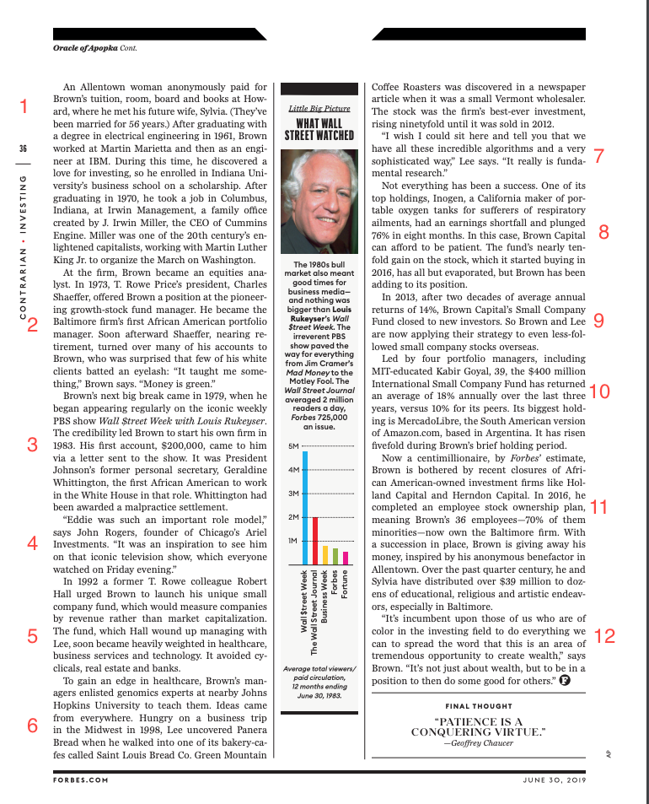
Online Magazine/Periodical
Gara, A. (2019). Oracle of Apopka. Forbes, 202(5), 32–36.
Retrieved from
https://search-ebscohost-com.ezproxy.callutheran.edu/logi
n.aspx?direct=true&db=bft&AN=136632050&site=ehost-liv
e&scope=site
Notes:
International MBA student activity only (feel free to copy and revise this presentation or add new article): Pass out this portion of an article. Have them number the paragraphs as demonstrated on screen. Draw their attention to the citation beside the article. Ask them what the in-text citation might look like. Write it on the board. Remind students that when paraphrasing, they should use this in-text citation.
Now, choose paragraphs # ???? to paraphrase.

Slide 24
Practice Independently
Read paragraph 12.
Practice your paraphrasing skills with in-text citations.
Notes:
Float around assisting and students while collaborating with one another in order to negotiate paraphrased statement.

Slide 26
Notes:
Thank attendees for coming and show this video in review of paraphrasing.

Slide 27
References
deLaplante, K. (2013, January). Plagiarism: Paraphrasing Without Attribution.
YouTube. Retrieved from www.youtube.com/watch?v=OPcqt_1Gpjk
May, I. (2017, August). The Art of Paraphrasing: Avoiding Plagiarism. Youtube.
Retrieved from https://www.youtube.com/watch?v=H1qo10dG5Gw&t=8s
Paraphrasing. (n.d.). Retrieved from
https://owl.purdue.edu/owl/research_and_citation/using_research/paraphrase_exercis
es/index.html

Slide 28
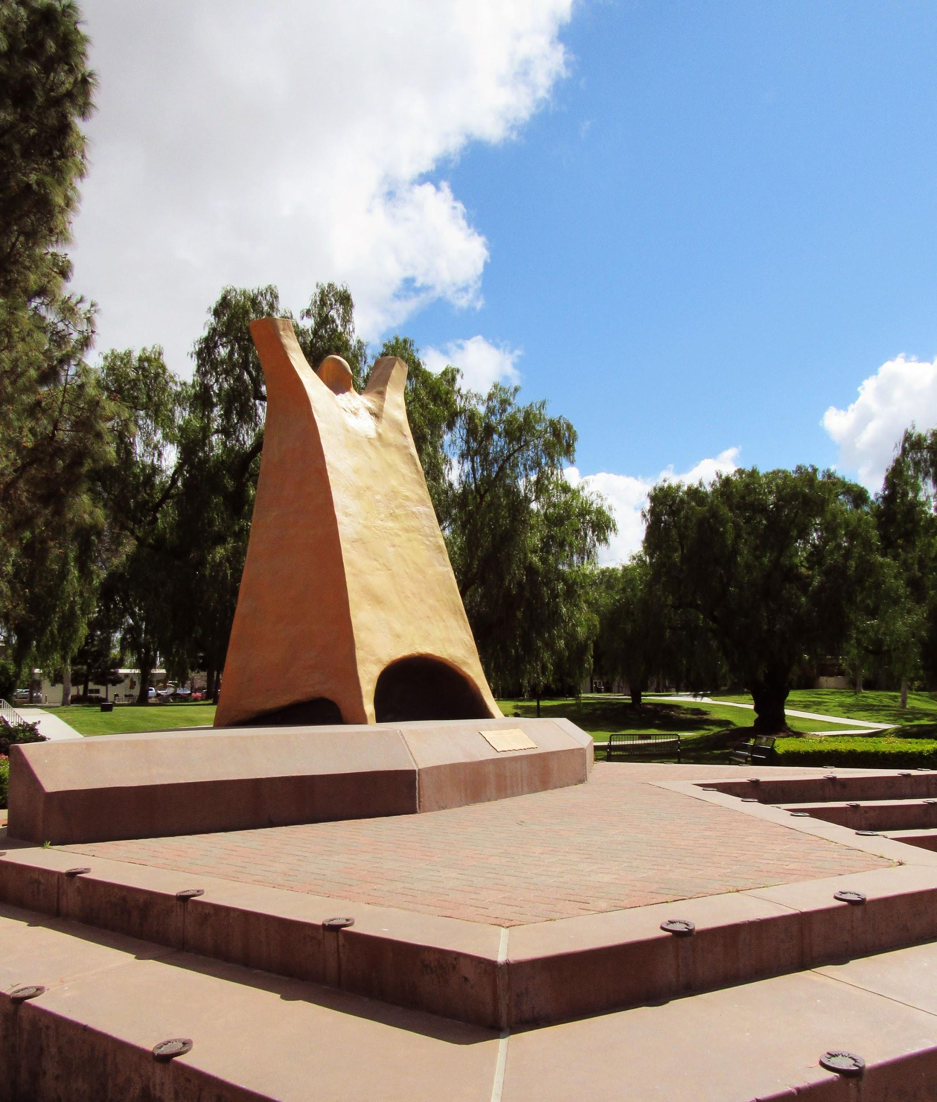
Questions? Contact Us!
Email:
writingcenter@callutheran.edu
Phone:
(805) 493-3257

