Slide 1
Presented by Tammy L. Whitlow - TESOL Specialist

Slide 2
The
Cover Letter

Slide 3
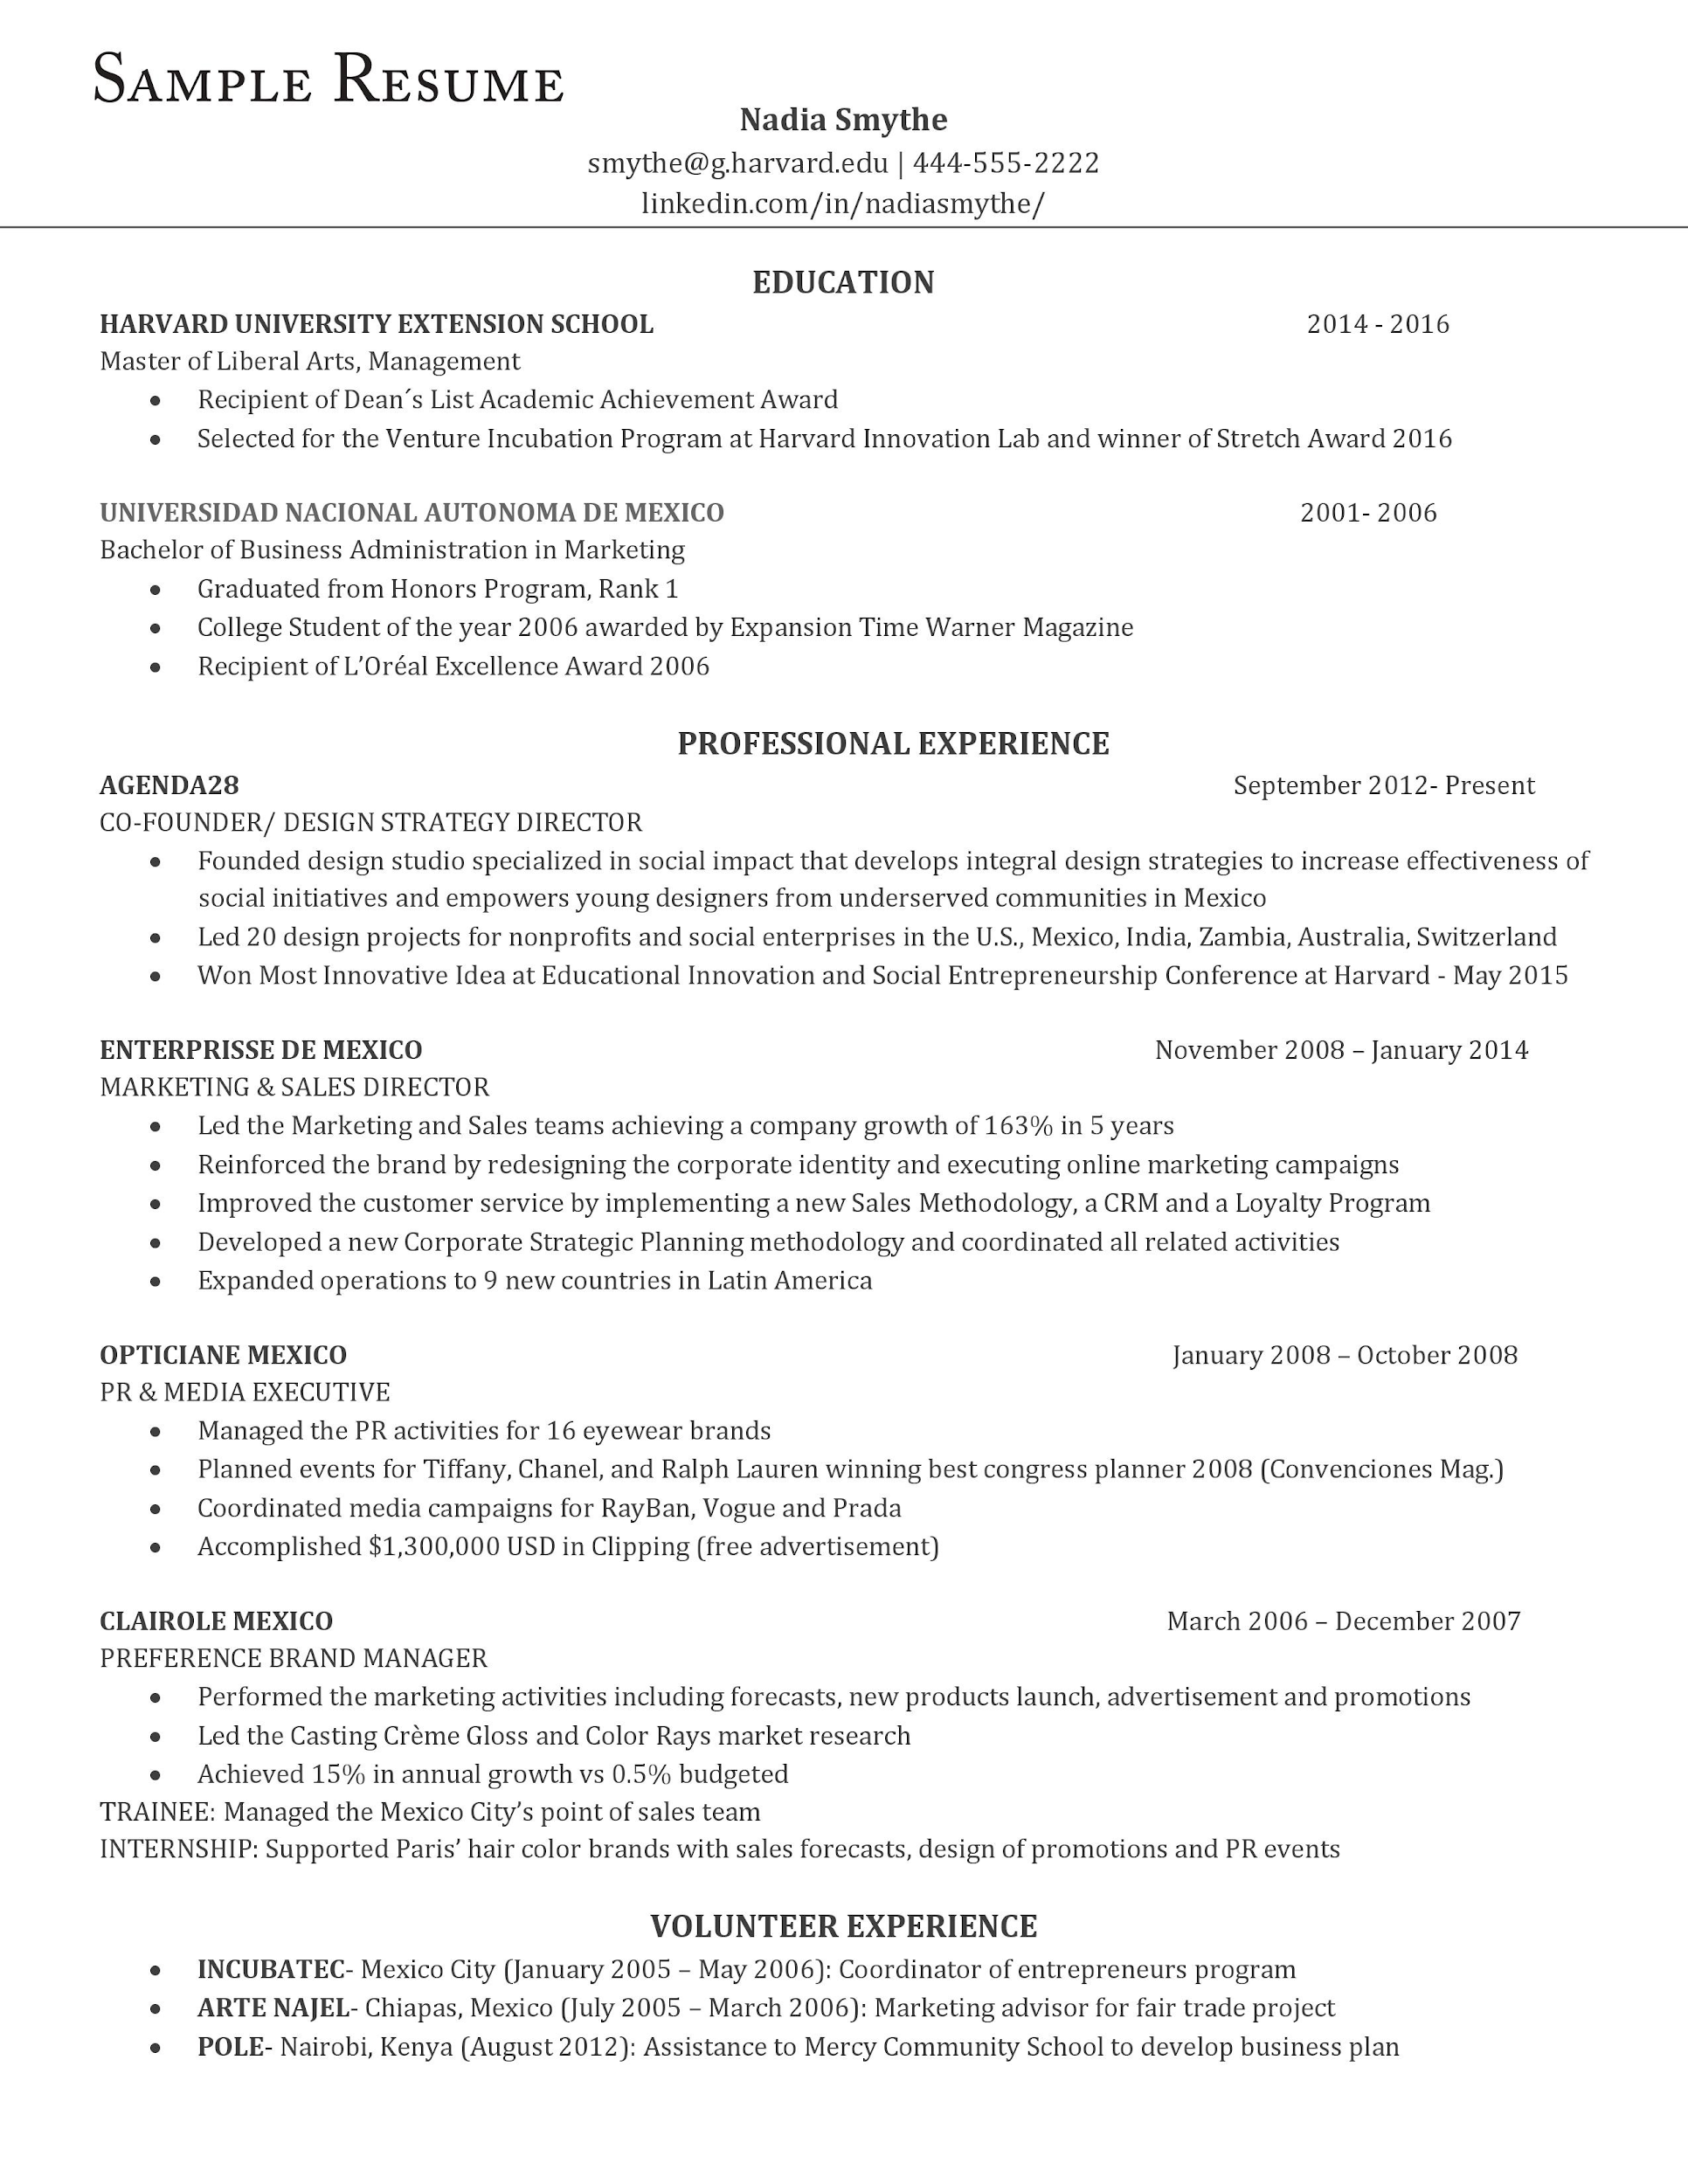
Your resume is...
Clear and concise
Organized
Appealing
Informative
Visited The WC and Career Center for help...

Slide 4
Next step...
Writing a cover letter!

Slide 5
What is it and why do I need one?
Part of your professional package. (resume + cover letter)
Introduces you and allows you to sell your interest to a hiring manager.
Summarizes your qualifications, training, experiences, and accomplishments
Why would you be a good fit for the job?
Why should they hire you?
Notes:
Indeed Q & A : Should You Include a Cover Letter?

Slide 6
A Cover Letter
Tell the story of your career in your own voice and capture the attention of the hiring manager (Indeed, 2019).

Slide 7
Yes?
No?
Maybe?
Do I even need a cover letter?
May be optional when applying
Often required
You want to “stand out from the pack.”
Notes:
Language Learning. Explain this idiom to International Students.

Slide 8
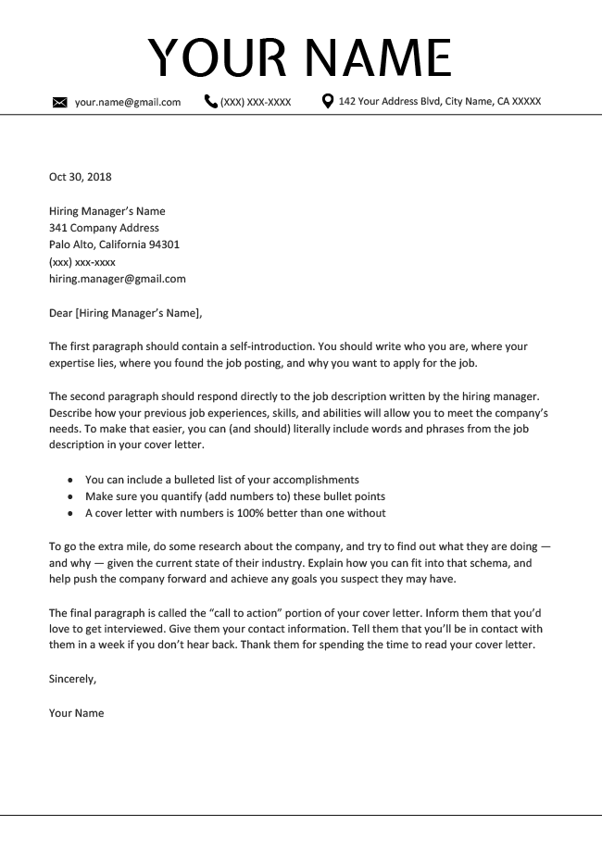
A cover letter template

Slide 9
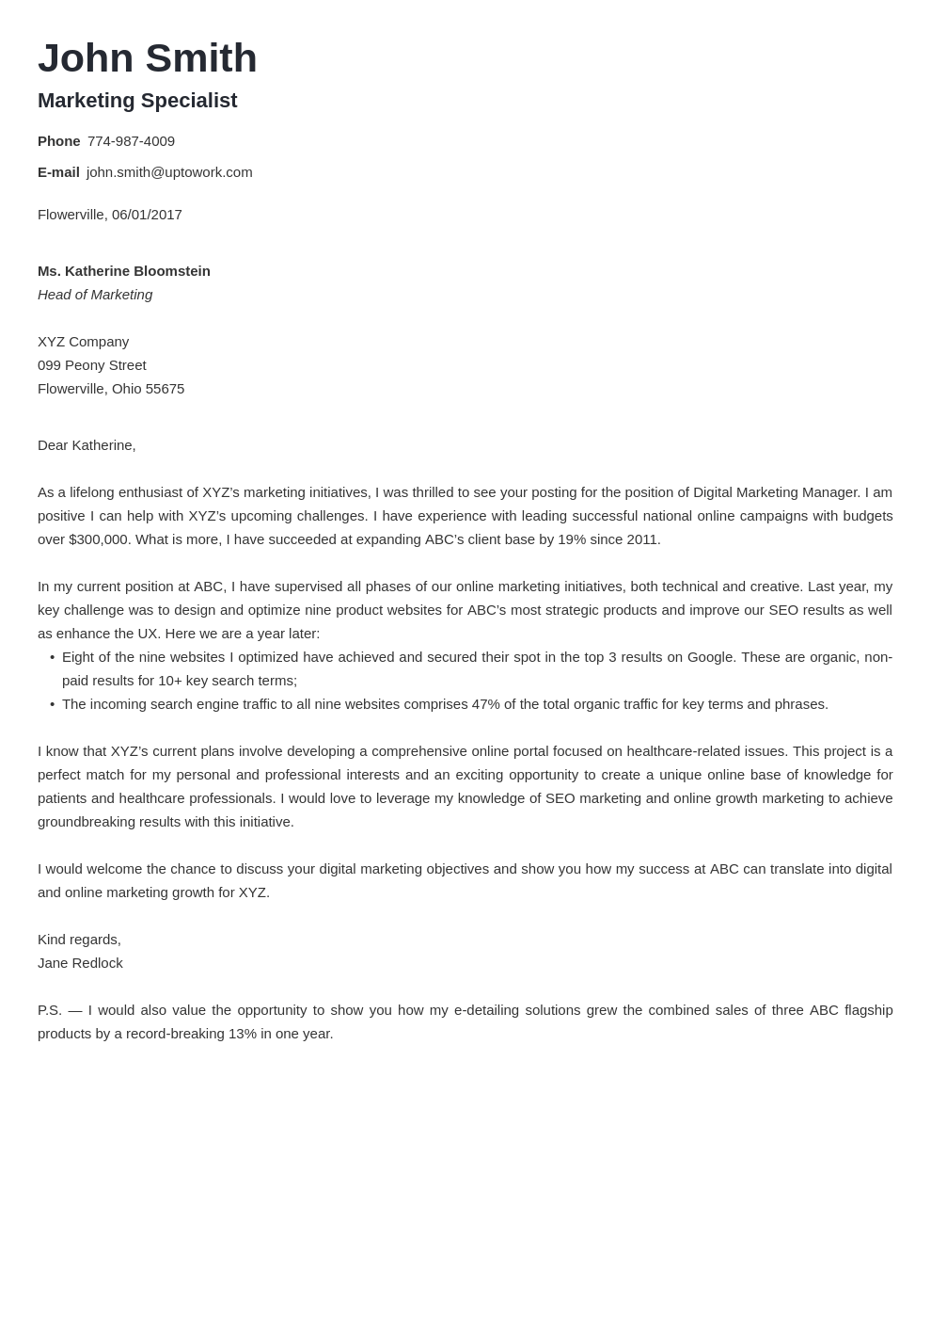
An example...
Did this person introduce themselves?
Is this person selling themselves?
Did they research the company?
Are they asking for an interview?

Slide 10
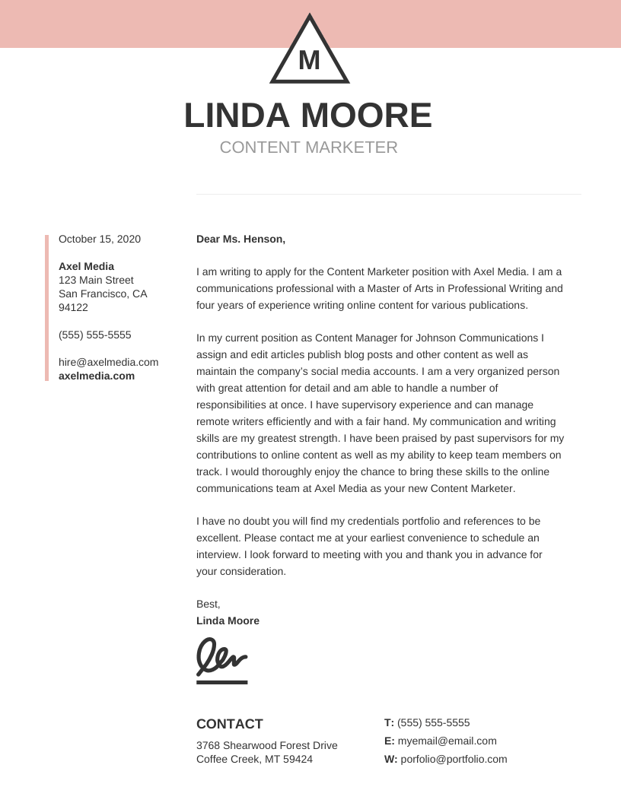
An example...
Did this person introduce themselves?
Is this person selling themselves?
Did they research the company?
Are they asking for an interview?
Notes:
https://venngage.com/templates/resumes/modern-symbol-cover-letter-d069a81e-a900-4031-a7ac-04763e41582d
Modern cover letter

Slide 11
How?
Notes:
Let’s craft your cover letter.

Slide 12
Cover letter writing tips...
Tailor your cover letter to hiring manager and position
Incorporate specific keywords aligned with job posting (target, match, or tailor)
Research company’s mission and connect it with your personal/career goals, passions, vision
No spelling or grammar mistakes.
Notes:
Hmmmm….should I take out the last one?

Slide 13
ACTIVITY 1 - Practice
Choose one of the jobs you think you’re most qualified for.
Follow the template.
Practice writing a cover letter.
Notes:
ZOOM - SKIP 4/22/2020

Slide 14
Activity 2 - Share
Notes:
ZOOM - Skip 4/20/2020

Slide 15
REVISE OR GET STARTED ON YOUR COVER LETTER TODAY!
Online appointment at The Writing Center
Email me, twhitlow@callutheran.edu
Career Services (appointments and workshops)
Notes:
ZOOM - Share screen. Show students how to locate Career Services on MyCLU.

Slide 16
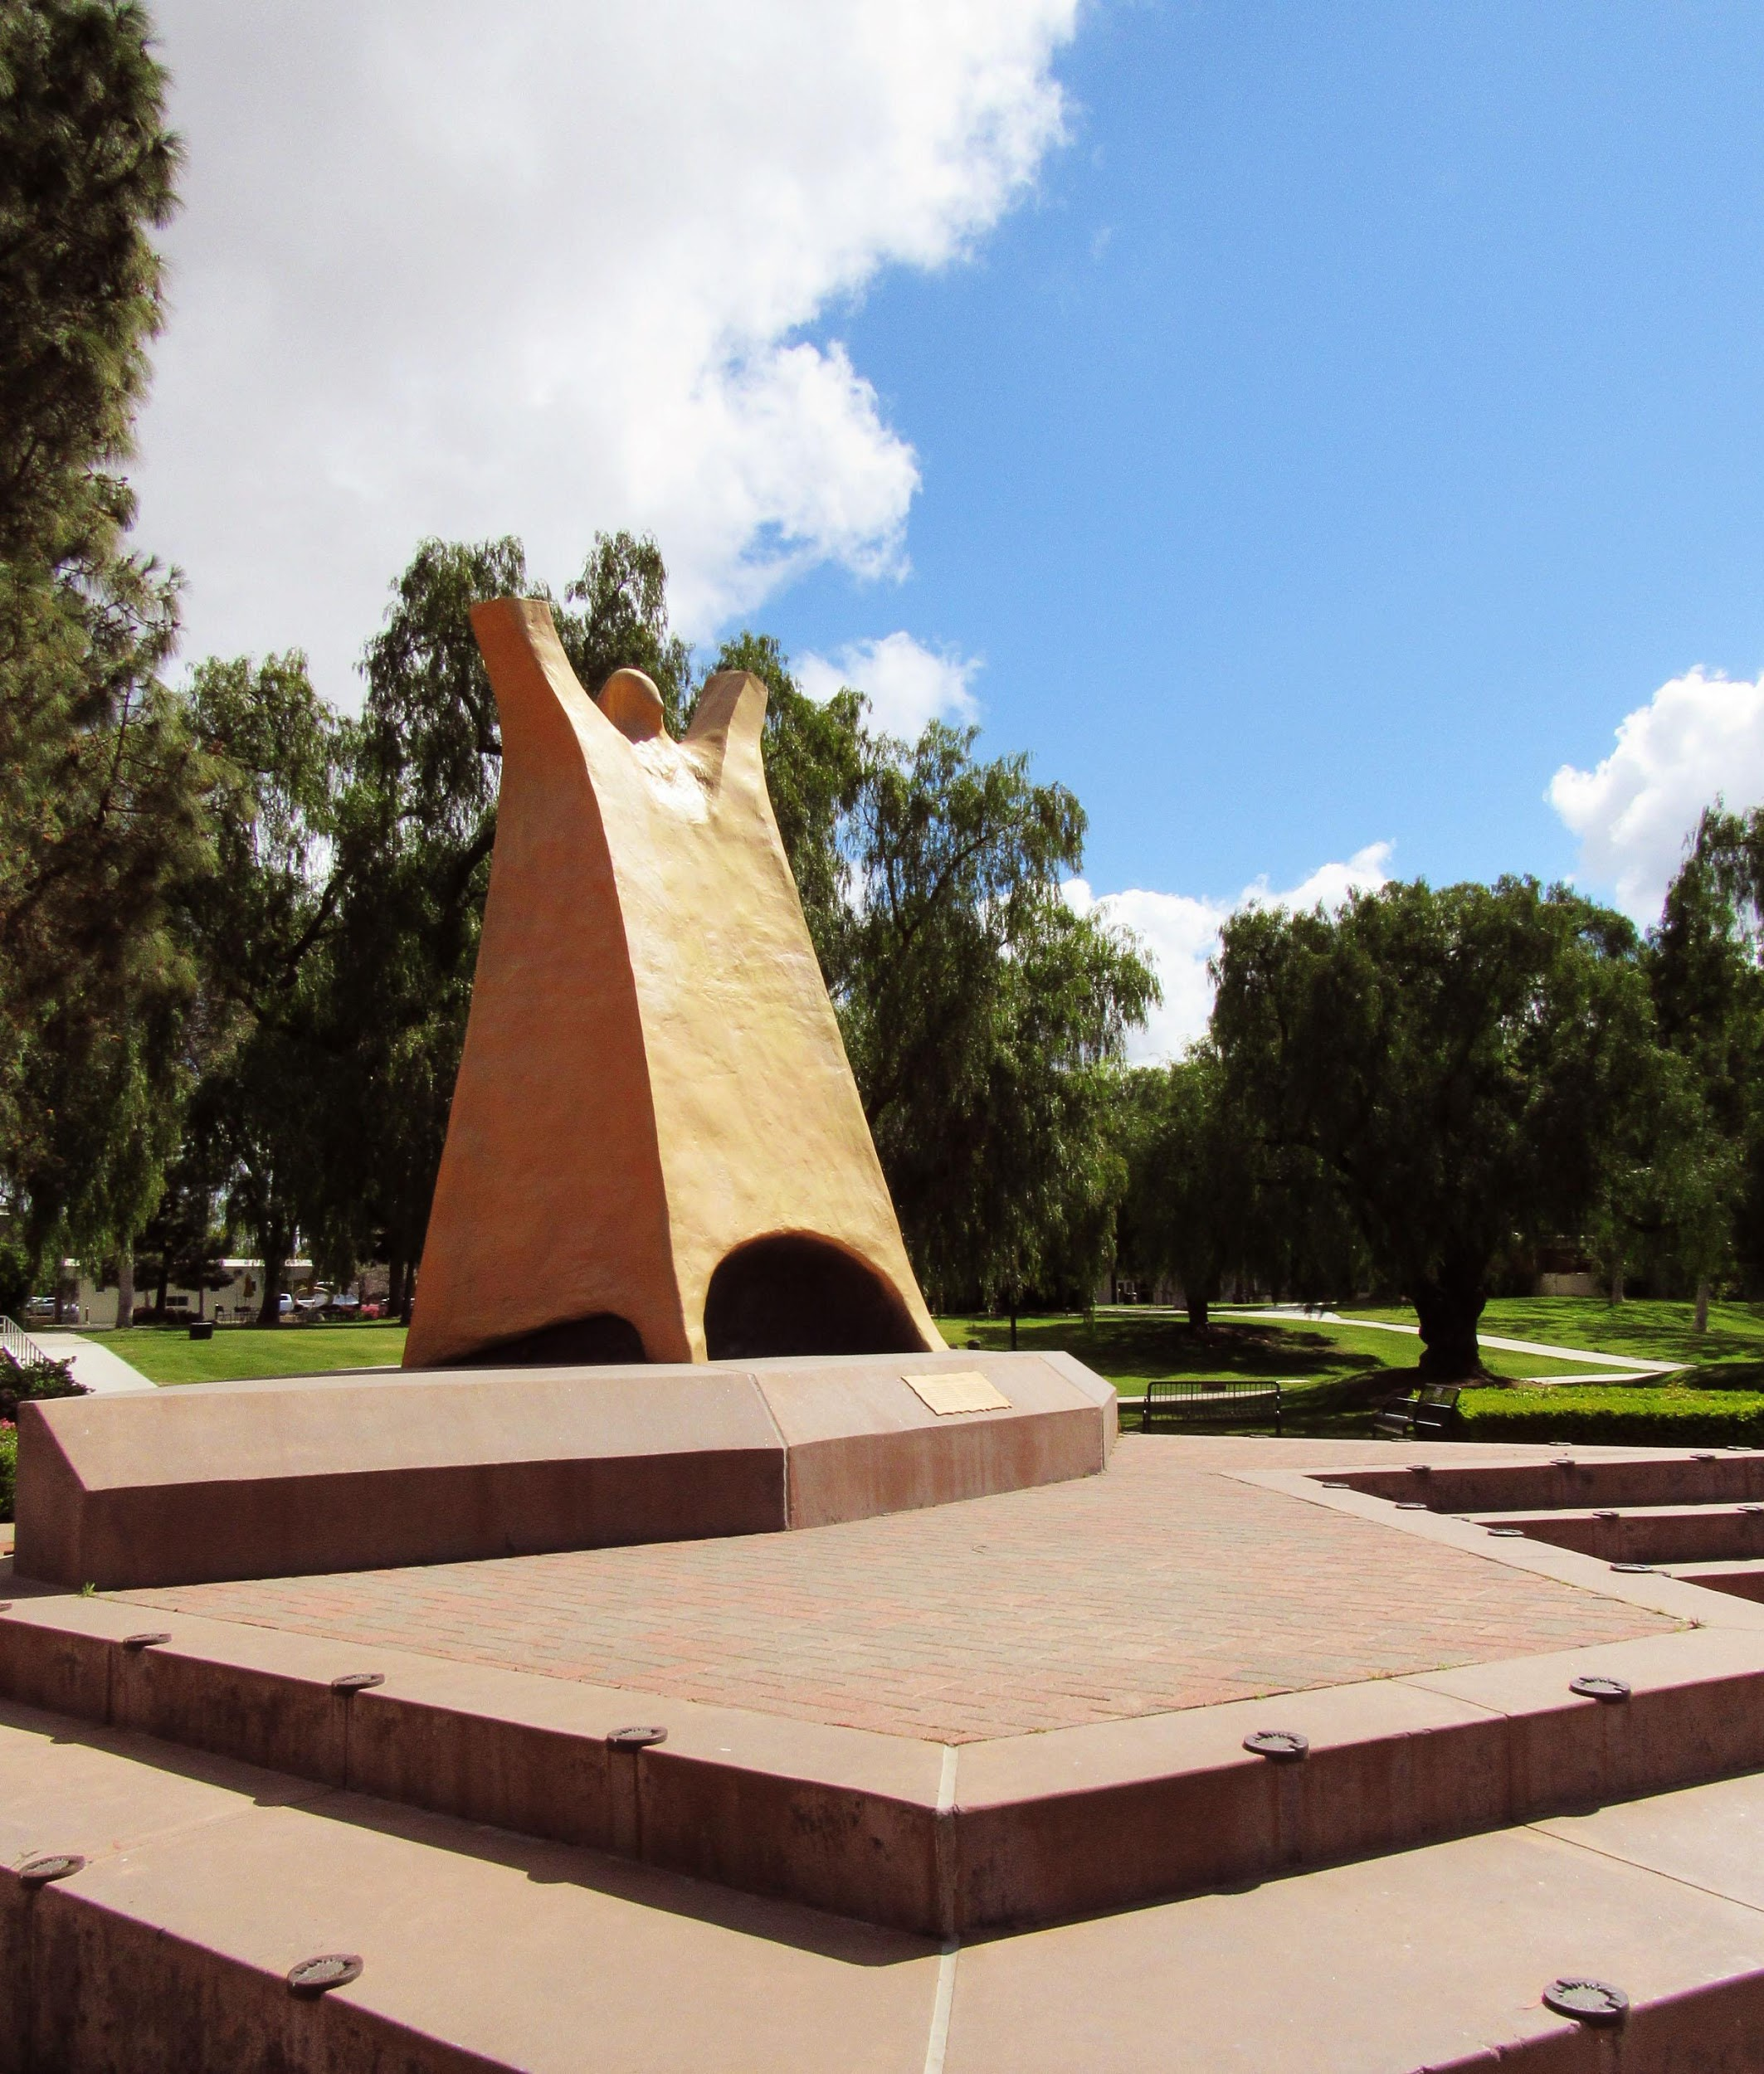
Thanks for participating!
WRITINGCENTER@CALLUTHERAN.EDU

