Slide 1
Presentation by Tammy L. Whitlow, TESOL Specialist

Slide 2
Introduction
to
Resume and Cover Letter Writing

Slide 3
RESUMES:
You’re Hired!

Slide 4
What does a resume look like in your country?
What are the details required ?
Must you write a cover letter?
Discussion #1
Notes:
Zoom - Place in break rooms. Presenter and Co-presenter will facilitate discussion to the questions. Rejoin. Presenter will share out.

Slide 5
Discussion #2
Scenario
I work in Human Resources and I was given 100 resumes for potential summer internships or full time positions. My job is to identify 10 candidates to invite to an interview. This means I’d have to eliminate (say no) 90 candidates based on their resumes.

Slide 6
Think and Generate a List
List qualities you would look for in the 10 resumes.
List qualities that would automatically disqualify applicants from this competitive position.
Create a t-chart like this one to make your list.
Notes:
Take small sticky notes. Have students to write down good and bad qualities under designated columns. Discuss a whole group.
ZOOM INSTRUCTIONS - use white board or chat box to gather responses

Slide 7
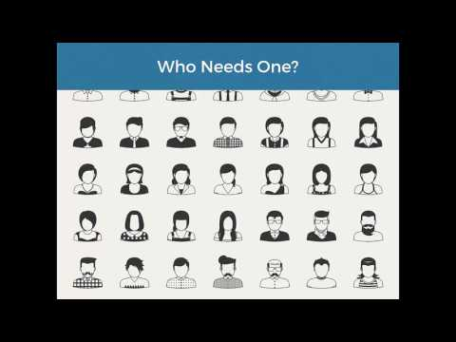
What is a resume?

Slide 8
A resume is a compilation...
relevant work experience
education
accomplishments
Notes:
Int’l participant - discuss the meaning of compilation if needed; break the word down ( base word: compile…)

Slide 9
A resume should be...
Clear and concise
Organized
Appealing
Informative
Notes:
Clear and concise - not wordy and easy to read; These are key terms which will be reiterated throughout the presentation. Feel free to expound as necessary.
Appealing - looks good, attractive, yet seen as interesting (peaking interest of employer)

Slide 10
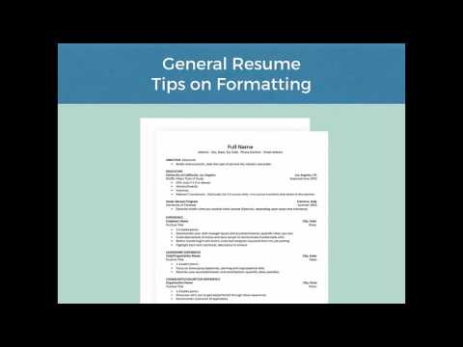
FORMATTING
There are different kinds of resumes.
Resumes have a specific structure.
Notes:
Formatting is key! It provides structure, organization, and if done properly, will be appealing to your future employer. Play short video. Click the link on the slide.

Slide 11
How do I format?
Templates (?)
Format yourself
Limiting to one page
Notes:
Show students. Go to Microsoft Word. Click new. Once on template page, type resume in the search box and all templates will come up. The best templates are basic/modern. Model how to begin making the template your own.
Remind students to be consistent with capitalization and spacing. Show a sample resume.

Slide 12
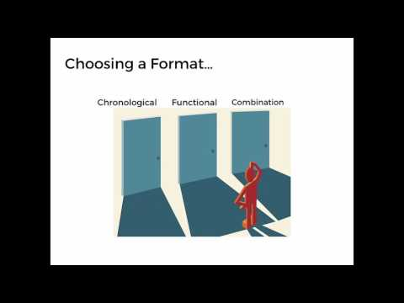
What determines the format?
Resume types:
Chronological
Functional
Combination
Notes:
What determines your format is the kind of resume you compose?

Slide 13
Tailor your resume
Your past and present experiences also determine resume format.
Ask yourself: What is the employer looking for?
https://www.youtube.com/playlist?list=PLQ_j79Pu_egv6TeYu8sXrPmzmVu4IyrAR
https://www.youtube.com/playlist?list=PLQ_j79Pu_egv6TeYu8sXrPmzmVu4IyrAR
Notes:
Zoom - Applicant Tracking System; Olivia leads this quick discussion. Share pdf with students while discussion is going forth.

Slide 14
Is there a match?
Match the language in your resume to what the employer is seeking.
Carefully read the job description.
Do your skills match the language of what employer is seeking?
Change the language in your resume to match language of job description.

Slide 15
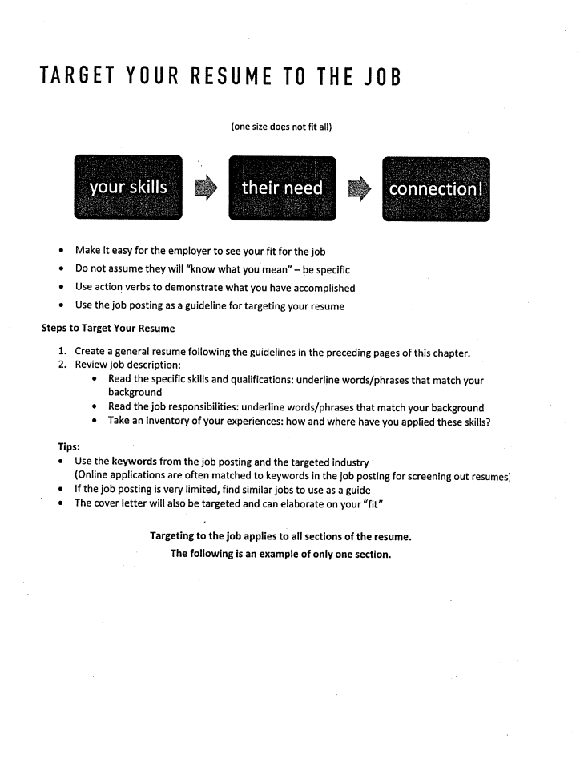
Target,
Match,
or Tailor
your resume!
Notes:
Pass this resource sheet out to participants and review.

Slide 16
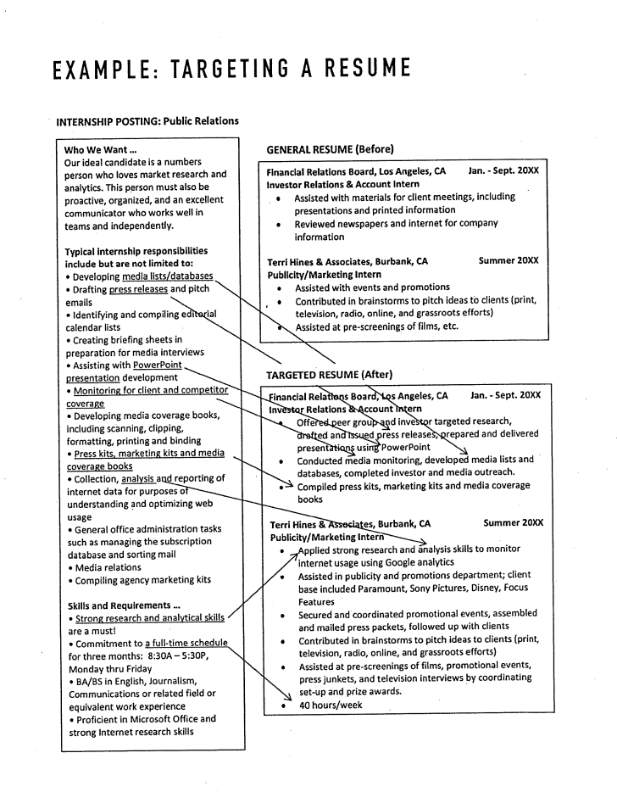
Targeting your resume cont...

Slide 17
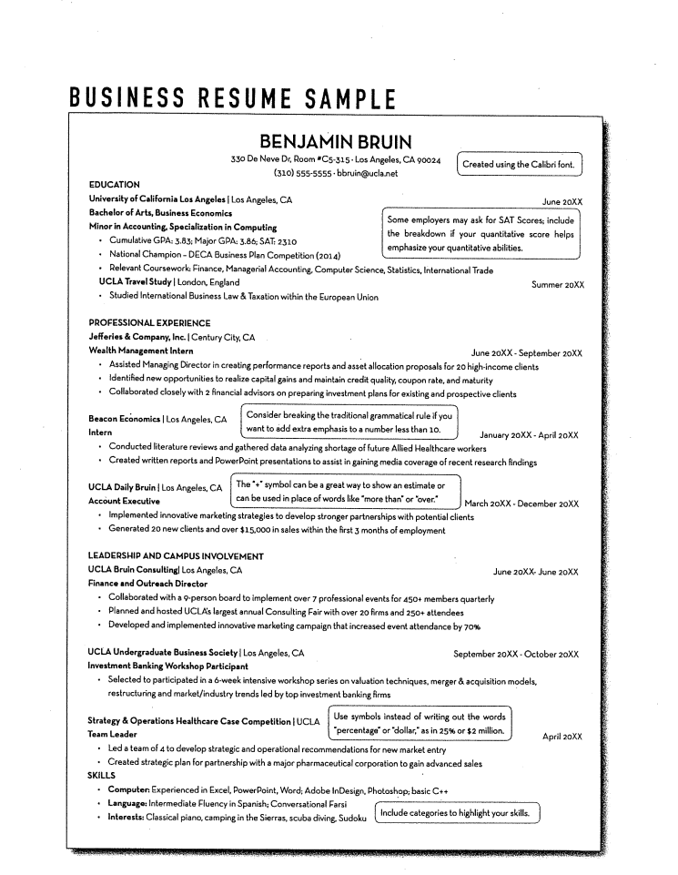
Building your bullets!
VERBS - SHOW THE ACTION YOU DID WHILE ON THE JOB
PAST OR PRESENT
Helps make your resume clear, concise, and organized.
Notes:
Reiterate…..Draw participants attention to the verbs used to describe their responsibilities and accomplishments. This is what makes helps to make your resume clear, concise, and organized. This is part of the formatting you should use consistently throughout your resume. Using a format such as this allows future employers to quickly glance over your resume. If it’s too wordy, employers might lose interest, getting lost in the wordiness.

Slide 18
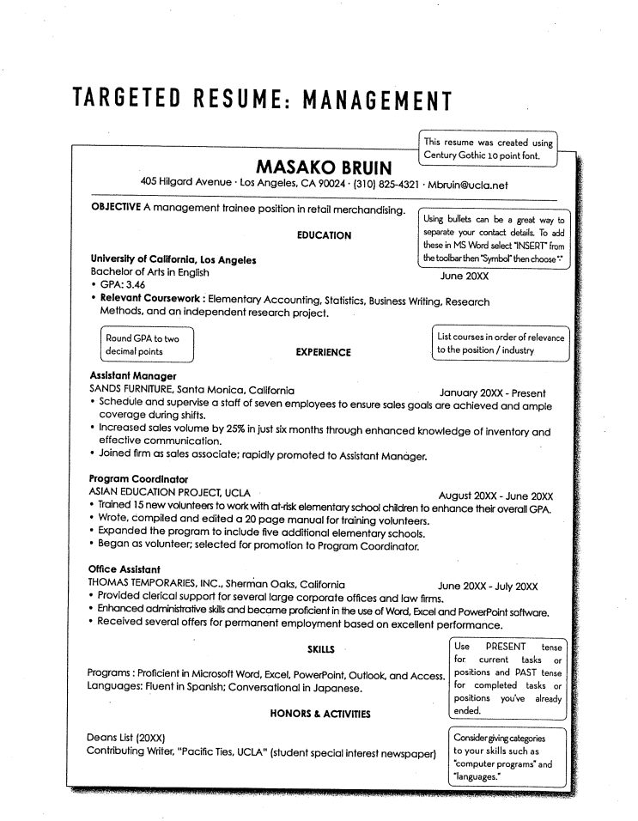
Notes:
Draw participants attention to the verbs used to describe their responsibilities and accomplishments. This is what makes helps to make your resume clear, concise, and organized. This is part of the formatting you should use consistently throughout your resume. Using a format such as this allows future employers to quickly glance over your resume. If it’s too wordy, employers might lose interest, getting lost in the wordiness.

Slide 19
Make an appointment to build your bullets!
Bullets should showcase...
Actions exhibiting contribution and results
Strengths
Accomplishments
Experiences
Honors
Will you bring value?
Notes:
A question to keep in mind…. Will you bring value? Your bullets should show this.

Slide 20
Let’s Practice!
Look at your resume or sample.
Notice the first word in front of bullets.
Is there a verb?
Verbs show what you’re doing or have done.
Helps employers glance quickly.
WORDY RESUMES WASTE THEIR TIME.
Notes:
ZOOM - SKIP 4/22/2020
Options:
Students that bring resumes. Look at employment experiences past/present. Revise to create clear, concise statements without wordiness.
Students who don’t have a resume - Direct them to the Microsoft Word template. Students will revise template to make it their own. Have them skip to employment section to practice creating a clear, concise statements just to be sure they understand.
Provide paper/index cards for students or have them use their computers. Have them choose one job to begin describing their skills, responsibilities, and accomplishments.

Slide 21
Verbs make it happen!
Notes:
ZOOM - SKIP 4/22/2020
Play video

Slide 22
REVIEW
What are the key components of an effective resume?
Organized
Consistent Formatting
Clear and concise
Strong Bullets
Appealing
Conveys you’re qualified!

Slide 23
Remember...
Your resume gets you the interview!

Slide 24
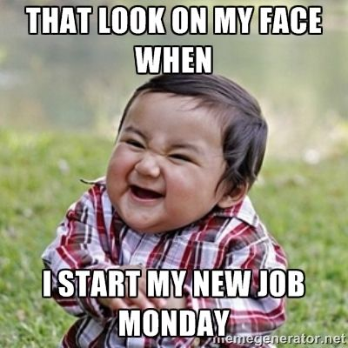
Hopefully...
Any questions??

Slide 25
Thanks for coming!
Email me twhitlow@callutheran.edu
Make appt. with any consultant today
Finish polishing your resume

Slide 26
Thank you !

